Slide 1
Biology
Chapter 1 Section 1

Slide 2
Definition
Biology is the scientific study of life
Biologists ask questions such as:
How does a single cell develop into an organism?
How does the human heart work?
How do living things interact in communities?
Life is recognized by what living things do
Seven general characteristics of life
Notes:
Click to add notes

Slide 3
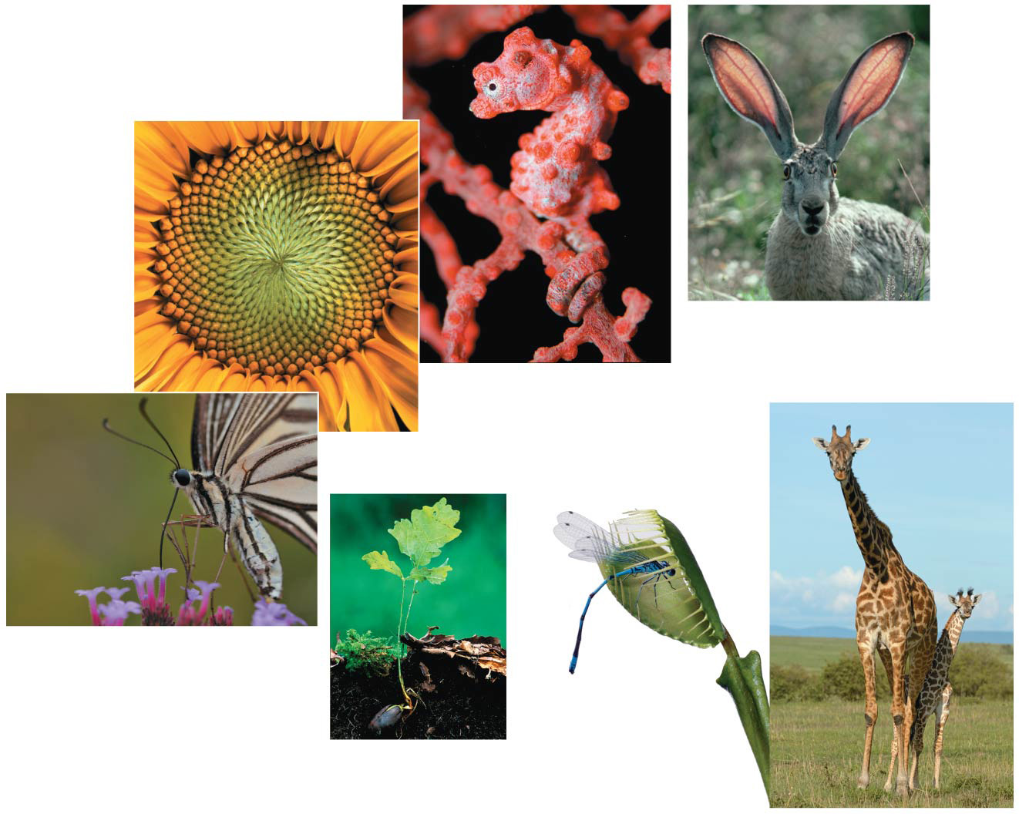
Figure 1.2
Characteristics of ‘life’
Order
and organization
Regulation (homeostasis)
Evolutionary adaptation
Reproduction
Energy processing
Response to the environment
Growth and development
Notes:
Figure 1.2 Some properties of life

Slide 4
The study of life reveals common themes
There are five unifying themes in biology:
Organization
Genetic Information
Energy and matter
Interactions
Evolution

Slide 5
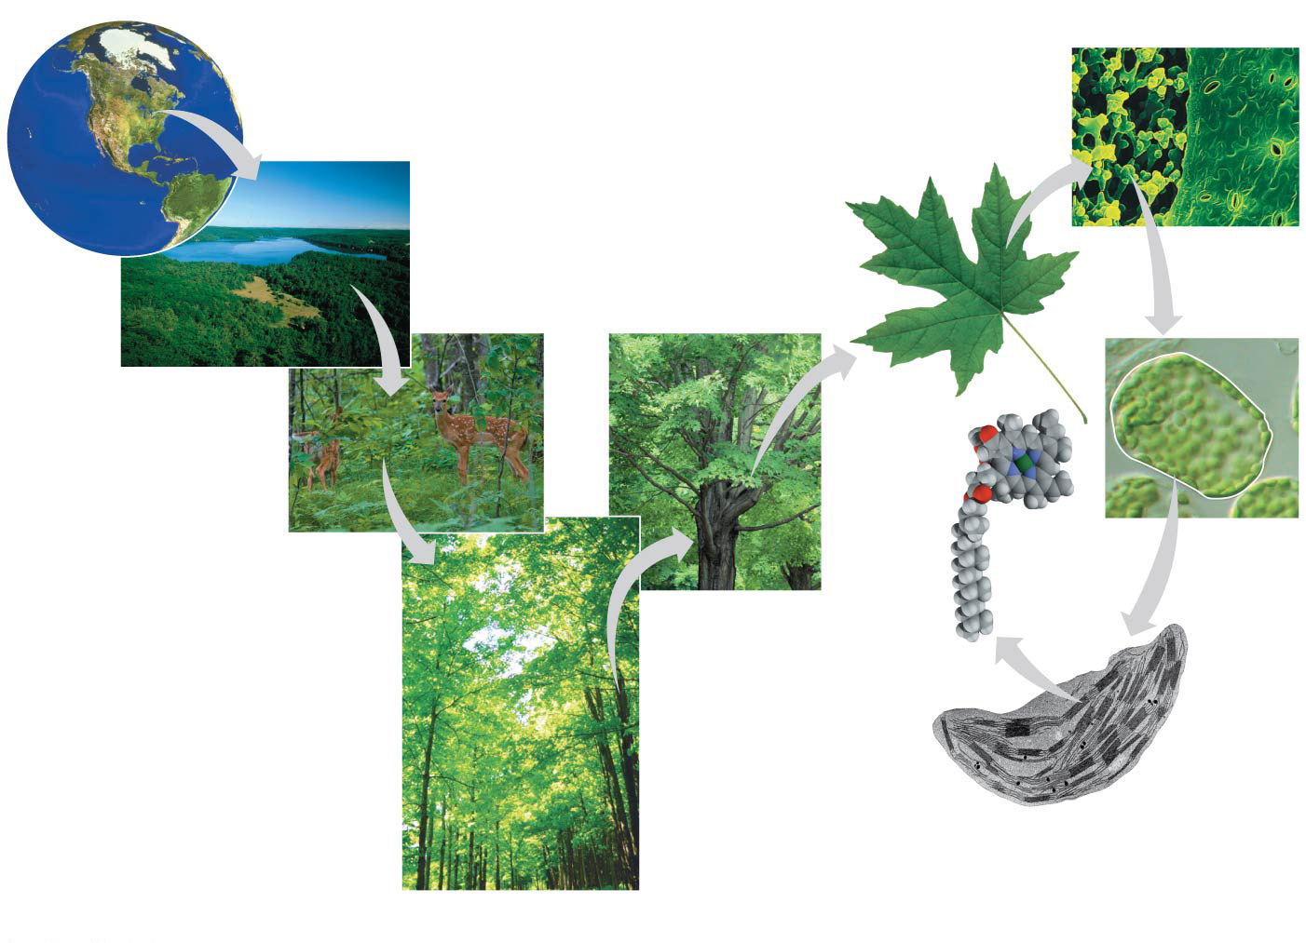
Figure 1.3
1 The Biosphere
7 Tissues
6 Organs and Organ Systems
2
Ecosystems
10
Mole- cules
3
Communities
8
Cells
5
Organisms
Levels of Organization
9 Organelles
4 Populations
Notes:
Figure 1.3 Exploring levels of biological organization

Slide 6
Interactions come in many types
Example of interaction:
ZM2
Flytrap
GPO

