Slide 1
Biology
Chapter 1 Section 2

Slide 2
Energy
Energy: the ability to do work
What’s work?
The input of energy from the sun or chemicals allows living things to do biological work
Example?
When organisms use energy to perform work, some energy is “lost” to the surroundings as heat
As a result, energy flows through an ecosystem, usually entering as light and exiting as heat
Energy is NOT recycled in an ecosystem

Slide 3
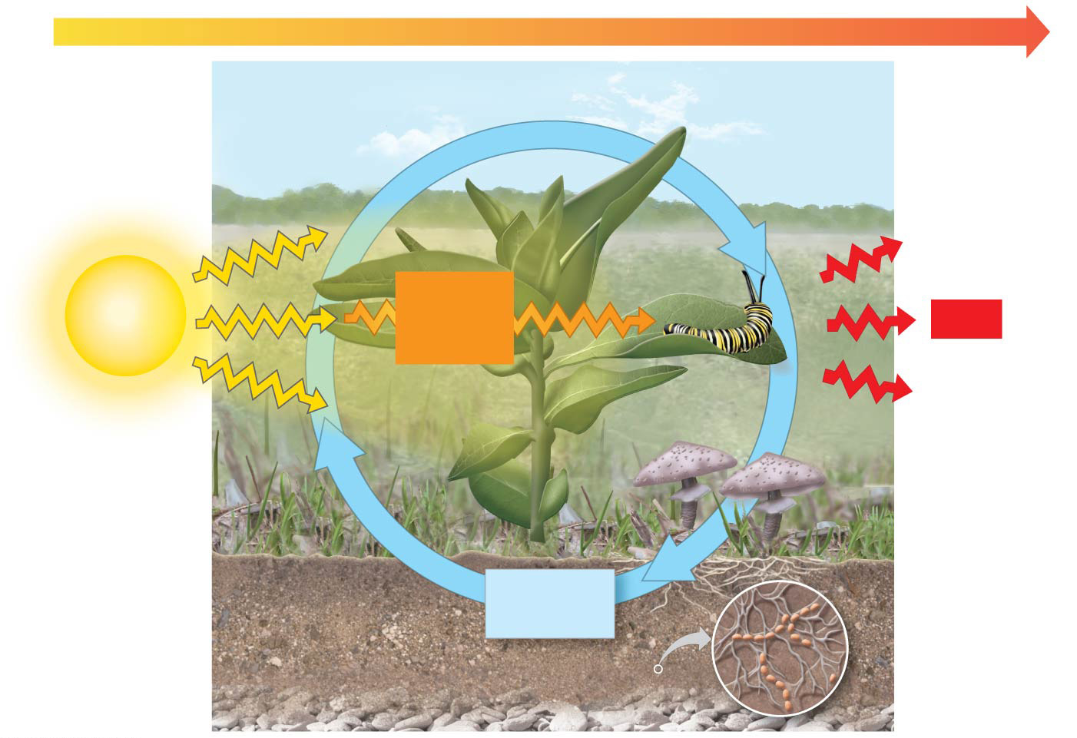

Figure 1.9
ENERGY FLOW
Chemicals pass to organisms that eat the plants.
Light energy
Chemical energy
Heat
Plants take up chemicals from the soil and air.
Decomposers return chemicals to the soil.
Chemicals
Notes:
Figure 1.9 Energy flow and chemical cycling

Slide 4
Where do organisms get the E?
Producers: turn inorganic E into organic E
Photosynthesis
Chemosynthesis
Consumers: must get E from organic source
Herbivore
Carnivore
Omnivore
Decomposer
Food (chain) web: illustrates the passing of E and matter through a community

Slide 5
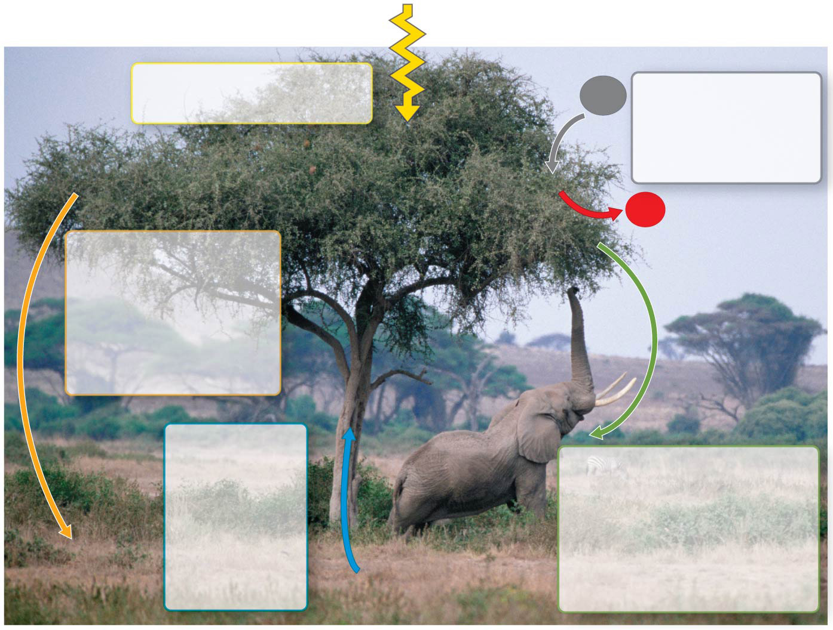
Figure 1.10
Sunlight
Leaves absorb light energy from the sun.
Leaves take in carbon dioxide from the air and release oxygen.
CO₂
O₂
Leaves fall to the ground and are decomposed by organisms that return minerals to the soil.
Water and minerals in the soil are taken up by the tree through its roots.
Animals eat leaves and fruit from the tree, returning nutrients and minerals to the soil in their waste products.
Notes:
Figure 1.10 Interactions of an African acacia tree with other organisms and the physical environment

Slide 6
Remember!
Nutrients cycle in the ecosystem
Examples:
Video
Energy does NOT cycle
Every energy interaction transfers about 1/10 the available energy to the next organism
Video

