Slide 1
Transcription
Chapter 10 Section 1a

Slide 2
Objectives
Understand the events that occur during transcription
Understand how transcription is different in prokaryotes and eukaryotes
Describe the process and result of transcription

Slide 3
Protein Structure
Made up of amino acids
Polypeptide- string of amino acids (primary structure)
20 amino acids are arranged in different orders to make a variety of polypeptides
Assembled on a ribosome

Slide 4
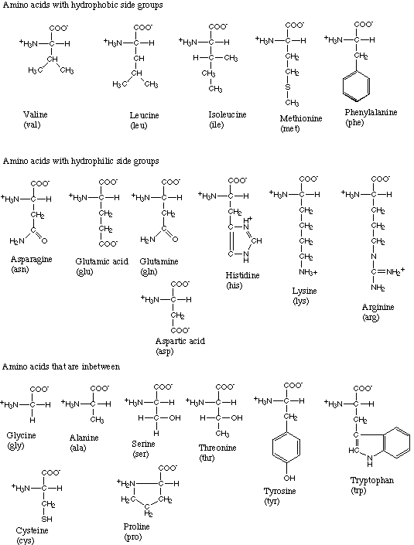

Slide 5
Questions to be answered today
How do we get from the bases found in DNA to amino acids?
How do we get from a bunch of amino acids to proteins?

Slide 6
Replication
DNA double helix unwinds
DNA now single-stranded
New DNA strand forms using complementary base pairing (A-T, C-G)
Used to prepare DNA for cell division
Whole genome copied/replicated
Semiconservative!

Slide 7
Transcription and Translation: An Overview
DNA
RNA
Protein
Transcription
Translation

Slide 8
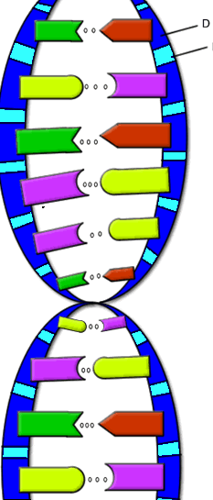
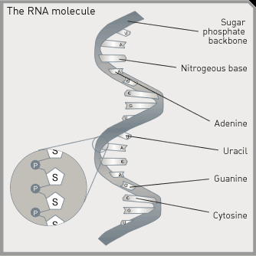
RNA vs. DNA
DNA
Double stranded
Deoxyribose sugar
Bases: C,G A,T
RNA
Single stranded
Ribose sugar
Bases: C,G,A,U
Both contain a sugar, phosphate, and base.

Slide 9
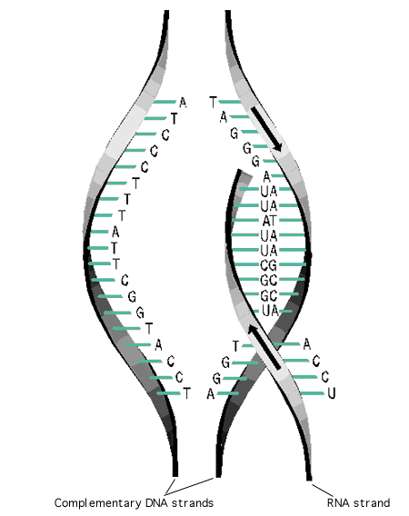
Transcription
RNA lines up base pairs with DNA
  C-G
  A-U
Primary transcript- length of RNA that results from the process of transcription

Slide 10
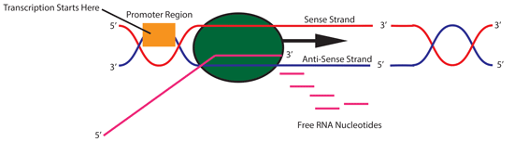
Major players in transcription
Promoter sites: locations on DNA just before the gene
Provide binding site for transcription factors (proteins) that attract RNA polymerase
Eukaryotic promoter Animation
https://www.addgene.org/mol-bio-reference/promoter-background/

Slide 11
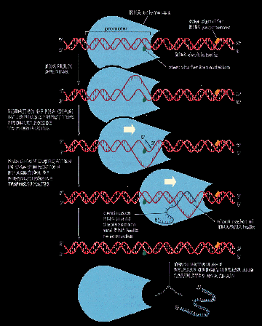
Major players in transcription
RNA polymerase- complex of enzymes with 2 functions:
  Unwind DNA sequence
  Produce primary transcript by bonding together the chain of RNA nucleotides

Slide 12
TRANSCRIPTION
ACGATACCCTGACGAGCGTTAGCTATCG
UGC
UAU
GGG
ACU

Slide 13
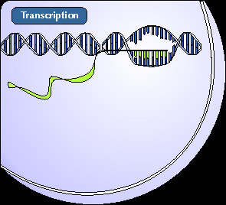
Major players in transcription
mRNA- type of RNA that encodes information for the synthesis of proteins and carries it to a ribosome from the nucleus

Slide 14
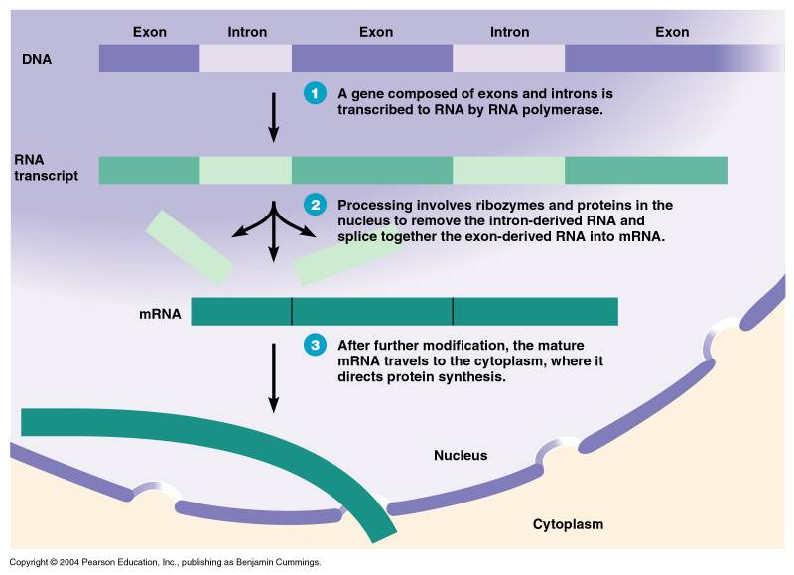
mRNA Processing in Eukaryotes
Primary transcript is not final mRNA
DNA sequence has coding regions (exons) and non-coding regions (introns)
Introns must be removed before primary transcript is mRNA and can leave nucleus

Slide 15
Transcription is done…what now?
Now we have mature mRNA transcribed from the cell’s DNA. It is leaving the nucleus through a nuclear pore. Once in the cytoplasm, it finds a ribosome so that translation can begin.
Transcription Video!

