Slide 1
Translation
Biology Chapter 10 Section 1 Part 2

Slide 2
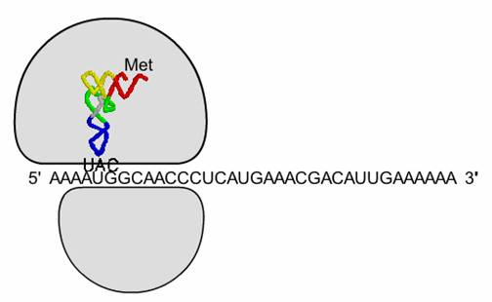
Translation
Second stage of protein production
mRNA is on a ribosome

Slide 3
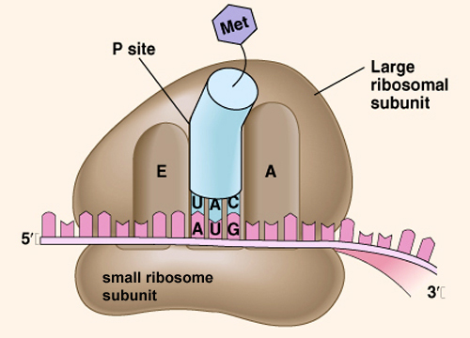
Ribosomes
2 subunits, separate in cytoplasm until they join to begin translation
Large
Small
Contain 3 binding sites
E
P
A

Slide 4
Translation
tRNA brings amino acids to the ribosome
Each tRNA has shape that attaches to a particular amino acid as well as an end with the appropriate anti-codon for that amino acid

Slide 5
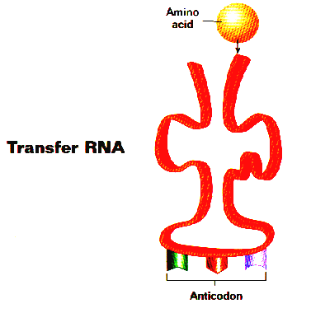
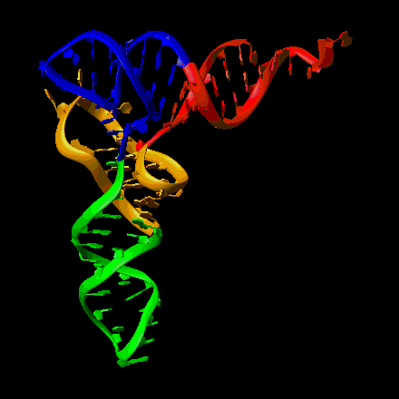
tRNA
Transfer RNA
Bound to one amino acid on one end
Anticodon on the other end complements mRNA codon

Slide 6
tRNA Function
Amino acids must be in the correct order for the protein to function correctly
tRNA lines up amino acids using mRNA code (complimentary)

Slide 7
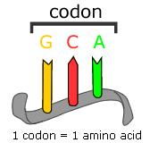
Reading the DNA code
Every 3 DNA bases pair with 3 mRNA bases
Every group of 3 mRNA bases encodes a single amino acid, matching a complimentary tRNA code
Codon- coding triplet of mRNA bases

Slide 8
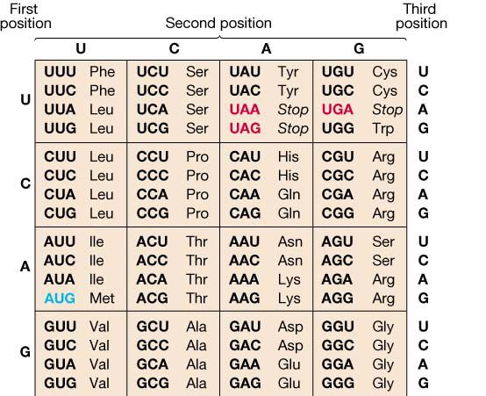
ACGATACCCTGACGAGCGTTAGCTATCG
UGC
UAU
GGG
ACUG

Slide 9
Steps of Translation-Initiation
Small unit of ribosome binds to mRNA
Small unit scans down mRNA until it reaches the codon AUG
At AUG codon, small and large ribosome units join, along with a tRNA initiator (methionine)‏

Slide 10
Steps of Translation-Elongation
tRNA carrying an amino acid with correct anticodon arrives at ribosome along with an enzyme and energy source
Peptide bond forms between preceding amino acid and the new amino acid
Empty tRNA is released, and ribosome moves one codon along mRNA chain to wait for next tRNA
This process is repeated

Slide 11
Steps of Translation-Termination
Ribosome reaches stop codon (UAA, UAG, UGA)‏
No tRNA molecules have stop anticodon
Protein release factors recognize stop codon, and release polypeptide from ribosome
Ribosome splits into subunits and can be used again

Slide 12
Control of Gene Expression
Usually, protein manufacture is controlled by transcription
However, there are controls after transcription;
P bodies: protein groups that can break down mRNA
MicroRNAs: small RNA molecules that bind to mRNA and keep it from being translated
Riboswitches: small section of RNA that binds to mRNA when polypeptide is not needed and changes mRNA shape

Slide 13
Transcription vs. Translation Review
Transcription
Process by which genetic information encoded in DNA is copied onto messenger RNA
Occurs in the nucleus or at DNA strand
DNA → mRNA
Translation
Process by which information encoded in mRNA is used to assemble a protein at a ribosome
Occurs on a ribosome
mRNA → polypeptide
Video

