Slide 1
Variation in Organisms
Mutation!

Slide 2
Objectives
Infer several ways in which genetic variation may occur
Understand techniques used in recombinant DNA technology and the uses of that technology

Slide 3
Mutation
Causes a change in genes
Provide the raw material for evolution
Most have no effect on eukaryotes
Remember, about 1% of eukaryotic DNA codes for polypeptides!
Mutations that affect cells are usually lethal

Slide 4
Types of Mutation
Gene mutation
Base changes
Chromosome mutation
Entire section of chromosome changes
Many genes are affected

Slide 5
Gene Mutation
Deletion
One base left out of code
Reading shifts over one (frameshift)‏
Insertion
One additional base in code
Reading shifts over one (frameshift)‏
Point mutation
One base changed
No reading shift

Slide 6
Gene Mutations
Think of this sentence as an example:
THE CAT ATE THE BIG RAT
With deletion:
THE ATA TET HEB IGR AT
With insertion:
THE CAT RAT ETH EBI GRA T
With point mutation:
THE CUT ATE THE BIG RAT

Slide 7
Chromosome Mutation
Changes structure of chromosome
Changes number of chromosomes

Slide 8
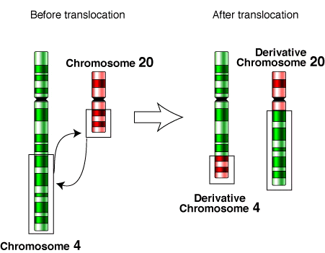
Chromosome Mutation
Translocation:
Segment of one chromosome transferred to another

Slide 9
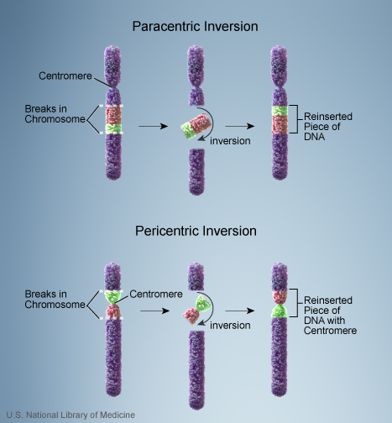
Chromosome Mutation
Inversion

Slide 10
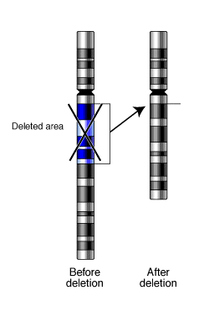
Chromosome Mutation
Deletion:
A segment of chromosome breaks off and is lost

Slide 11
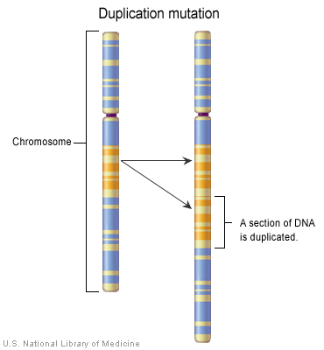
Chromosome Mutation
Duplication

Slide 12
Chromosome Mutation
Change in chromosome number
Polyploidy
Nondisjunction

Slide 13
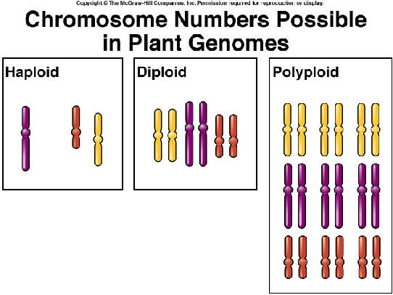
Chromosome Mutation
Polyploidy
Mainly occurs in plants (animal cells die)
Multiple of n chromosome number (3n, 4n, etc)

Slide 14
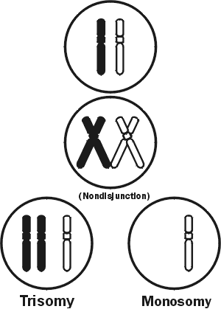
Chromosome Mutation
Nondisjunction
Entire (or large part) of chromosome misplaced during meiosis
Result may be trisomy or monosomy

Slide 15
Biotechnology
The use of microorganisms, cells, or cell components to make a product
Foods that are produced by the action of microorganisms (bacteria and yeasts)
Antibiotics
Vitamins
Enzymes

Slide 16
Modern Biotechnology
Selection
Culture a naturally-occurring microbe that produces desired product (antibiotic producing bacteria)
Mutation and selection
Mutagens cause mutations that might result in a microbe with a desirable trait (penicillin produced by the fungus over 1000 times)
Select and culture microbe with the desired mutation
Gene modification
Change a specific DNA bases ( change the corresponding codons) to change a protein

Slide 17
Recombinant DNA
Recombinant DNA - DNA that has been artificially manipulated to combine genes from two different sources.
Genes transferred - among unrelated species via laboratory manipulation.
Genetic engineering - human manipulation of an organism's genetic material in a way that does not occur under natural conditions

Slide 18
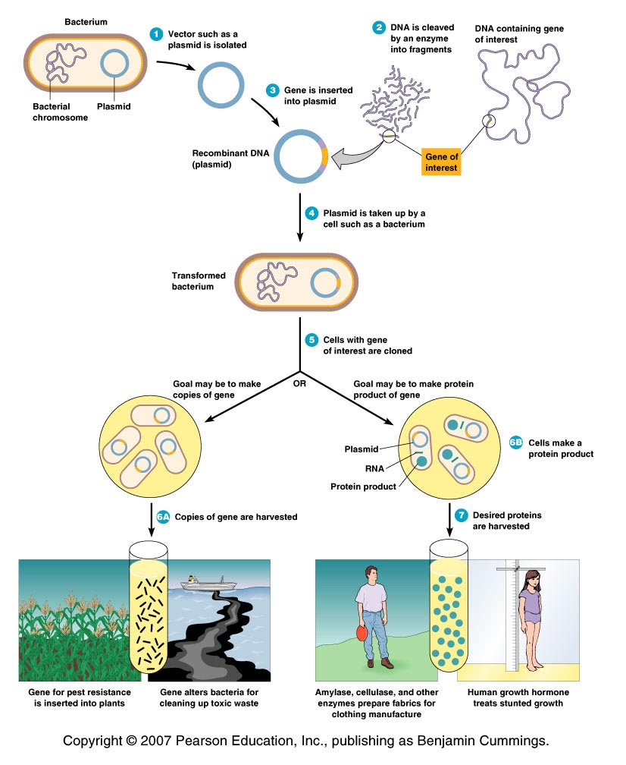
An Overview of Recombinant DNA Technologies
1. Gene of interest (DNA) is isolated
(DNA fragment)
2. A desired gene is inserted into a DNA molecule - vector
(plasmid, bacteriophage or a viral genome)
3. The vector inserts the DNA into a new cell, which is grown to form a clone.
(bacteria, yeast, plant or animal cell)
4. Large quantities of the gene product can be harvested from the clone.
Figure 9.1.2

Slide 19
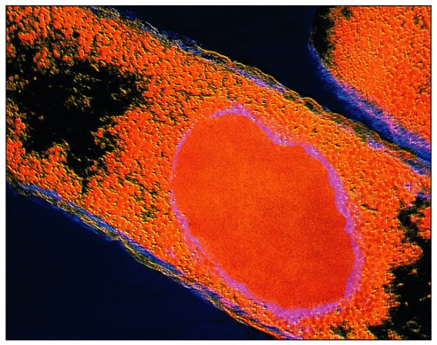
Hosts for DNA recombinant technology
Bacteria
E. coli - used because is easily grown and its
genomics are well understood.
Gene product is purified from host cells
2. Yeasts - Saccharomyces cerevisiae
Used because it is easily grown and its genomics are known
May express eukaryotic genes easily
Continuously secrete the gene product.
Easily collected and purified
3. Plant cells and whole plants
May express eukaryotic genes easily
Plants are easily grown - produce plants with new properties.
4. Mammalian cells
May express eukaryotic genes easily
Harder to grow
Medical use.

Slide 20
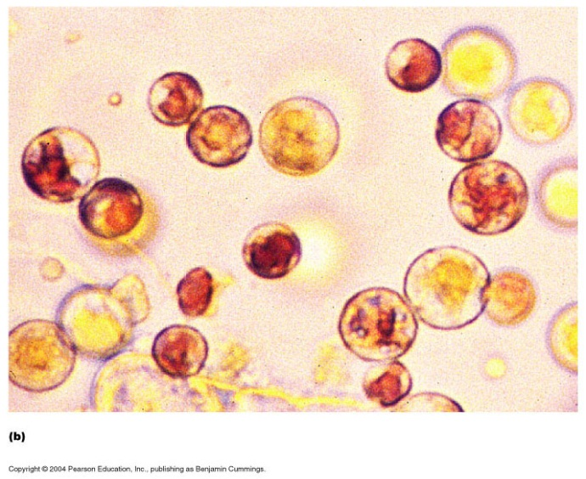
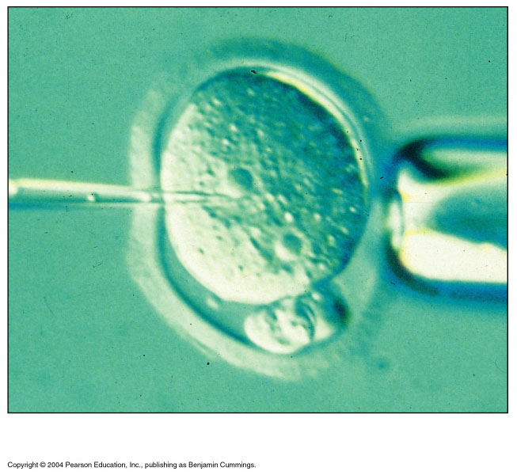
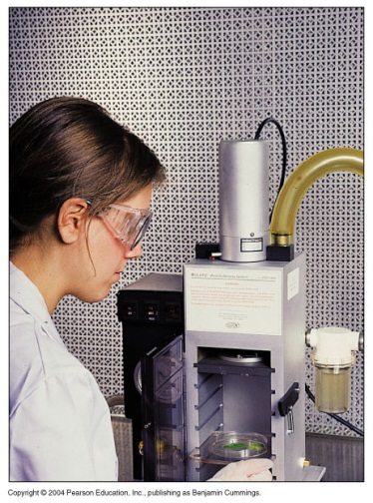
Insert the naked DNA into a host cell
1.Transformation
* treatment make cells competent to accept foreign DNA (CaCl₂ make pores in cell membrane)
2. Electroporation
*use electrical current to form microscopic pores in the membranes of cell
3. Protoplast fusion
– yeast, plants and algal cells
4. Microinjection
5. Gene gun
Figure 9.5b

