Slide 1
Human Genetic Disorders Part 3
Biology Chapter 11 Section 1 C

Slide 2
Hemophilia
Inherited bleeding disorder
About 18 000 people in US (about 400 born/year, about 1 in 5000 male births)‏
Usually occurs only in males
Two main types
Hemophilia A: little/no clotting factor VIII
Hemophilia B: low clotting factor IX

Slide 3
Hemophilia
Symptoms:
Excessive bleeding
Bleeding may be external or internal
Bleeding into joints
Easy bruising

Slide 4
Hemophilia
Caused by defect on gene for clotting factors on X chromosome
Hemophilia A: 90% of occurrences
Mutation of Factor VIII gene, recessive
Without this protein, stable clots do not form
Hemophilia B: about 9% of occurrences
Mutation of Factor IX gene, recessive

Slide 5
Hemophilia A
Mutation of factor VIII may be point mutation, inversion, deletion or insertion
Differences in mutation may lead to differences in severity of disorder
Gene is close to that responsible for colorblindness

Slide 6
Hemophilia B
Also known as Christmas disease
Mutation of coagulation factor IX
Mutation may be point mutation or deletion

Slide 7
Hemophila
Treatment:
Replacement therapy
Complications of treatment:
Antibodies to replacement clotting factor
Viruses in clotting factor from blood
Desmopressin: man-made hormone

Slide 8
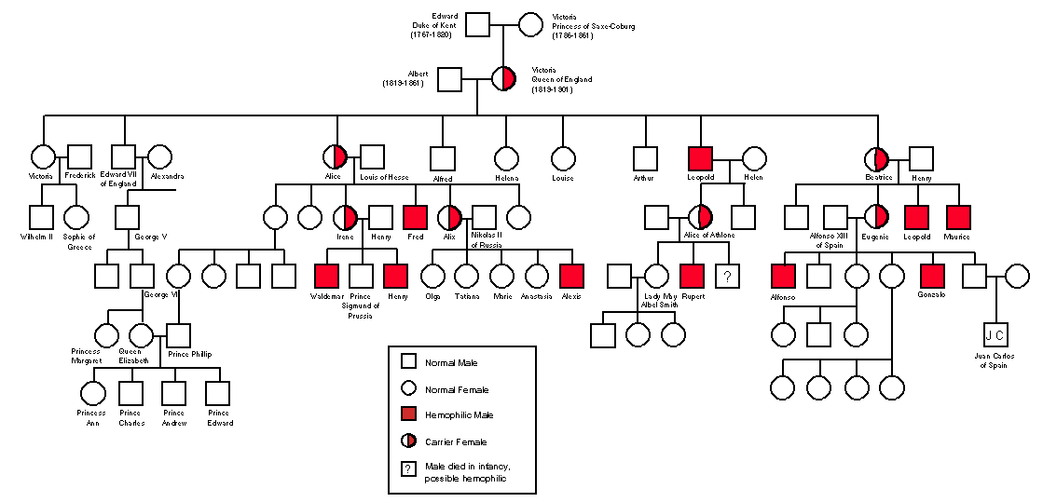

Slide 9
Colorblindness
Deficiency in the way a person sees color
Certain cells in the retina do not work properly to detect color
Three major categories:
Red-green
Blue-yellow
Absence of color

Slide 10
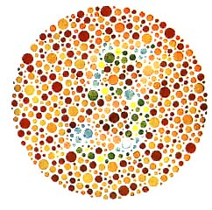
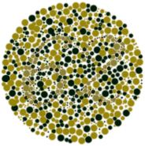
Colorblindness

Slide 11
Colorblindness
Sex-linked recessive
Red-green is most common
8% of males and 0.5% females
Blue-yellow affects males and females equally
Autosomal dominant
Less than 1 in 10 000 people
Achromatopsia less common
Autosomal recessive
1 in 30 000 people

Slide 12
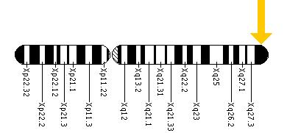
Colorblindness
Red-green caused by deletion, insertion and point mutation in two genes responsible for formation of cones in retina
X chromosome

Slide 13
Colorblindness
Why does it remain in gene pool?
Not naturally threatening to life
May make a person more able to see textures hidden by color

