Slide 1
Human Genetic Disorders Part 4
Biology Chapter 11 Section 1 D

Slide 2
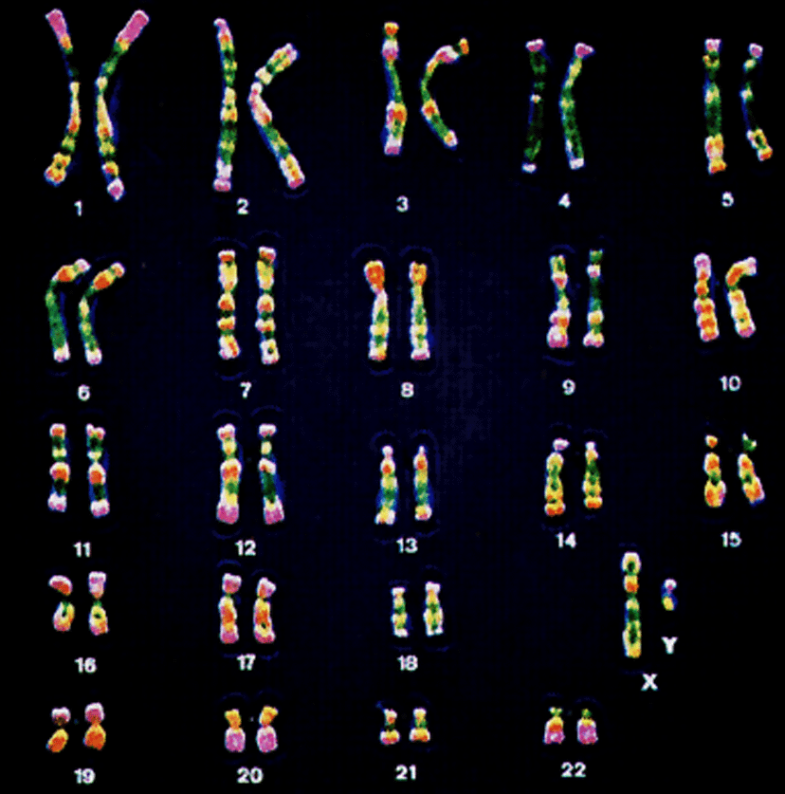
Chromosomes and Inheritance
A normal human male karyotype.
http://www.biology.usu.edu/courses/biol1010-podgorski/PPpage.htm

Slide 3
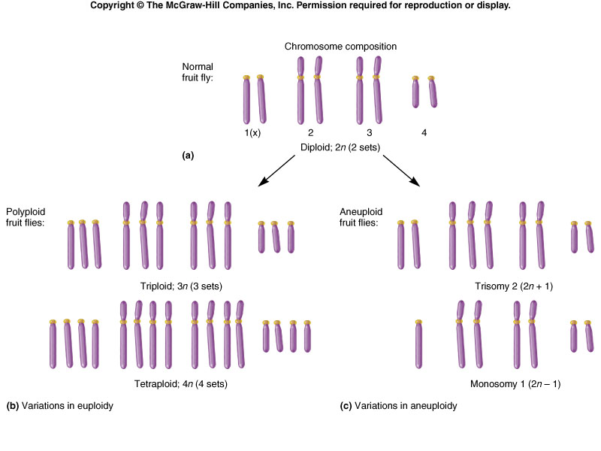
Aneuploidy
Aneuploidy occurs when one of the chromosomes is present in an abnormal number of copies.
Trisomy and monosomy are two forms of aneuploidy.

Slide 4
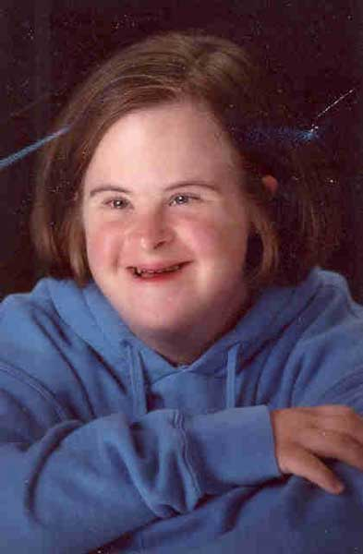
Down Syndrome is Caused by Trisomy for Chromosome 21
Aneuploidy is remarkably common, causing termination of at least 25% of human conceptions.
Aneuploidy is also a driving force in cancer progression (virtually all cancer cells are aneuploid).

Slide 5
Down Syndrome
Video
Symptoms:
Intellectual disability
Facial appearance
Poor muscle tone
Heart defect
Digestive tract defect
Vision and hearing problems
Trisomy and monosomy are two forms of aneuploidy.

Slide 6
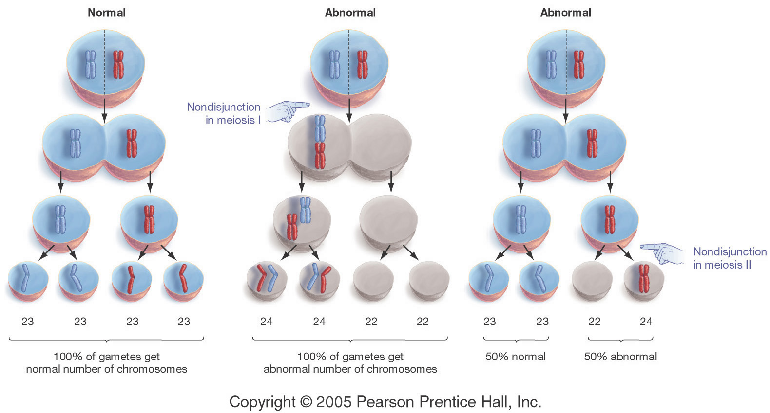
Chromosome Non-Disjunction in Meiosis Causes Aneuploidy

Slide 7
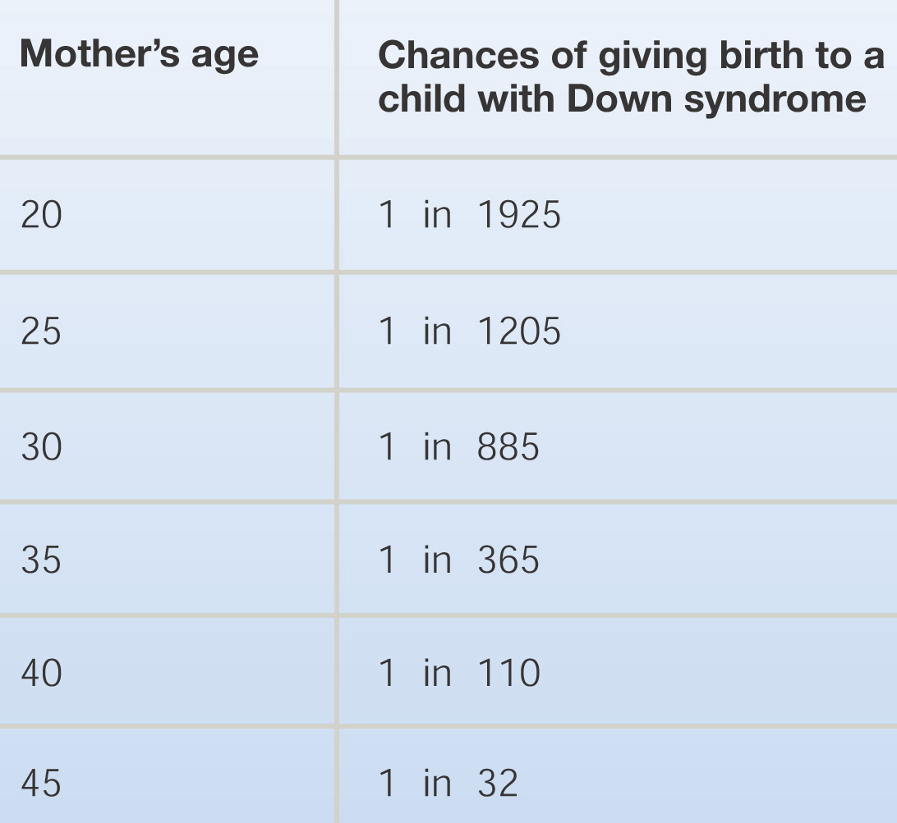
The Frequency of Chromosome Non-Disjunction And Down Syndrome Rises Sharply with Maternal Age
The phenomenon is clear – the explanation isn’t.

Slide 8
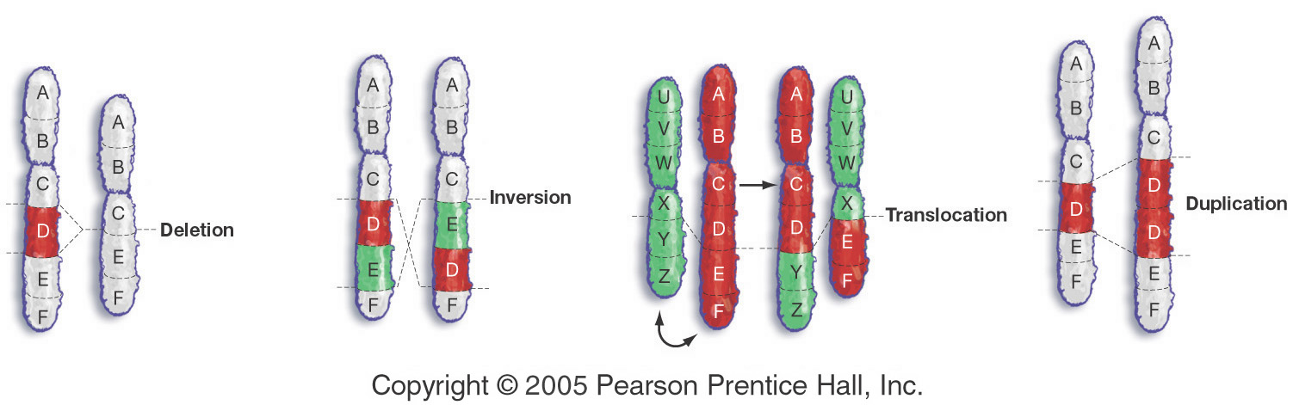
Chromosome Structural Changes
There are 4 types of chromosome structural change – all of them associated with human disorders

Slide 9
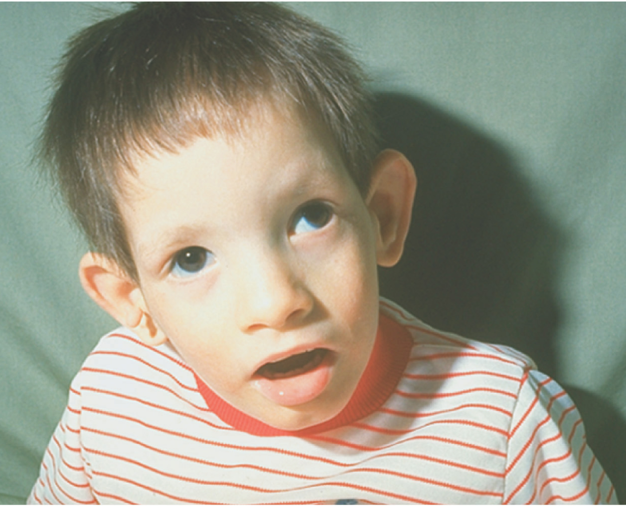
A Boy with Cri-du-Chat Syndrome – a Debilitating Disorder Caused by Chromosome Deletion

Slide 10
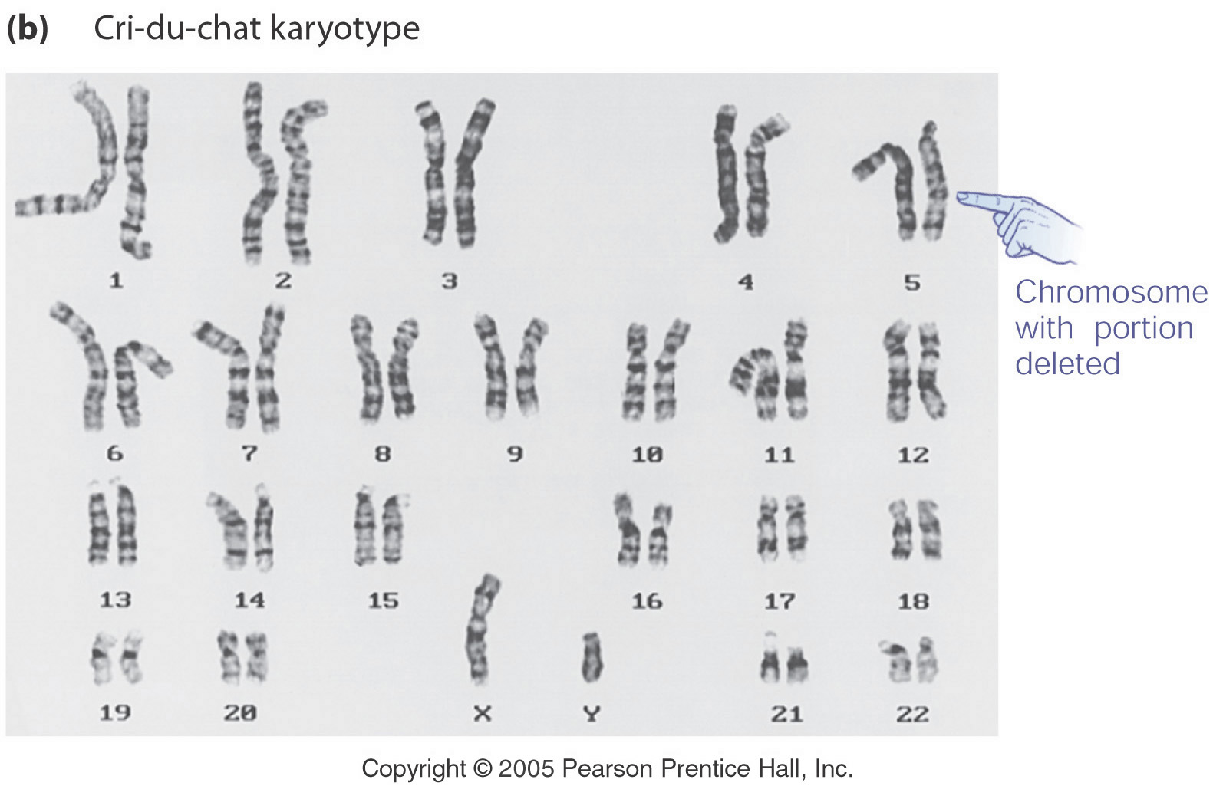
Cri-du-Chat is Caused by the Loss of the Short Arm of One Copy of Chromosome 5

Slide 11
Cri du chat
Larynx is improperly developed so make sound like cat's cry
Severe mental retardation (IQ below 20)‏
Facial deformity
Heart disease
Most die in early childhood

