Slide 1
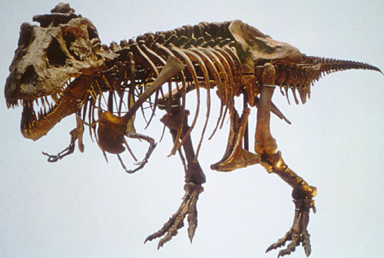

Slide 2
Biology Chapter 12 Section 1a
Objectives:
  Recognize that various lines of evidence for evolution exist
  Apply knowledge of evolution to organisms (both modern and extinct)

Slide 3
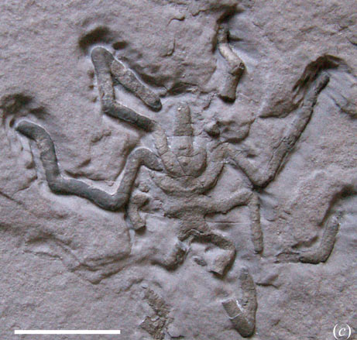
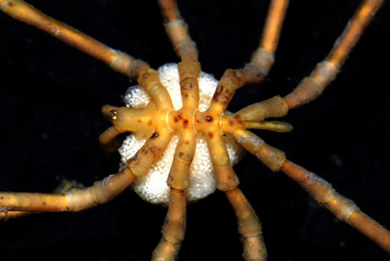
Evidence of Evolution

Slide 4
Fossil
Definition: preserved remains or indications of organisms from the past
To become a fossil, an organism must be buried quickly, remain buried, and be preserved
There are different ways fossils are formed
Most organisms do not become fossils
Fossils provide a record of evolution

Slide 5
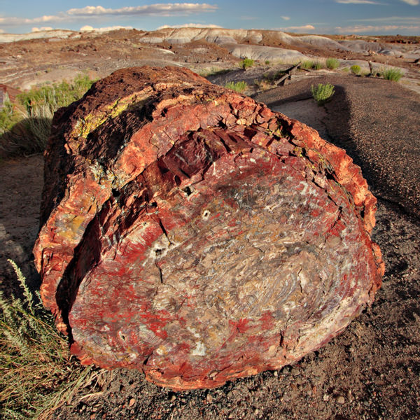
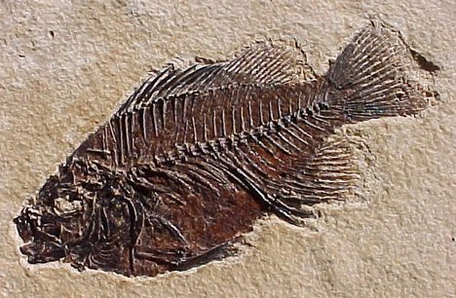
Ways Organisms are Fossilized
Petrification: minerals replace the tissues of the organism
  Most easily replaced tissues are hard parts like bones and shells

Slide 6
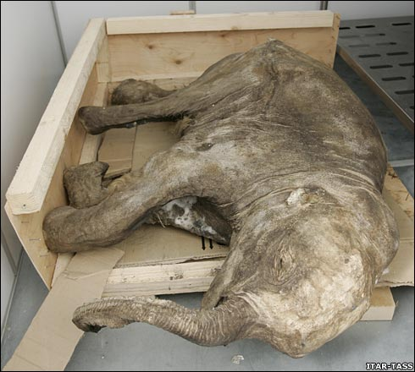
Ways Organisms are Fossilized
Freezing: some organisms were frozen during the most recent Ice Age.
  If the organism thaws, it usually is quickly destroyed
  We can get information about soft tissue from frozen fossils

Slide 7
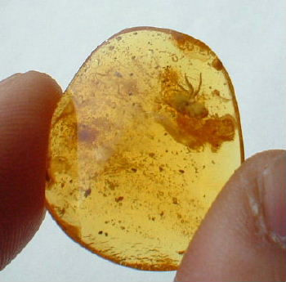
Ways Organisms are Fossilized
Amber: hardened tree sap that may trap small organisms
  The entire organism is often preserved in the coating of amber

Slide 8
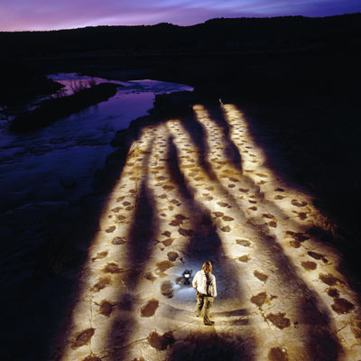
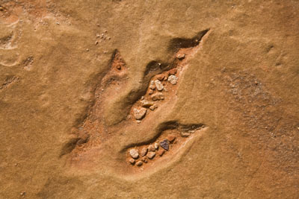
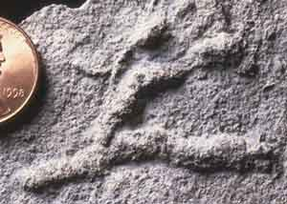
Ways Organisms are Fossilized
Trace fossils: not the organism, but a track or trace left by the organism
  May be footprints, leaf imprints, or burrows
  Trace fossils tell us about how the organism lived

Slide 9
Ways Organisms are Fossilized
Fossils are most often found in sedimentary rock
  Layers of mud, sand, silt or clay pile up and bury organisms

Slide 10
Dating Fossils
Fossils are dated in two main ways:
  Relative dating
    Use the layering of rocks to tell if a rock with a fossil is older or younger than those around it
    Oldest rocks are on the bottom of a series of rocks
  Absolute dating
    Use radioactive elements to determine how old a rock is
    Different elements are used for different ranges of age
Usually both methods are used together

Slide 11
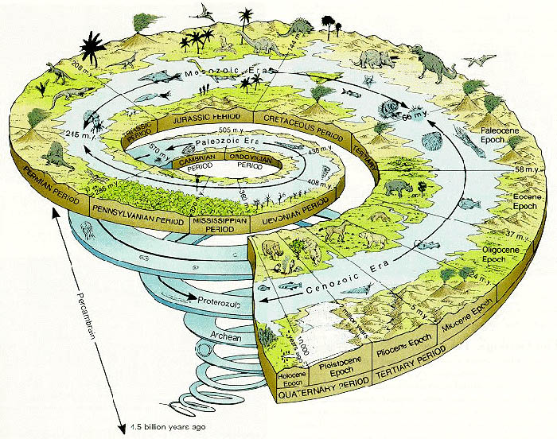
The Geologic Time Scale
Using fossils and radiometric dating, geologists try to look at the changes in Earth over time
This includes changes in life!

