Slide 1
Charles Darwin
And the voyage of HMS Beagle

Slide 2
Objectives
Analyze how Darwin’s observations led to his conclusions about natural selection and evolution
Explain natural selection
Apply knowledge of genetics to an understanding of natural selection

Slide 3
Basic Biographical Info
February 12 1809 Charles Robert Darwin born
Darwin spent his childhood exploring, shooting birds, and collecting insects
Darwin attended medical school at the University of Edinburgh Scotland from 1826-1827

Slide 4
More Basic Biographical Info
Darwin dropped out of medical school
Had more interest in chemistry and natural science
Attended Christ's College, Cambridge to study for the clergy 1828-1831 and passed his final exams to be a clergyman

Slide 5
Even More Basic Biographical Info
During his years at Cambridge, Darwin found an interest in botany, geology and entomology
1831 - Darwin's name was proposed as naturalist for the expedition of HMS Beagle by his tutors at Cambridge
  The plan was for a 2 year survey of South America
  Darwin's father and sisters were opposed

Slide 6
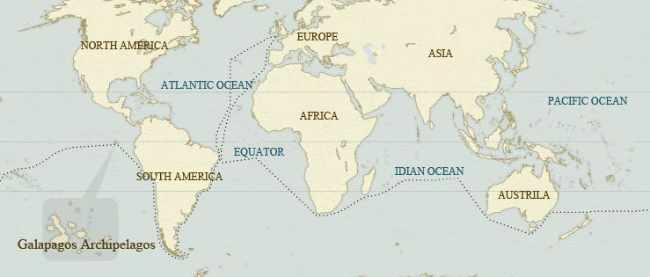
Voyage of HMS Beagle

Slide 7
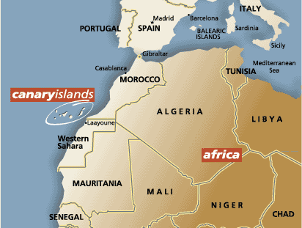
The Voyage of HMS Beagle
Left London December 27, 1831
January 16 1832 – Darwin discovered a layer of shells 45 feet above sea level in Canary Islands

Slide 8
Voyage of HMS Beagle: South America!
February 28 1832: arrived at Salvador, Brazil
  Darwin explored tropical rain forest
April - August 1832: survey in Brazil
  Darwin sends his first shipment of specimens (birds, rocks, insects, plants and small mammals) back to England
August – December 1832: survey Patagonia
  Darwin sends a second shipment containing fossils, mammals, birds, plants and insects back to England

Slide 9
Voyage of HMS Beagle: 1833
Darwin and the Beagle explore the eastern coast of South America, including Terra del Fuego and the Falkland Islands
Darwin sends shipments of animals, plants, seeds, fossils and rocks back to England
  Ground sloth fossil in rocks under layer of sea shells puzzled Darwin

Slide 10
Voyage of HMS Beagle: 1834
Finally sailed around Cape Horn to Pacific Ocean in April
Darwin sent samples of birds, plants, rocks and water and gas from hot springs in Andes back to England

Slide 11
Voyage of HMS Beagle: 1835
Darwin experienced massive earthquake in Valdivia Chile
Darwin explores Andes Mountains
September 7 1835: Beagle sets sail for Galapagos and reaches them on September 16

Slide 12
Voyage of HMS Beagle: Galapagos
Arrived September 16 1835
Darwin was intrigued by black volcanic rock and organisms
Collected samples of plants, birds, rocks and insects
Spent days on several islands exploring
Left October 20 1835

Slide 13
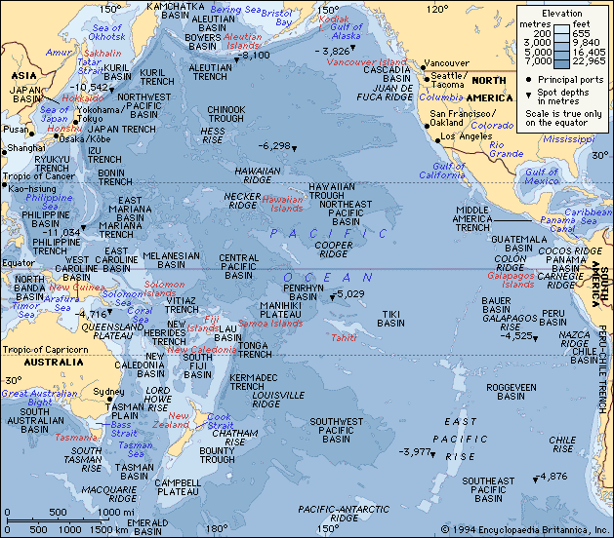
Voyage of HMS Beagle: 1835-6
Left Galapagos October 20
Arrived Tahiti November 15 and stayed 10 days
Arrived New Zealand December 21

Slide 14
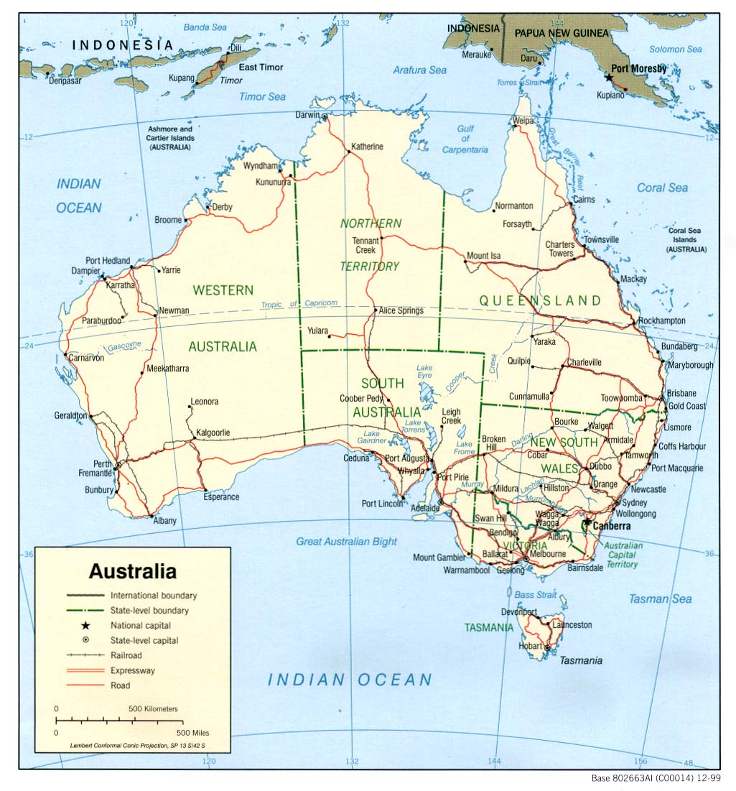
Voyage of HMS Beagle: 1836
January 12: Arrived Sydney Harbor, took inland trip 130 miles
February 5: Went to Tasmania, took inland trips
March 6: Arrived at Albany, Darwin unimpressed with area

Slide 15
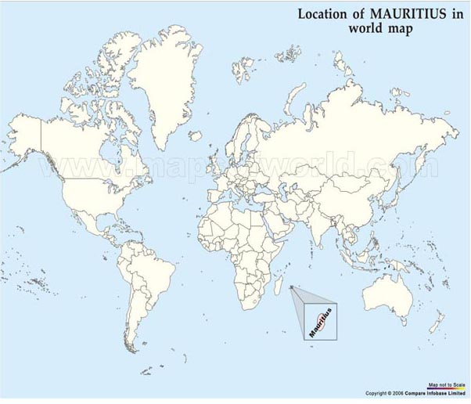
Voyage of HMS Beagle: 1836
April 29: arrived Mauritius Islands
May 31, sailed around Cape of Good Hope and docked at Cape Town
  Darwin visits Sir John Herschel

Slide 16
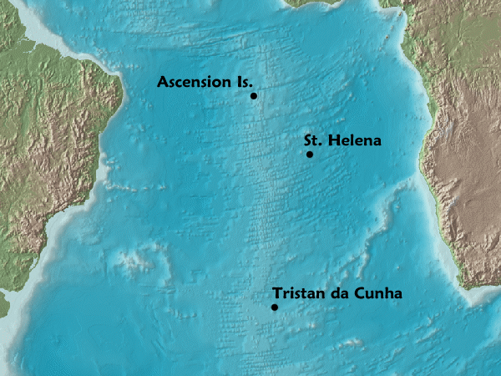
Voyage of HMS Beagle: 1836
June - July: Travelled to St. Helena and Ascension Islands
  Darwin explored geology
July: Captain FitzRoy was concerned his measurements were incorrect, so detoured back to South America

Slide 17
Voyage of HMS Beagle: 1836
August: Completed survey corrections on east coast of South America
October 2: HMS Beagle returns to England, Darwin sets off for home

Slide 18
Charles Darwin: 1836
October 29: Finally unloaded all specimens from HMS Beagle, met Charles Lyell, who helped find naturalists to study specimens
Darwin spent the winter organizing his specimens and writing a paper on South America

Slide 19
Charles Darwin: 1837
Ornithologist John Gould told Darwin that the bird specimens from Galapagos were all finches, not different groups as Darwin had thought
Darwin is working out ideas about transmutation of species

Slide 20
Charles Darwin: 1838 - 1839
Darwin thinks about descent, fitness and corresponds with breeders of animals regarding selection
Darwin marries his cousin Emma Wedgwood in January 1839
Darwin's narrative of the Beagle expedition was published

Slide 21
Charles Darwin: 1840-1846
Darwin works out his idea of transmutation, including natural selection
  Corresponds with specialists in botany, geology, and natural science
Darwin was very ill
Spent some time consuting with experts in botany about his samples from South America and Galapagos
Consumed by research on organisms and writing his idea about transmutation

Slide 22
Charles Darwin: 1847- 1859
Darwin almost continually ill, but took “water cure” and recovered by 1850
Darwin continues to work on his ideas about speciation
1856: Receives a draft of a paper by Alfred Wallace, containing ideas similar to his ideas about transmutation
Darwin writing chapter (which became book) on natural selection
  Book on sale November 22 1859

Slide 23
Charles Darwin: 1860- 1882
1860: Many debates about Darwin's idea published in “On the Origin of Species by Natural Selection”
Darwin becomes interested in orchids, insects and animal domestication
1863: Archaeopteryx fossil discovered in Germany
  Archaeopteryx
1867 Darwin works on book about sexual selection
1882: after many years of heart problems, Darwin dies

Slide 24
Natural Selection
Organisms produce more offspring than can survive
There are variations in a population that are inherited
Organisms with certain variations are more healthy and more likely to reproduce and pass those variations to offspring
Over time, a population becomes better adapted to its environment

