Slide 1
Methods of Science
Biology Chapter 2 Section 1

Slide 2
What is Science?
Science is a process that helps us learn about the natural world
Science is a logical and orderly method of testing ideas
Science is a systematic method of studying the universe
Applied science is called technology—using science to make our lives better or easier

Slide 3
The process of science
The way we do science is called the scientific method
  This is a series of steps that are done to give us more knowledge
    Although we say ‘steps’, the order can and does change
    Sometimes steps are repeated!
  Science can only study testable ideas
  Science begins with observations, and during the process, we collect more observations (data)‏and propose an explanation

Slide 4
The Scientific Method
Make observations
State a problem
Formulate an hypothesis
Test the hypothesis
  May be an experiment
    Experiment must have a control
  May be continued observations
Analyze the data collected during the test
Draw conclusions (relate to hypothesis)
  Support or disprove!
Report the results
  Report is essential so others can critique the work and test the same idea themselves

Slide 5
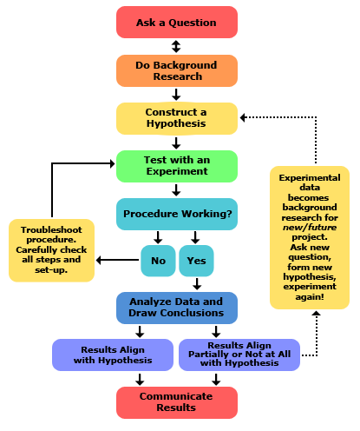

Slide 6
Theory
A theory is not a guess, it is an idea that has been tested repeatedly and not disproven
A theory is a description or explanation of how things work
Examples in Biology: Cell Theory, Theory of Evolution

Slide 7
Scientific Law
A scientific law is a general statement describing what happens
This may be a general statement about a theory or group of theories, so it has been tested and repeatedly observed
The law does not explain HOW something works, or WHY, but just that it does

Slide 8
Why do science?
What do you think?

