Slide 1
Biology Chapter 2 Section 2
Tools of the Trade

Slide 2
Observations in Biology
Because we are often concerned with observing how things work, and often how cells work, a microscope is a commonly used tool in biology.
A light microscope uses convex lenses and light to magnify an image.
An electron microscope uses a beam of electrons that interact with the atoms of the object and form an image.

Slide 3
Light Microscopes
The first compound light microscope was made in 1595 by Zacharias (or maybe his father Hans) Janssen in Holland. It magnified 3x to 9x.
Robert Hooke improved how microscopes work, and in 1660, after looking at plant bark, coined the word 'cell' for the little units there.
Anton van Leeuwenhoek used a simple (one lens) but very good microscope to describe little organisms he saw in pond water in the late 1600s.

Slide 4
Differences in scale
See http://nobelprize.org/educational_games/physics/microscopes/powerline/index.html

Slide 5
Resolution
Resolving power is the ability to tell that two things very close together are two things (that they are separate objects).
Generally, the more you try to magnify, the less resolution you have.
Another example of the resolving power of various instruments: http://www.ncbi.nlm.nih.gov/books/bv.fcgi?rid=mboc4.figgrp.1717

Slide 6
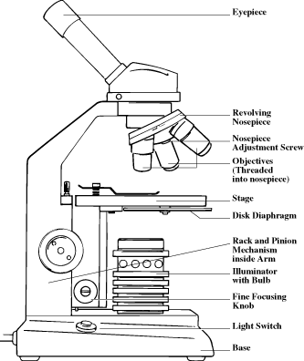
The Compound Light Microscope
The compound light microscope shines light through an object.
It uses two lenses to magnify the object.
Our microscopes can magnify from 40x to 400x (generally).
Some light microscopes may magnify 2000x.

Slide 7
The Compound Light Microscope
The resolution of the light microscope is on the order of 500 nm (0.0000005 m) for a good set of lenses.
Objects that are closer than 500 nm cannot be seen as separate.

Slide 8
Magnification
Magnification depends on the lenses you use. The microscope has an eyepiece lens, which is usually 10x, and three other objective lenses (4x, 10x and 40x usually). Total magnification is the eyepiece x the objective lens power.
An excellent web page: http://www.cas.miamioh.edu/mbiws/microscopes/Magnification.html

Slide 9
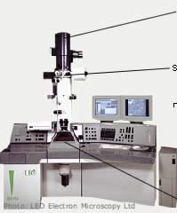
Electron Microscopes
Electron microscopes have better resolution because they do not use lenses.
They use a guided beam of electrons that bounce off an object or go through the object.
The image is formed on a computer screen.
Your eye cannot see electrons directly.

Slide 10
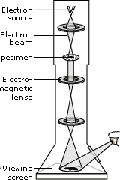
Transmission Electron Microscope
Electrons are generated and aimed using magnets.
The electrons pass through the object. The object must be very thin.
Some electrons are scattered as they hit dense areas.
The pattern of scattered electrons is captured by a detector and used in the computer to make an image.

Slide 11
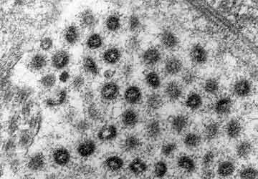
Transmission Electron Microscope
This is an image of corona virus from the airways of a young girl with a common cold. (http://nobelprize.org/educational_games/physics/microscopes/tem/gallery/2.html)‏

Slide 12
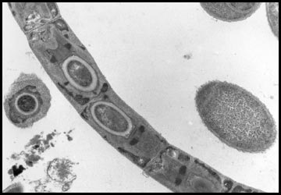
Transmission Electron Microscope
These are bacteria from the gut of a termite. (http://nobelprize.org/educational_games/physics/microscopes/tem/gallery/2.html)‏

Slide 13
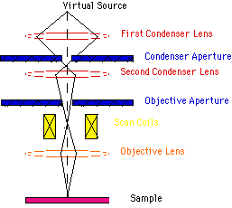
Scanning Electron Microscope
The Scanning Electron Microscope looks at the surface of objects.
It produces a 3D image by bouncing electrons off the surface.
The electrons interact with the object.
The number of interactions are detected, forming the image.

Slide 14
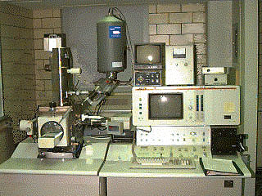
The Scanning Electron Microscope
Like the TEM, the SEM has higher resolution than a light microscope.

Slide 15
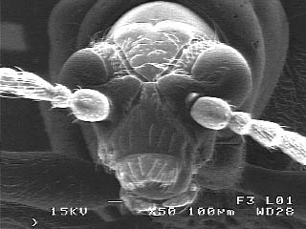
The Scanning Electron Microscope
Very cool images can be created! This is from http://www.mse.iastate.edu/microscopy/tutorials.html

Slide 16
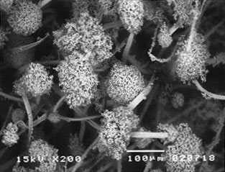
The Scanning Electron Microscope
Bread mold from http://www.mse.iastate.edu/microscopy/tutorials.html

Slide 17
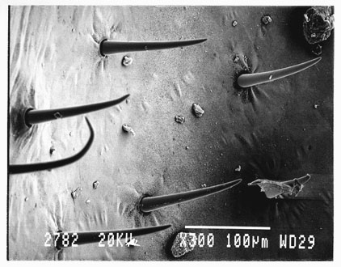
The Scanning Electron Microscope
This is an insect wing, magnified 300x from http://www.mse.iastate.edu/microscopy/tutorials.html

Slide 18
Tools
No matter which tool we use, we make observations in the form of both qualitative (non-numerical) and quantitative (measured numbers) data.
The system we use in measurement is the metric system (SI).
SI review and Mr. Boal’s handy dandy conversion line

