Slide 1
Biology Chapter 27 Section 2
Regulation of Population Size

Slide 2
Objectives
Predict the effect of predation and/or food supply on a population
Discuss the importance of parasitism and disease as density-dependent limiting factors
Tell the difference between interspecific and intraspecific competition

Slide 3
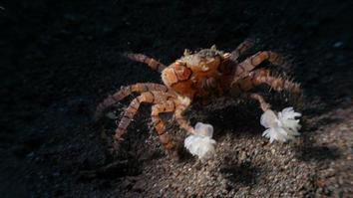
Communities in Motion
A biological community is an assemblage of populations of various species living close enough for interaction
For example, the “carrier crab” carries a sea urchin on its back for protection against predators
National Geographic

Slide 4
Population Change and Population Density
In density-independent populations, birth rate and death rate do not change with population density
In density-dependent populations, birth rates fall and death rates rise with population density

Slide 5
Density Dependent Limiting Factors
Density-dependent factors often involve interactions between different species
A population still may reach the carrying capacity
Competition for resources may be interspecific (between different species) or intraspecific (among members of same species)
Often intraspecific competition is controlled by behaviors such as dominance or territoriality

Slide 6
Community interactions are classified by whether they help, harm, or have no effect on the species involved
Ecologists call relationships between species in a community interspecific interactions
Examples are competition, predation, herbivory, symbiosis (parasitism, mutualism, and commensalism), and facilitation
Interspecific interactions can affect the survival and reproduction of each species involved
The effects can be summarized as positive (+), negative (–), or no effect (0)

Slide 7
Competition
Interspecific competition (–/– interaction) occurs when species compete for the same resource which is in short supply
Strong competition can lead to competitive exclusion, local elimination of a competing species
2 species competing for a limiting resource cannot live in the same place in large numbers

Slide 8
Predation
Predation (+/– interaction) refers to an interaction in which one species, the predator, kills and eats the other, the prey
Some feeding adaptations of predators are claws, teeth, fangs, stingers, and poison
Prey display various defensive adaptations
Behavioral defenses include hiding, fleeing, forming herds or schools, self-defense, and alarm calls
Animals also have morphological and physiological defense adaptations
Animals with effective chemical defense often exhibit bright warning coloration, called aposematic coloration

Slide 9
In some cases, a prey species may gain significant protection by mimicking the appearance of another species
In Batesian mimicry, a palatable or harmless species mimics an unpalatable or harmful model
In Müllerian mimicry, two or more unpalatable species resemble each other

Slide 10
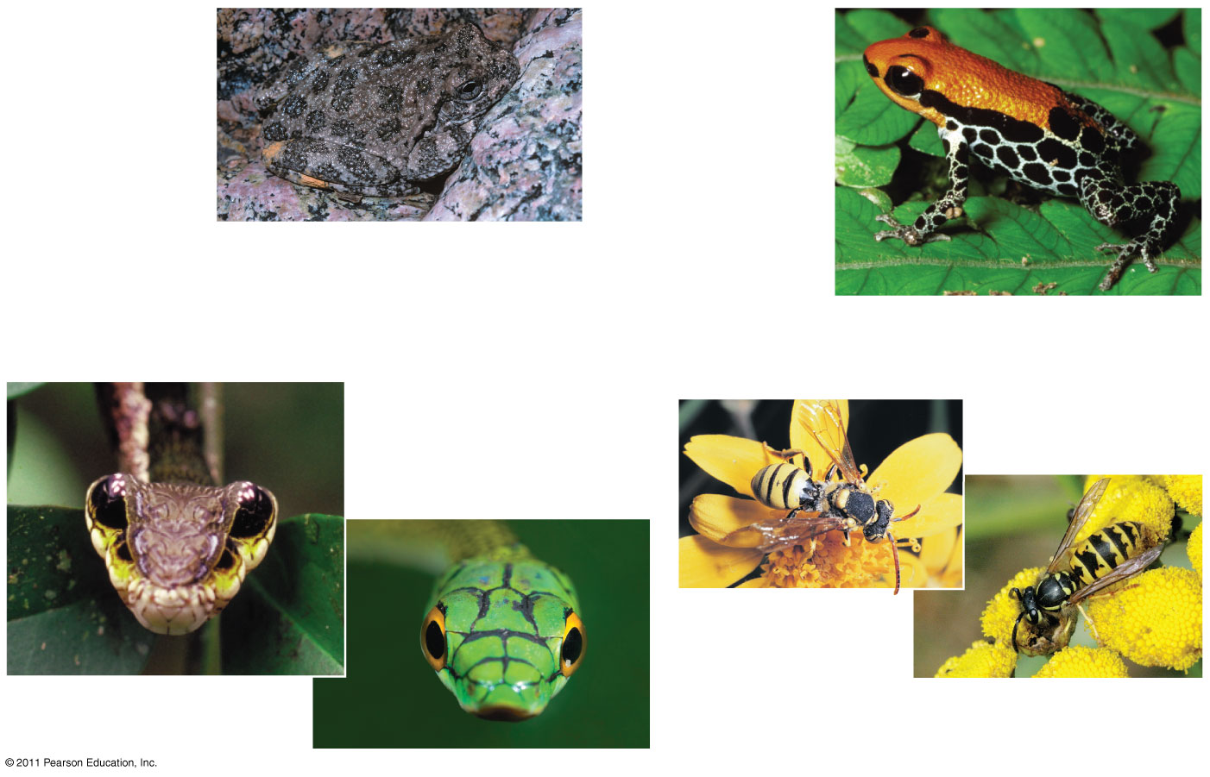
Figure 54.5
(a) Cryptic coloration
(b) Aposematic
coloration
Canyon tree frog
Poison dart frog
(c) Batesian mimicry: A harmless species mimics a harmful one.
(d) Müllerian mimicry: Two unpalatable species
mimic each other.
Hawkmoth
larva
Cuckoo bee
Yellow jacket
Green parrot snake
Notes:
Figure 54.5 Examples of defensive coloration in animals.

Slide 11
Herbivory
Herbivory (+/– interaction) refers to an interaction in which an herbivore eats parts of a plant or alga
Herbivory has led to evolution of plant mechanical and chemical defenses and adaptations by herbivores

Slide 12
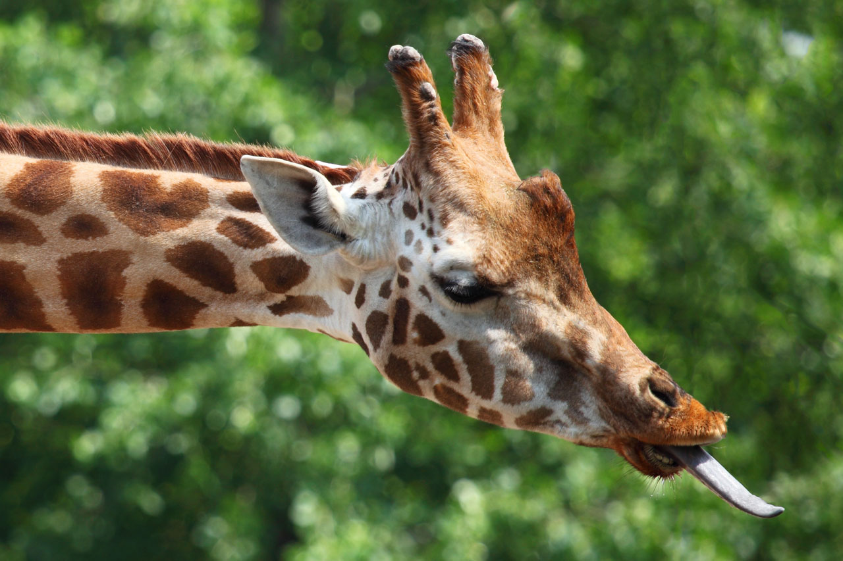
http://publicdomainpictures.net
National Geographic Giraffe and Acacia
Notes:
Figure 54.6 A West Indies manatee (Trichechus manatus) in Florida.

Slide 13
Symbiosis
Symbiosis is a relationship where two or more species live in direct contact with one another

Slide 14
Parasitism
In parasitism (+/– interaction), one organism, the parasite, derives nourishment from another organism, its host, which is harmed in the process
Disease is often caused by a form of parasite
Parasites that live within the body of their host are called endoparasites
Parasites that live on the external surface of a host are ectoparasites

Slide 15
Mutualism
Mutualistic symbiosis, or mutualism (+/+ interaction), is an interspecific interaction that benefits both species
Obligate--one species cannot survive without the other
Facultative--both species can survive alone

Slide 16
Commensalism
In commensalism (+/0 interaction), one species benefits and the other is neither harmed nor helped
Commensal interactions are hard to document in nature because any close association likely affects both species

Slide 17
Facilitation
Facilitation (+/+ or 0/+) is an interaction in which one species has positive effects on another species without direct and intimate contact
For example, the black rush makes the soil more hospitable for other plant species

