Slide 1
Biology
Chapter 2 Section 1

Slide 2
Matter
Organisms are composed of matter
Matter is:
Matter is composed of atoms of elements
Elements are the simplest form of matter
Elements are defined by the number of protons in an atom’s nucleus
Matter can be pure substance or mixture

Slide 3
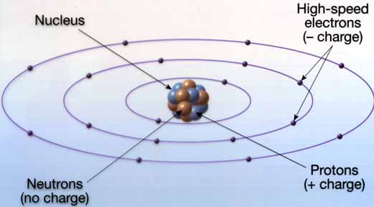
Atoms
An atom is the smallest part of an element that still has the properties of the element (pure substance)
Atoms have a nucleus with protons (and neutrons)
Electrons surround the nucleus in energy levels
Image from https://wsc11sci.wikispaces.com/

Slide 4
Numbers!
Atoms of elements differ in number of subatomic particles
An element’s atomic number is the number of protons in its nucleus
An element’s mass number is the sum of protons plus neutrons in the nucleus
Average Atomic mass, the mass on the periodic table, is the average of all possible isotopes’ masses for that element

Slide 5
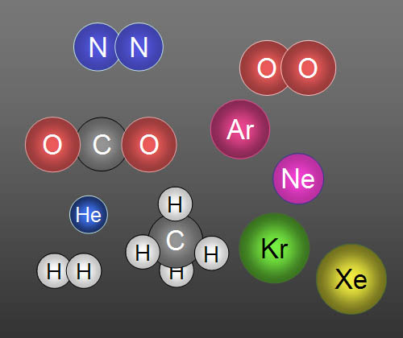
Bonding
All atoms except those of the noble gases have electron arrangements that are not stable
Bonding atoms make compounds (pure substance)
Molecules form when atoms of nonmetals (and hydrogen) share electrons (covalent bond)
Ions (and ionic compounds) form when metals and nonmetals transfer electrons (ionic bond)
Image from https://wsc11sci.wikispaces.com/Matter

Slide 6
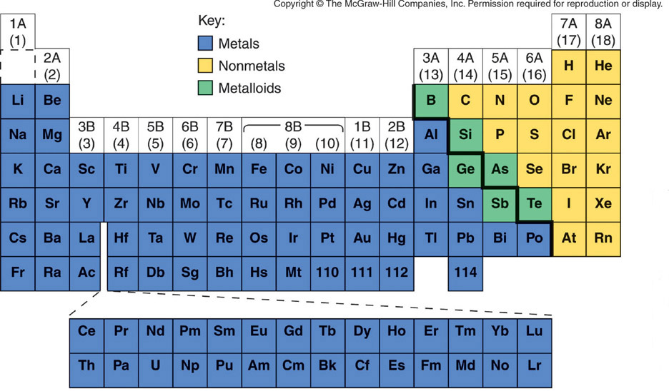
Who bonds with who?
Bonding for most elements follows the ‘octet rule’
Nonmetal bond with nonmetal→ covalent
Metal bond with nonmetal→ ionic
www.chem.uci.edu
The periodic table represents the electron arrangement of atoms

Slide 7
Properties
Properties are characteristics or measurable observations
Physical properties are measured by observing without changing the substance
Examples:
Chemical properties are measured as the substance takes part in a chemical change
Examples:
Both physical and chemical properties of substances are important to living things

Slide 8
Chemical Reactions
Chemical reactions (changes in bonding) are represented by chemical equations
Equations show reactants and products
Equations give formula
Equations must follow the Law of Conservation

Slide 9
Mixtures
Mixtures are physical combinations of pure substances
May be separated using physical means
Heterogeneous: materials are not evenly combined
Homogeneous: materials are evenly combined (solution)

Slide 10
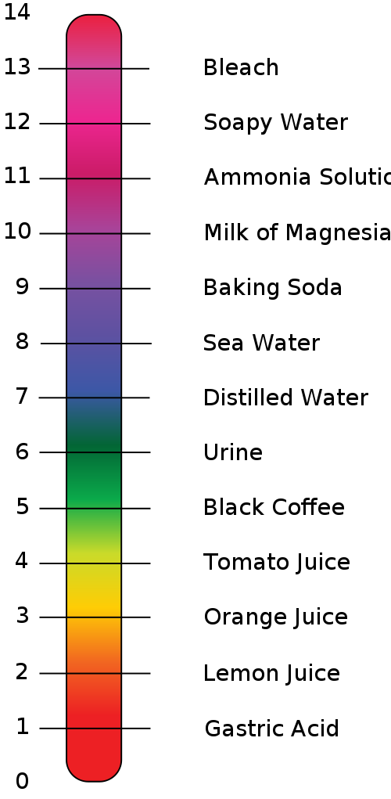
Acids and Bases
Acids and bases are solutions
Whether a substance is acid or base is determined by pH
pH measures the concentration of hydrogen ions in a solution
Ph greater than 7 indicates base, less than 7 indicates acid
Chemical indicators change color when ph changes
Cells often use buffers to maintain a relatively constant ph

Slide 11
Acid
Acids have high hydrogen (H+) ion concentrations
Acids turn litmus red
Acids have ph between 0 and 7
Acids taste sour
acids often react with metal and carbonate compounds
Most rainwater is slightly acidic

Slide 12
Bases
Bases have high hydroxide (OH-) ion concentrations
Bases turn litmus blue
Bases have ph between 7 and 14
Bases taste bitter
Bases are often corrosive
Bases are often used as cleaning materials
Human blood is slightly basic, with ph from 7.35-7.45 normally

