Slide 1
Organic Compounds
Things with Carbon and Hydrogen!

Slide 2
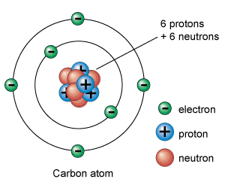
Carbon
Carbon is the backbone of organic molecules
Carbon is unique because it can form single, double and triple covalent bonds
Carbon wants to form 4 covalent bonds

Slide 3
Isomers
Carbon molecules with more than 3 carbons form different arrangements of the atoms
These molecules, with the same formula but with different structure, are called isomers
Isomers have different chemical and physical properties

Slide 4
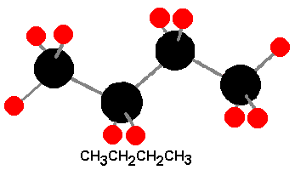
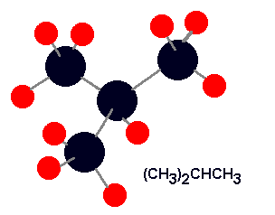
Isomers
Formula is C₄H₁₀
Isomers are butane and 2-methylpropane
Structural formula shows the difference
Butane
2-methylpropane

Slide 5
Metabolic Pathways
Chemical reactions occur in the cells
One chemical is modified and changed into another chemical
Two main pathways:
  Anabolism
  Catabolism

Slide 6
Anabolism
Smaller chemicals come together to form larger (and more complex) chemicals
Organic chemicals typically do this by dehydration synthesis (also called condensation) reactions
Example: C₆H₁₂O₆ + C₆H₁₂O₆ → C₁₂H₂₂O₁₁ + H₂O

Slide 7
Catabolism
Large molecules are broken down into smaller ones
Organic molecules commonly do this by hydration (adding water chemically)
Example: C₁₂H₂₂O₁₁ + H₂O → C₆H₁₂O₆ + C₆H₁₂O₆

Slide 8
Organic Molecules
Commonly broken into main categories:
  Carbohydrates
  Lipids
  Proteins
  Nucleic Acids

Slide 9
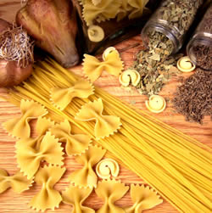
Carbohydrates
Important to the cell in energy storage, structure of the cell, immune system and development
Compounds containing mainly carbon, hydrogen and oxygen

Slide 10
Carbohydrate
General formula is (CH₂O)_{n}, but some carbohydrates may differ from this
Simplest carbohydrates are called monosaccharides
Two monosaccharides bonded together are called a disaccharide
Multiple monosaccharides bonded together are called a polysaccharide

Slide 11
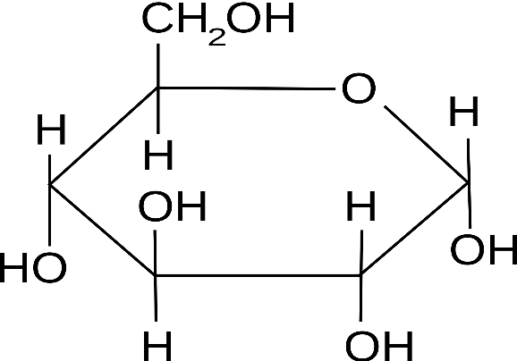
Monosaccharides
From 3-10 carbons bonded with hydrogen and oxygen atoms
Many isomers exist
Simplest forms of carbohydrate
Many are ring structures
Energy stored in bonds between carbon, hydrogen and oxygen
Example: glucose C₆H₁₂O₆

Slide 12
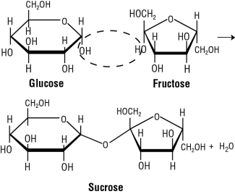
Disaccharides
Two monosaccharides joined by dehydration synthesis
Example: sucrose (table sugar) C₁₂H₂₂O₁₁ formed when fructose joins with glucose
C₆H₁₂O₆ + C₆H₁₂O₆ → C₁₂H₂₂O₁₁ + H₂O

Slide 13
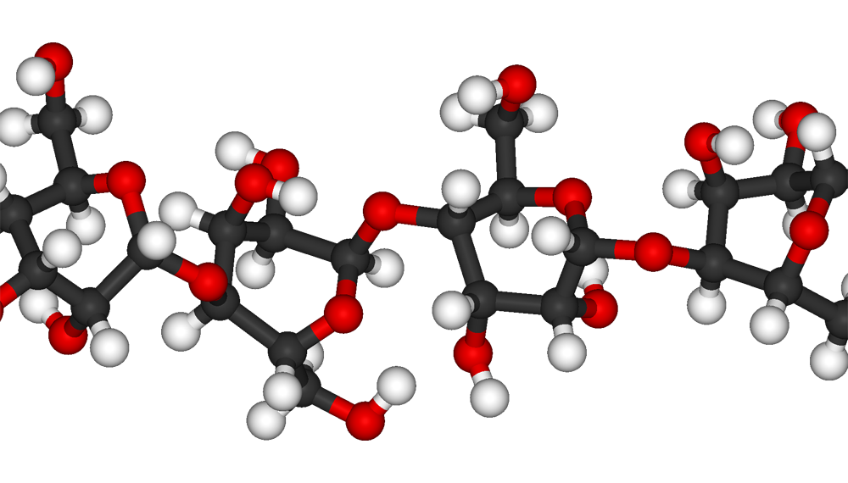
Polysaccharides
Many monosaccharides join together by dehydration synthesis to make large complex molecules
May be chains or branched
Often do not taste sweet

Slide 14
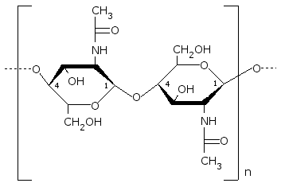
Polysaccharides
Examples:
  Starch
  Glycogen
  Cellulose
  Chitin →

Slide 15
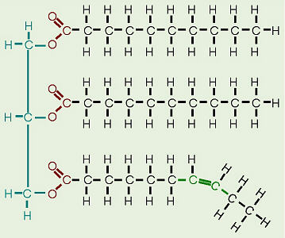
Lipids
Fat soluble, naturally occurring chemicals
Used by cells as energy storage, structural components and as signaling chemicals

Slide 16
Lipids
Steroids are lipids with 4 joined ring structures
2 main kinds of molecules join by dehydration synthesis to form fats
  Glycerol (a 3 carbon alcohol)
  Molecules attached to the carbons of glycerol
  Attached molecules may be:
    Fatty acids
    Phosphate

Slide 17
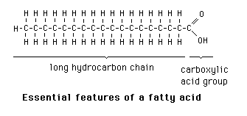
The Fatty Acid chain
Fatty acids are long hydrocarbon chains, with from 4 to 30 carbons

Slide 18
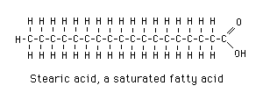
Saturated Fatty Acids
Single bonds between carbons
Saturated with hydrogen
Often solid at room temperature
Often produced as animal fat

Slide 19
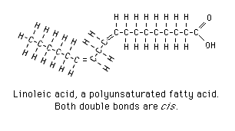
Unsaturated Fatty Acids
Some double bonds exist between carbons
Less saturated with hydrogen
Often liquids at room temperature
Often produced as plant oils

Slide 20
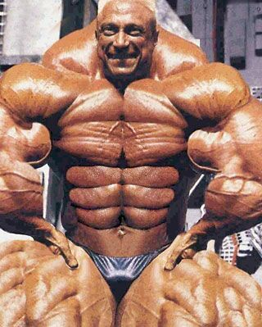
Steroids

Slide 21
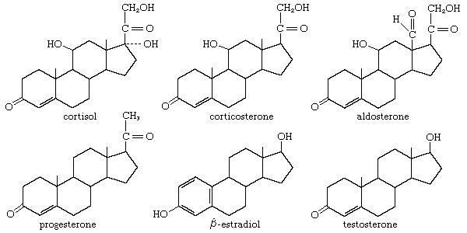
Steroids
Structurally different from fats
Not soluble in water, so classified as lipids
Important as chemical messengers and in structure of cell
Contain 4 ring structures

