Slide 1
Organic Compounds
Part 2

Slide 2
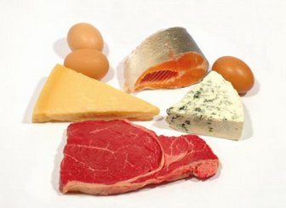
Proteins
Long chains (polymers) of amino acids
Used by cells for structure, for information transfer, and for control of chemical reactions

Slide 3
Structure of Proteins
Structure has 4 levels
Primary structure: order amino acids to make a polypeptide chain
This order is controlled by DNA

Slide 4
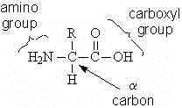
Amino acids
The building blocks of polypeptide chains
20 commonly found in proteins in living things
These differ in ‘R’ group
In peptide bonding, the carboxyl group of one amino acid joins to the amine group of the next (dehydration synthesis)

Slide 5
Peptide Bond
Joins two amino acids to make a dipeptide
Many amino acids join to make a polypeptide
Order of amino acids is controlled by nucleic acids
Polypeptides differ in the number and sequence of amino acids

Slide 6
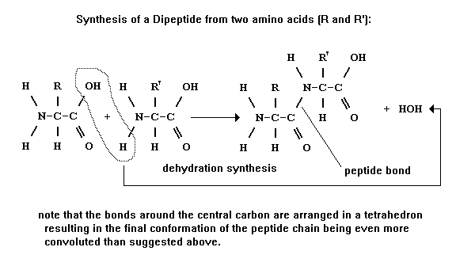
Peptide bond formation

Slide 7
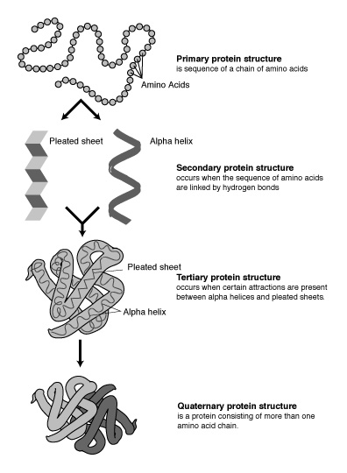
To make a protein:
Once the proper order of amino acids exists, the secondary, tertiary and quaternary structures are formed

Slide 8
Structure of Proteins
Structure has 4 levels
Primary structure: order amino acids to make a polypeptide chain
Secondary structure: H bonds form between R groups of amino acids in polypeptide
Tertiary structure: the entire structure twists and bonds again (usually H bonds)‏
Quaternary structure: association of 2 or more polypeptide chains to make protein

Slide 9
Protein
The shape of the molecule is everything!
Shape is controlled by order of amino acids and higher level structural changes.

Slide 10
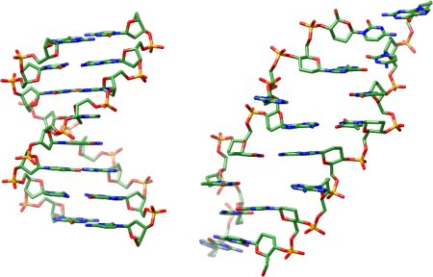
Nucleic Acids
Composed of chain of nucleotides
Controls cell activities
Two main varieties:
RNA
DNA

Slide 11
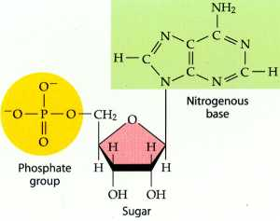
Nucleotides
A particle composed of a sugar (5 C ring structure), phosphate group, and base

Slide 12
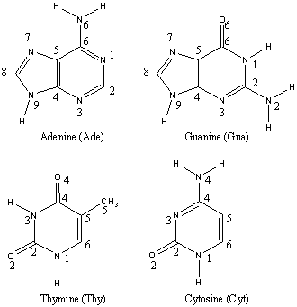
Nucleotides
Each nucleotide has one of four bases
The order of the bases in the macromolecule contains a code for protein formation

Slide 13
DNA
Sugar is deoxyribose
Remains in nucleus in eukaryotic organisms as long strands
Circular strand in prokaryotic organisms
Contains the genetic instructions for operation of cell

Slide 14
RNA
Sugar is ribose
Several varieties of RNA do differing jobs
mRNA carries instructions from the DNA to the ribosomes and assists in protein manufacture

