Slide 1
Energy
And reactions!

Slide 2
Objectives
Distinguish between potential and kinetic energy using examples
Understand the relationship between a reaction and activation energy
Describe how enzymes facilitate reactions in cells

Slide 3
Energy
The ability to do work
Work is:

Slide 4
Energy
There are two general categories of energy:

Slide 5
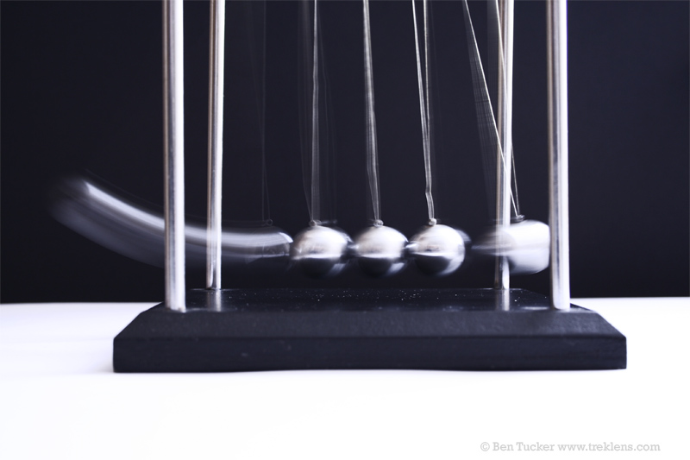
Energy
There are two general categories of energy:
Kinetic energy: energy an object possesses due to its movement

Slide 6
Energy
There are two general categories of energy:
Kinetic energy: energy an object possesses due to its movement
Potential energy: energy of position or stored energy

Slide 7
Law of Conservation of Energy
Energy cannot be created or destroyed
It can be transformed from one form to another

Slide 8
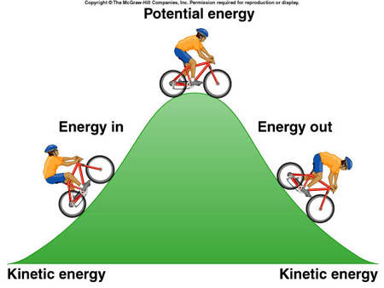
Law of Conservation of Energy
Energy cannot be created or destroyed
It can be transformed from one form to another

Slide 9
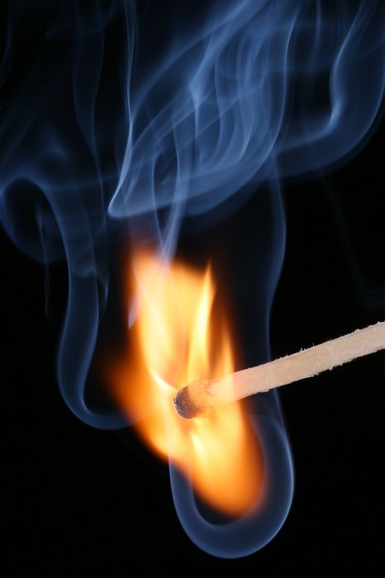
Activation energy
Energy required to begin a chemical reaction

Slide 10
Activation energy
In self-sustaining reactions, the activation energy needed to keep the reaction going comes from the energy given off by the reaction

Slide 11
Enzymes
Proteins that lower the activation energy for reactions inside the cell
Specific—can only affect one type of reaction
Are not used up in the reaction
May speed up reaction by aligning reactants
Substrate—the substance the enzyme works on

Slide 12
Enzyme Function
Lock and key model—part of the enzyme (active site) fits to a shape in the substrate and causes the reaction to occur
This model has been shown to be inaccurate, but does give us some idea of the importance of shape

Slide 13
Enzyme Function
Induced Fit model—enzyme changes shape as reaction proceeds
Active site of enzyme continues to change shape until substrate involved in reaction is used up

Slide 14
Coenzymes
Also called cofactors
Non-protein particles required for enzymes to work
May join with enzyme, causing its shape to change and match substrate
May be inorganic particles like metals
May be organic particles like vitamins

Slide 15

Energy and Chemical Reactions
Life requires energy and chemical reactions

