Slide 1
The Cell
Theory and Membrane
Biology Chapter 4 Section 1

Slide 2
Objectives
Describe the discovery of the cell
Know the important discoveries that led to the cell theory
Relate the properties of the cell membrane (plasma membrane) to its structure

Slide 3
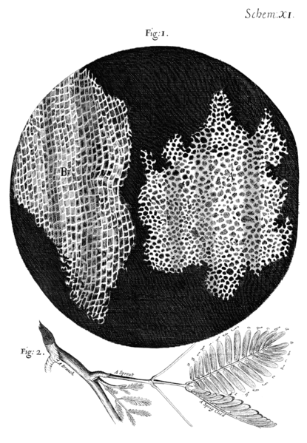
Cell Theory
First recorded view by Robert Hooke in 1665
Cork structures look like monks' cells

Slide 4

Cell Theory
Antonie van Leeuwenhoek viewed living cells in 1674
Named moving objects in pond water animalcules (little animals)‏
Henri Dutrochet—1837
“The cell is the fundamental element of organization.”
Matthias Schleiden—1837
All plants are composed of cells that come from other plant cells

Slide 5
Cell Theory
Theodor Schwann—1838
Animals have cells and those come from other animal cells
Schleiden and Schwann: All living things have at least one cell (VIDEO)
Rudolf Virchow—1858
Cells come from pre-existing cells (refutes spontaneous generation)‏

Slide 6
Cell Theory
All living things have at least one cell
The cell is the basic unit of structure and function in organisms
All cells are produced from other cells
Video

Slide 7
All Cells
Cell membrane
Cytoplasm
Usually live in fluid environment

Slide 8
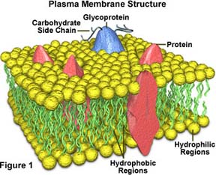
Plasma Membrane
Also called cell membrane
Controls what goes into and comes out of cell
Selectively permeable

Slide 9
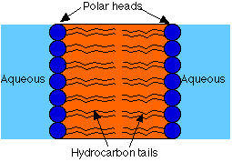
Plasma Membrane
Lipid bilayer made of phospholipids
Phosphate portion is attracted to water, while tails of fatty acid are repelled by water

Slide 10
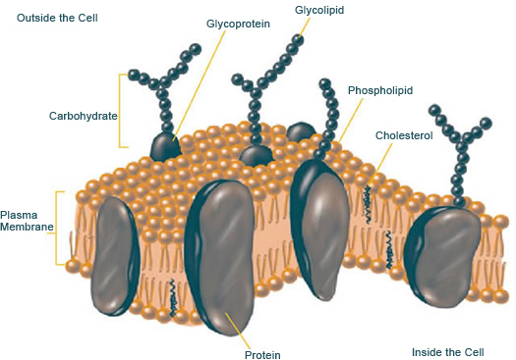
Plasma Membrane
Proteins extend through structure to enable transport
Glycolipids and cholesterols help maintain shape and function

Slide 11
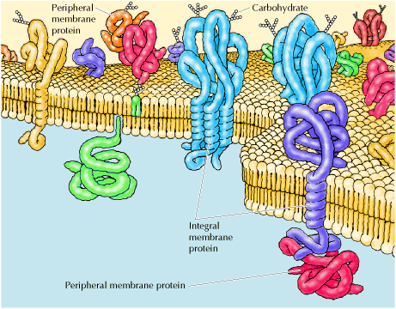
Fluid Mosaic Model
Proposed by S. J. Singer and Garth Nicolson
Proteins are free to move around in fluid phospholipid layer

Slide 12
Cell Theory
All living things have at least one cell
The cell is the basic unit of structure and function in organisms
All cells are produced from other cells
Video

Slide 13
Other Membranes
Internal cell structures (organelles)‏
Membrane composition and structure differs slightly for organelles
Function depends on structure

Slide 14
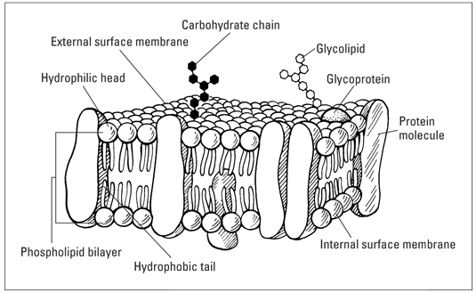
Cell membrane VIDEO

