Slide 1
Active Transport
Biology Chapter 4 Section 2

Slide 2
Objectives
Understand the ways various substances enter cells
Compare and contrast the processes of active and passive transport

Slide 3
Active Transport
Cell uses energy (ATP)
Movement is against the concentration gradient (uphill)
Movement is from low concentration areas to high concentration areas

Slide 4
3 types of active transport
Protein Pumps
Protein recognizes shape/charge of particle
Protein changes shape to pull particle through membrane
Example: Sodium/potassium pump (VIDEO)

Slide 5
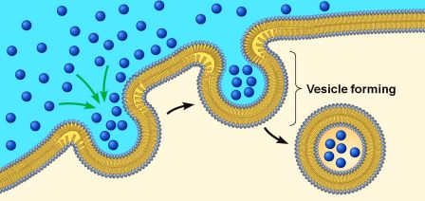
3 types of active transport
Endocytosis
Taking large particles into the cell
Cell membrane folds around a particle, forming a container (vacuole)—changing shape requires energy
Receptor-mediated endocytosis
Phagocytosis
Pinocytosis

Slide 6
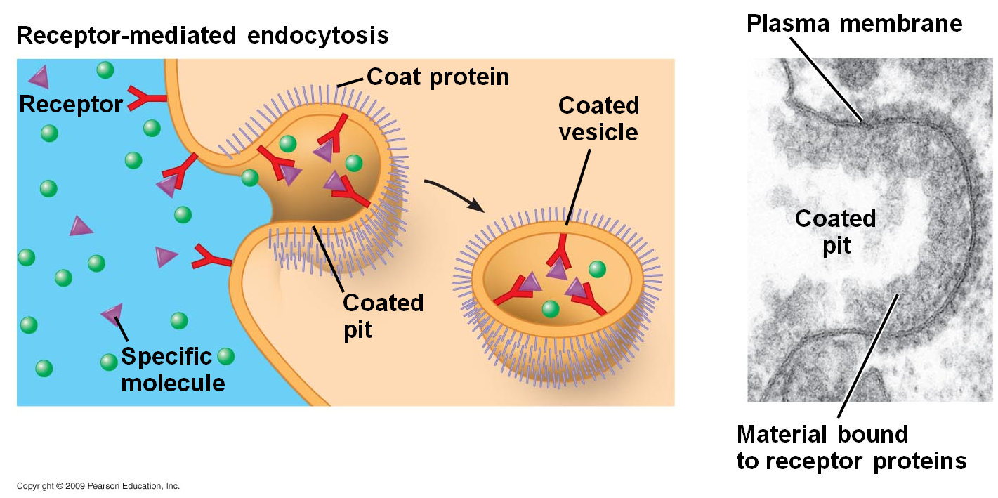
3 types of active transport

Slide 7
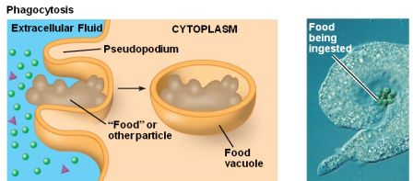
3 types of active transport

Slide 8
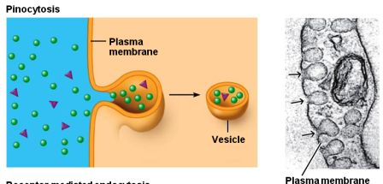
3 types of active transport

Slide 9
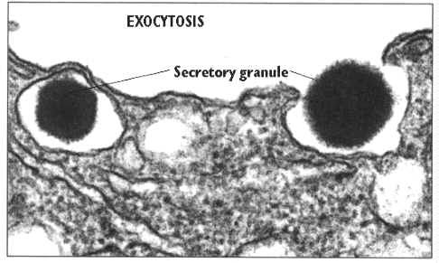
3 types of active transport
Exocytosis
Large amount of material forced out of cell
Vacuole containing material fuses with cell membrane and pushes out material

Slide 10
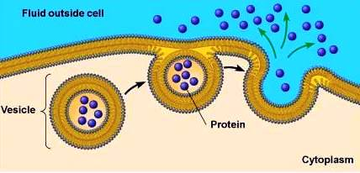
3 types of active transport
Exocytosis

Slide 11
Cell Membranes are Selectively Permeable!
Video Bozeman
Video Crash Course

