Slide 1
Structure of Cells
Biology Chapter 5 section 1

Slide 2
Objectives
Recognize the differences between unicellular and multicellular organisms
Describe the levels of organization from cells to organism
Discuss the importance of common organelles to cellular function

Slide 3
One Celled Organisms
Unicellular organisms do not make tissues
Each cell must be able to do all living functions
What are the functions all living things must be able to do?

Slide 4
Living Things
What are the functions all living things must be able to do?
  Organize structures and cells
  Use energy to maintain cells (respiration)
  Grow and develop
  Reproduce
  Maintain homeostasis
  Respond to environment

Slide 5
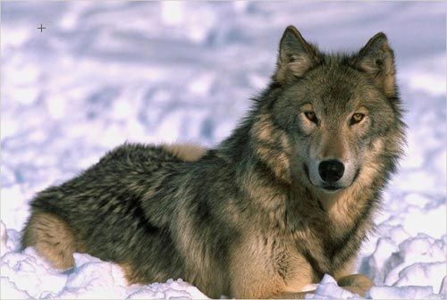
Multicellular Organisms
Cells must work together
Not all cells must do all jobs, some specialize
  Multicellular organisms have tissues, organs and organ systems
Cells depend on other cells

Slide 6
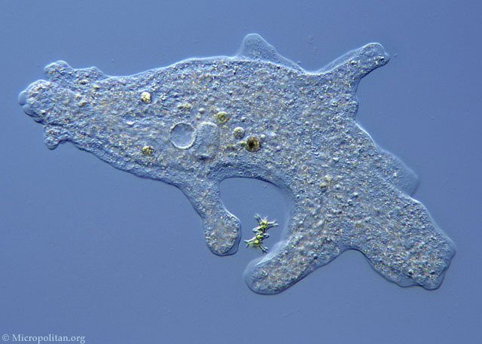
Every cell has:
Whether unicellular or multicellular, every cell has:
Cell (plasma) membrane
  Controls what enters and leaves cell
Cytoplasm
  Chemical reactions occur here
Nucleic acid
  Instructions for cell functions
  Video

Slide 7
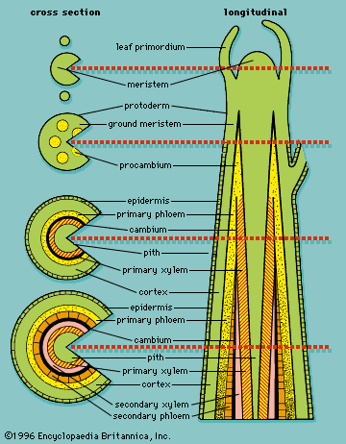
Organization
Tissues are groups of similar cells grouped together to do one job.

Slide 8
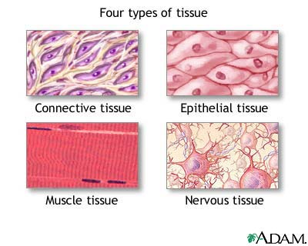
Animal Tissues
Animals have 4 basic types of tissue:
Connective tissue
Epithelial tissue
Muscle tissue
Nervous tissue

Slide 9
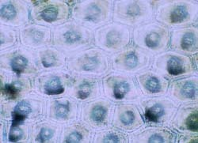
Plant Tissue
Plants have tissues too!
Epidermis tissue
Vascular tissue
Ground tissue

Slide 10
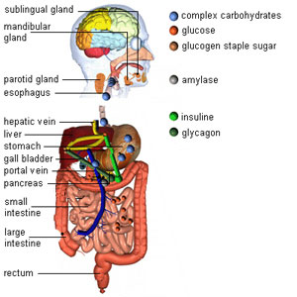
Organs
An organ is a group of (different) tissues working together to do a job.

Slide 11
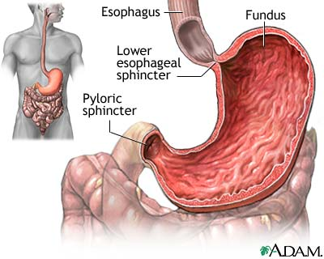
Animal Organs
Animal organs help the animal do the functions of life.
Heart
Lungs
Brain
Stomach

Slide 12
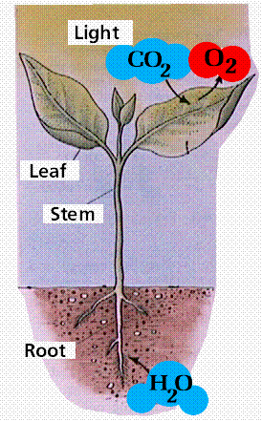
Plant Organs
Plant organs help the plant do the functions of life.
Roots
Stems
Leaves
Flowers
Fruits

Slide 13
Organ Systems
A group of organs working together to help the multicellular organism live
Animals: circulatory system, reproductive system, digestive system, integument
Plants: root system, shoot system, reproductive system

Slide 14
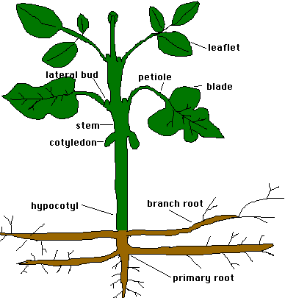
An organism!
Groups of cells organized into tissues, organs and organ systems working together.

Slide 15
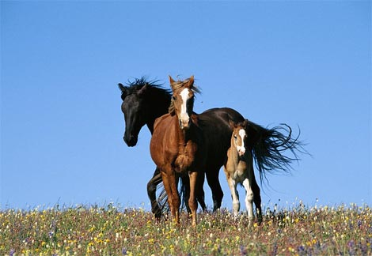
An organism!
Groups of cells organized into tissues, organs and organ systems working together.

