Slide 1
Photosynthesis
The story of Light!
Chapter 6 Section 2

Slide 2
Objectives
Describe how light transmits energy
Describe the interactions of light with objects (including chlorophyll)
Understand the relationship of the light dependent and light independent reactions of photosynthesis
Describe how chemosynthesis differs from photosynthesis
Analyze the relationship between photosynthesis and aerobic respiration

Slide 3
Waves
Waves are a method of transmitting energy by a disturbance
Two types:
Longitudinal: disturbance moves parallel to direction of wave
Transverse: disturbance moves perpendicular to direction of wave
We can measure wavelength, frequency, amplitude of waves

Slide 4
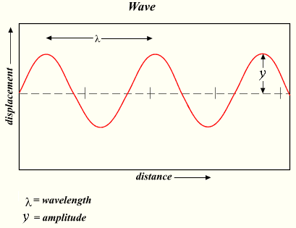
Transverse wave

Slide 5
Wave equation
Velocity equals frequency times wavelength
V = f λ
We can use this for any kind of wave
The importance of this relationship:

Slide 6
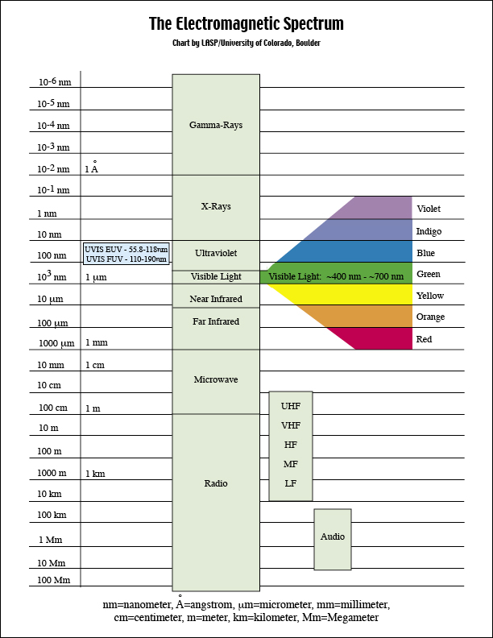
Electromagnetic spectrum: all the wavelengths of energy that travel at the speed of light

Slide 7
COLORS
Objects appear to be colors because they reflect that wavelength (or combination of wavelengths)‏
Why do leaves of plants appear green?

Slide 8
Chlorophyll!
Found in thylakoid membrane of chloroplast
Pigment that absorbs most wavelengths of visible light (esp blue - red)
Reflects yellow-green
Absorbed light transfers energy to Photosystems (series of proteins acting as enzymes) of Photosynthesis

Slide 9
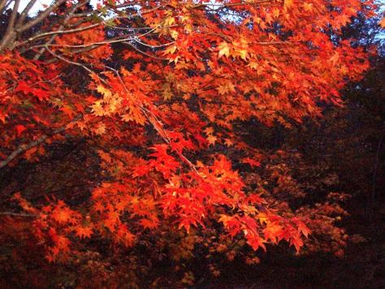
Other pigments

Slide 10
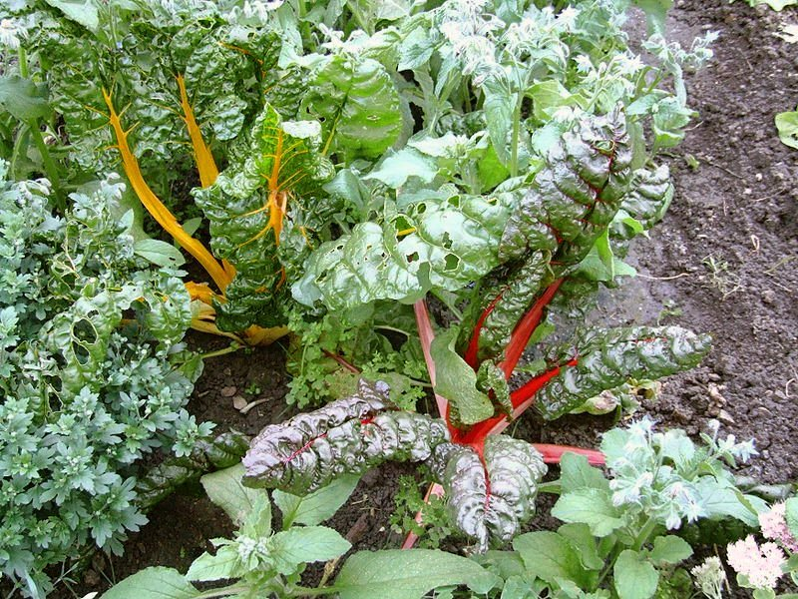
Other pigments
Carotenoids: absorb blue-green, reflect red-orange
Anthocyanins: reflect blue
Betalains: reflect red-yellow (only in plants without anthocyanins)
https://en.wikipedia.org/wiki/Betalain

Slide 11
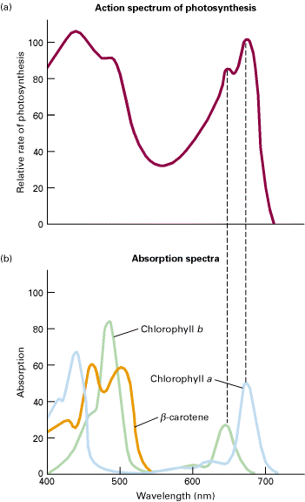
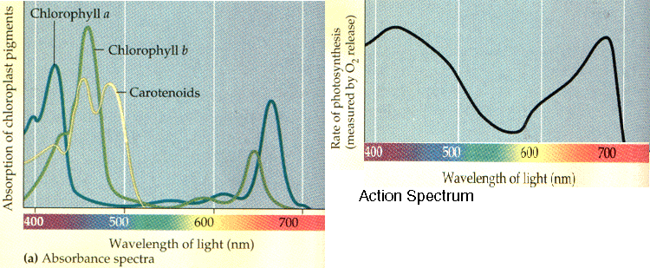
Different pigments absorb light differently

Slide 12
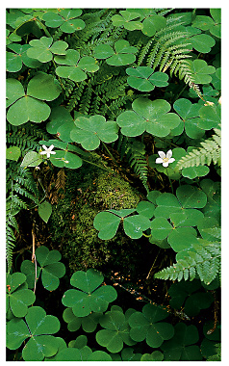
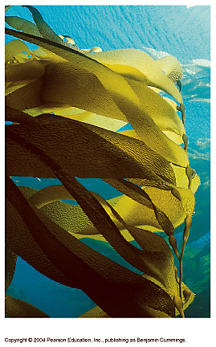
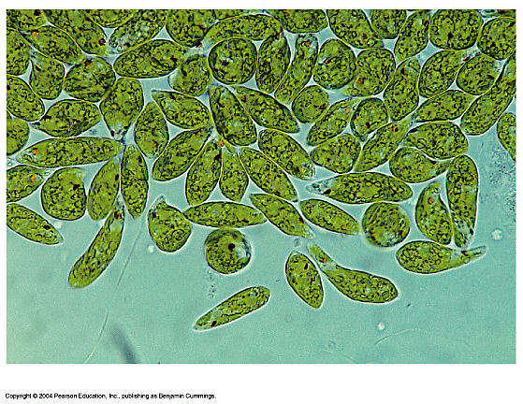
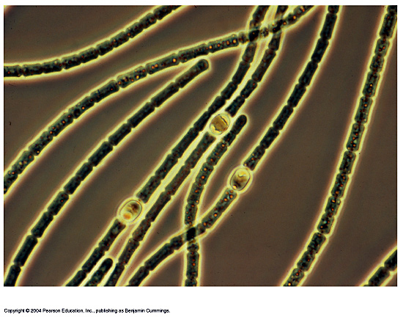
THE BASICS OF PHOTOSYNTHESIS
Almost all plants are photosynthetic autotrophs, as are some bacteria and protists
Sunlight energy is transformed to energy stored in the form of chemical bonds
(c) Euglena
(d) Cyanobacteria
(b) Kelp
(a) Mosses, ferns, and
flowering plants

