Slide 1
How do we know that plants make carbohydrates from just carbon dioxide water and light energy?
Experiments!
For example:
Jan Baptisa van Helmont (1648) planted a willow branch weighing 5 pounds into 200 pounds of soil. After 4 years the tree weighed 169 lbs. and the soil was still nearly 200 lbs.

Slide 2
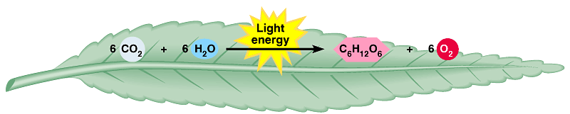
AN OVERVIEW OF PHOTOSYNTHESIS
Photosynthesis is the process by which autotrophic organisms use light energy to make sugar and oxygen gas from carbon dioxide and water
Carbon dioxide
Water
Glucose
Oxygen gas
PHOTOSYNTHESIS

Slide 3
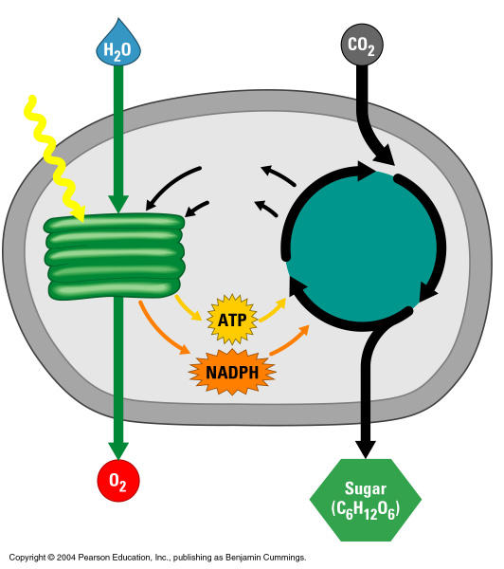
AN OVERVIEW OF PHOTOSYNTHESIS
The light reactions convert solar energy to chemical energy
Produce ATP & NADPH
Light
Chloroplast
NADP⁺
ADP
+ P
The Calvin cycle makes sugar from carbon dioxide
ATP from the light reactions provides the energy for sugar synthesis
The NADPH produced by the light reactions provides the electrons for the reduction of carbon dioxide to glucose
Calvin
cycle
Light
reactions

Slide 4
Steps of Photosynthesis
Light hits reaction centers of chlorophyll, found in chloroplasts in thylakoid
Chlorophyll vibrates when light strikes it and causes water to break apart.
Oxygen is released into air
Hydrogen remains in chloroplast attached to NADPH
“THE LIGHT REACTION”
and ATP is made

Slide 5
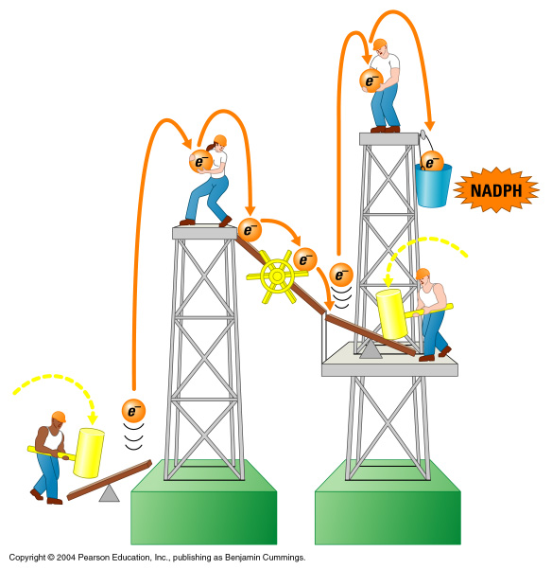
Two types of photosystems cooperate in the light reactions
Photon
ATP
mill
Photon
Water-splitting
photosystem
NADPH-producing
photosystem

Slide 6
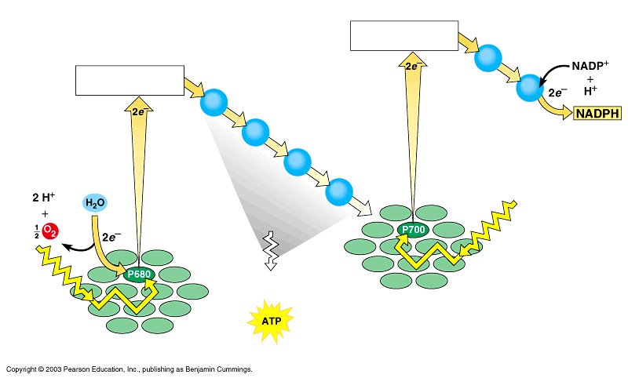


Noncyclic Photophosphorylation
Photosystem II regains electrons by splitting water, leaving O₂ gas as a by-product
Primary electron acceptor
Electron transport
Primary electron acceptor
Electron transport
Electron transport chain
Photons
PHOTOSYSTEM II
chemiosmosis
PHOTOSYSTEM I

Slide 7
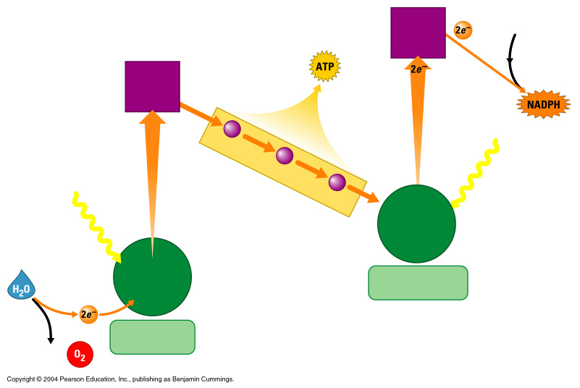
How the Light Reactions Generate ATP and NADPH
Primary
electron
acceptor
NADP⁺
Energy
to make
Primary
electron
acceptor
3
2
Light
Electron transport chain
Light
Primary
electron
acceptor
Reaction-
center
chlorophyll
NADPH-producing
photosystem
1
Water-splitting
photosystem
2 H⁺ + ¹/₂

Slide 8
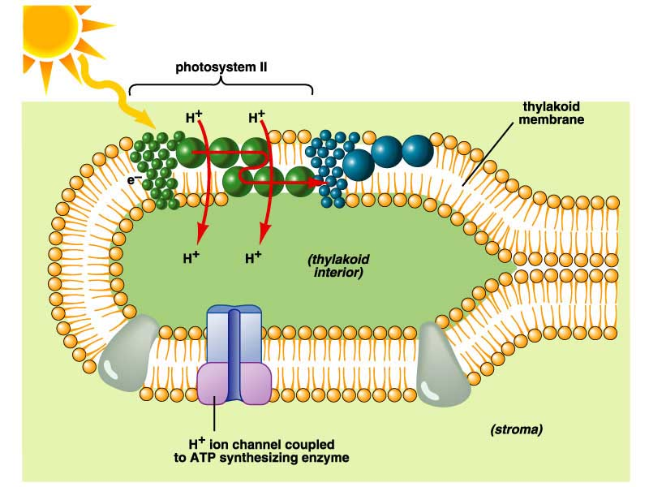

Slide 9
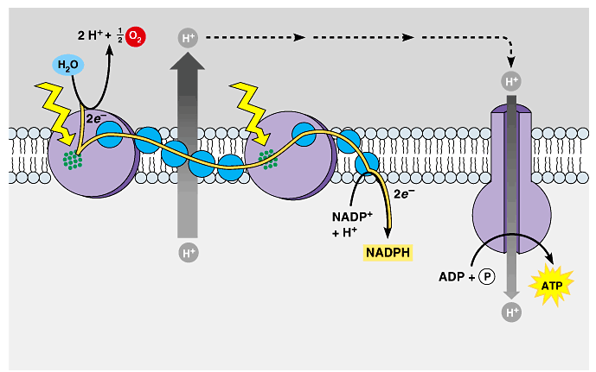
The production of ATP by chemiosmosis in photosynthesis
Thylakoid compartment (high H⁺)
Light
Light
Thylakoid membrane
Antenna molecules
Stroma (low H⁺)
ELECTRON TRANSPORT CHAIN
PHOTOSYSTEM II
PHOTOSYSTEM I
ATP SYNTHASE

Slide 10
Steps of Photosynthesis
The DARK (light independent) Reactions or Calvin Cycle
CO₂ from atmosphere is joined to form glucose
Glucose can be converted into other molecules with yummy flavors!

Slide 11
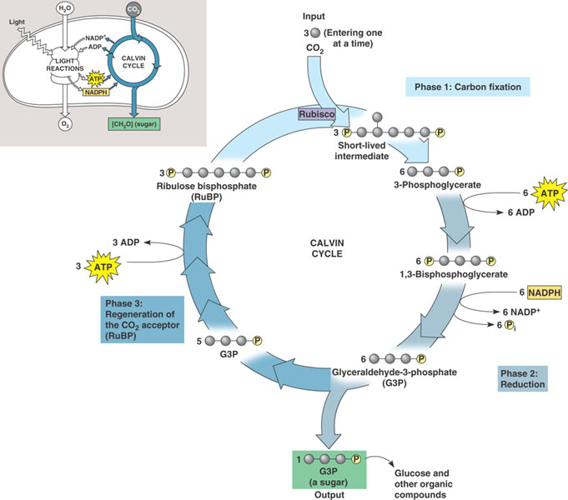
Light Independent Reactions aka Calvin Cycle
Carbon from CO₂ is converted to glucose
(ATP and NADPH drive the reduction
of CO₂ to C₆H₁₂O₆.)

Slide 12
Light Independent Reactions aka Calvin Cycle
CO₂ is added to the 5-C sugar RuBP by the enzyme rubisco.
This unstable 6-C compound splits to two molecules of PGA or 3-phosphoglyceric acid.
PGA is converted to Glyceraldehyde 3-phosphate (G3P), two of which bond to form glucose.
G3P is the 3-C sugar formed by three turns of the cycle.

Slide 13
Summary—Light Independent Reactions
Overall input
CO₂
ATP, NADPH (from light reactions)
Overall output
glucose.

Slide 14
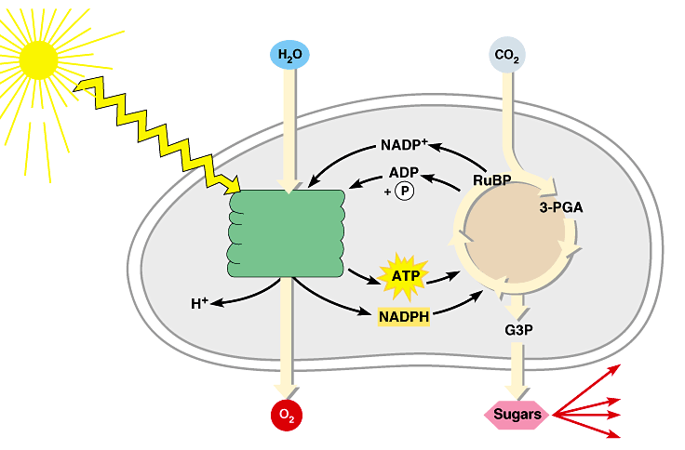
Review: Photosynthesis uses light energy to make food molecules
A summary of the chemical processes of photosynthesis
Chloroplast
Light
Photosystem II Electron transport chains Photosystem I
CALVIN CYCLE
Stroma
Electrons
Cellular respiration
Cellulose
Starch
LIGHT REACTIONS
CALVIN CYCLE
Other organic compounds

Slide 15
PHOTOSYNTHESIS
2 Phases
Light-dependent reaction
Light-independent reaction
Light-dependent: converts light energy into chemical energy; produces ATP molecules to be used to fuel light-independent reaction
Light-independent: uses ATP produced to make simple sugars.

Slide 16
Photosynthesis occurs in chloroplasts
In most plants, photosynthesis occurs primarily in the leaves, in the chloroplasts
A chloroplast contains:
stroma, a fluid
grana, stacks of thylakoids
The thylakoids contain chlorophyll
Chlorophyll is the green pigment that captures light for photosynthesis

Slide 17
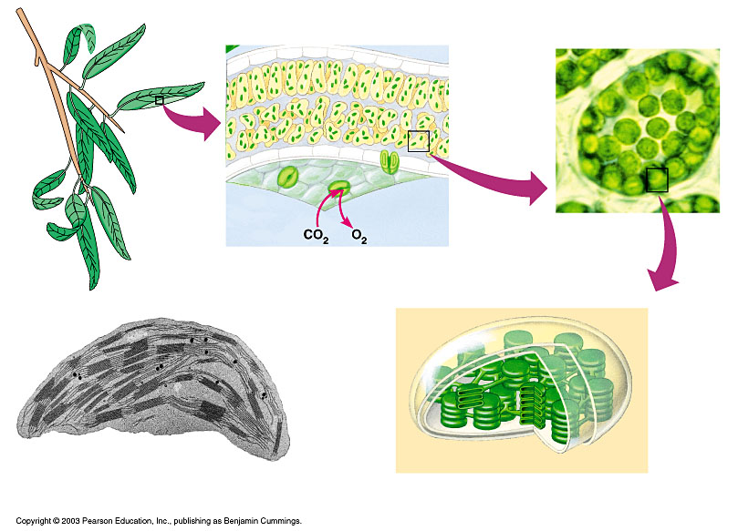
The location and structure of chloroplasts
LEAF CROSS SECTION
Chloroplast
MESOPHYLL CELL
LEAF
Mesophyll
CHLOROPLAST
Intermembrane space
Outer
membrane
Granum
Inner membrane
Grana
Stroma
Stroma
Thylakoid

