Slide 1
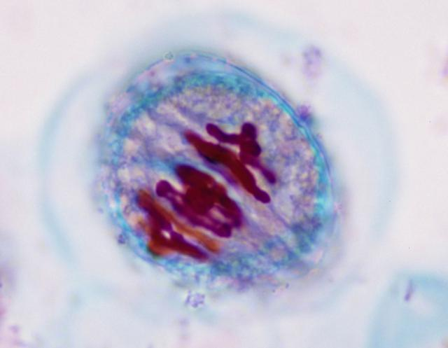
Meiosis and Variation
Image from about.com meiosis_metaphase_1.jpg

Slide 2
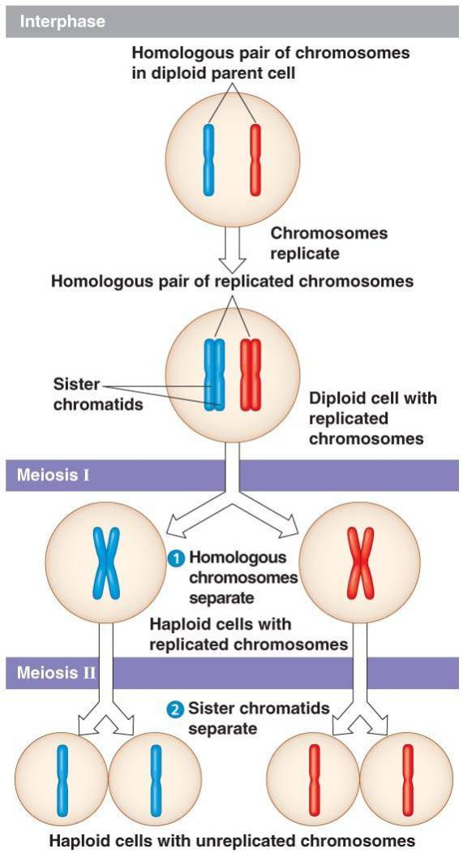

Slide 3
Sources of genetic variation
Mutations (changes in an organism’s DNA) are the original source of all genetic variation
Mutations create different versions of genes called alleles
Notes:
3

Slide 4
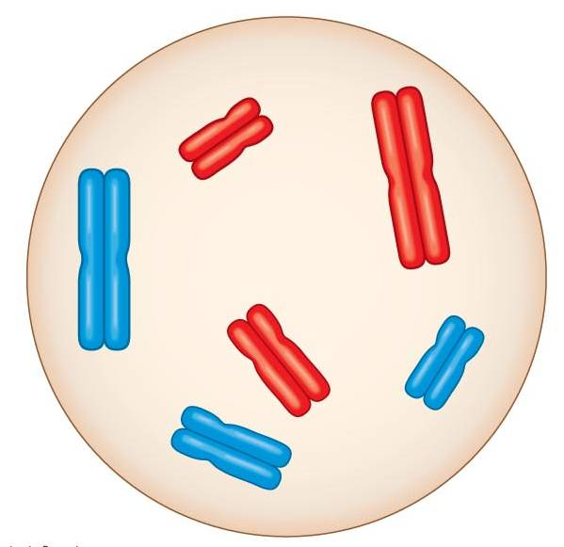

Homologous Chromosomes
SAME gene, different ALLELES
Gene for hair color;
Allele for blonde hair
Gene for hair color; allele
for brown hair
Notes:
4

Slide 5
Sources of genetic variation
The behavior of chromosomes during meiosis and fertilization reshuffles alleles and chromosomes every generation
Three mechanisms contribute to genetic variation:
Independent assortment of chromosomes (meiosis)
Crossing over (meiosis)
Random fertilization
Notes:
5

Slide 6
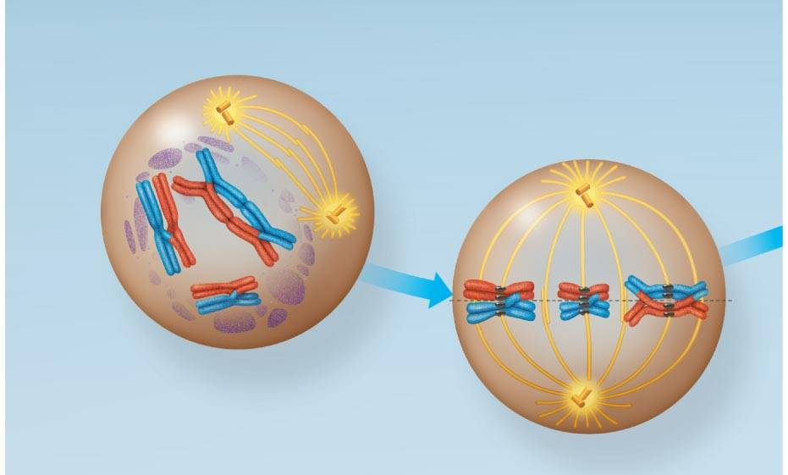
Sources of genetic variation
Fig. 13-8b
aassortment
Homologous pairs of chromosomes orient randomly during Meiosis I
→ maternal and paternal homologues assort into daughter cells independently of the other pairs
Metaphase I of meiosis I
Blue can be on top or bottom
Notes:
6
Figure 13.8 The meiotic division of an animal cell

Slide 7
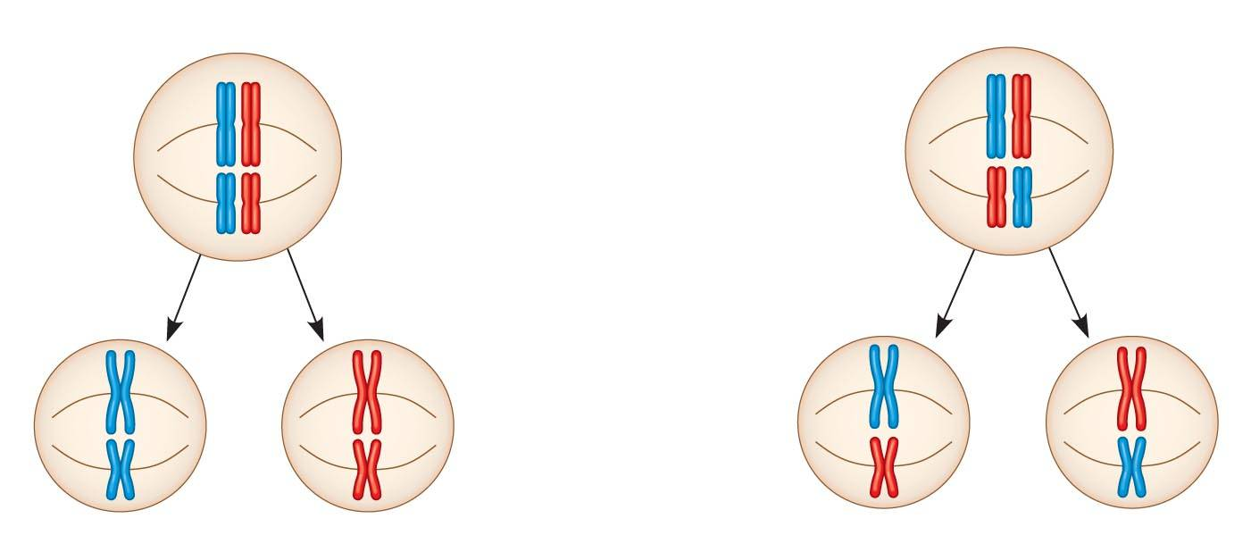
Sources of genetic variation
Fig. 13-11-2
a) Independent assortment
Possibility 1
Possibility 2
with n = 2
there are 2 possibilities
for lineup in meiosis I and 4 possibilities
for lineup during meiosis II
4 possible assortments of chromosomes in the gametes
Notes:
7
Figure 13.11 The independent assortment of homologous chromosomes in meiosis

Slide 8
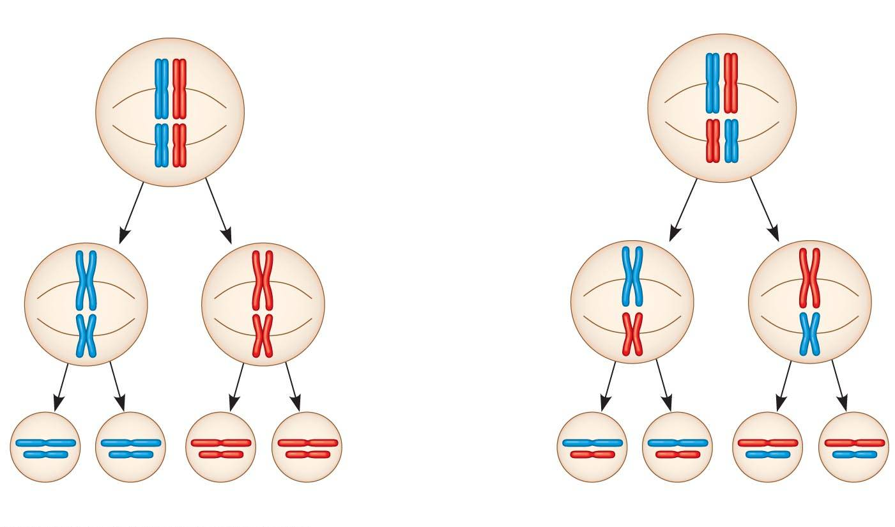
Sources of genetic variation
Fig. 13-11-3
a) Independent assortment
Possibility 1
Possibility 2
Metaphase II
Daughter
cells
Combination 1
Combination 2
Combination 3
Combination 4
Notes:
8
Figure 13.11 The independent assortment of homologous chromosomes in meiosis

Slide 9
Possible gametes
What are the possible gametes for a male with 2n = 4 and the genotype AaBb?

Slide 10
Sources of genetic variation
a) Independent assortment
“2^{n} rule”: the number of possible chromosome sorting combinations = 2^{n}
→ For humans (n = 23), there are 2²³ = 8,388,608 possible combinations of chromosomes based on independent assortment alone!
Notes:
10

Slide 11
Sources of genetic variation
b) Crossing over (Prophase of Meiosis I)
homologous chromosomes pair up gene by gene and exchange homologous segments
This combines alleles that originated from two (grand)parents into a single chromosome
blond hair from G’pa
red hair from G’ma
red hair from G’ma
blond hair from G’pa
brown eyes from G’ma
brown eyes from G’ma
blue eyes from G’pa
blue eyes from G’pa
Mom’s ovary cell
Notes:
11

Slide 12
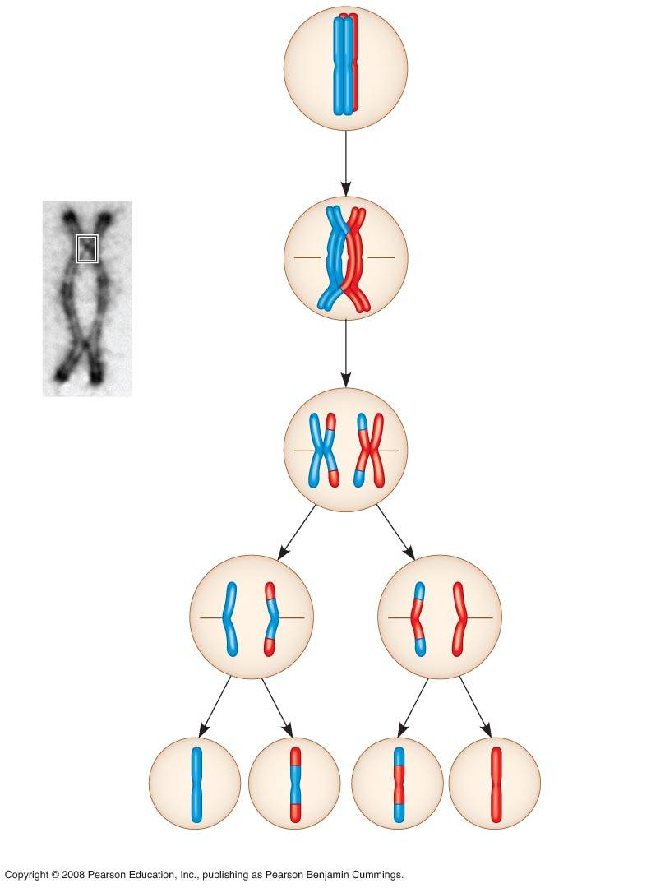
Sources of genetic variation
b) crossing over
Early in Meiosis I
Nonsister
chromatids
held together
during synapsis
Pair of
homologues
A single crossing over event leads to 4 genetically unique daughter cells!
during Meiosis I (at anaphase I)
during Meiosis II (at anaphase II)
Daughter
cells
Recombinant chromosomes
Notes:
12
Figure 13.12 The results of crossing over during meiosis

Slide 13
Sources of genetic variation
c) Random fertilization
8.4 million possible gametes
8.4 million possible gametes
> 70 trillion possible offspring!!!
Notes:
13

Slide 14
Fertilization
We will think more about this in future chapters. For now… what if our previous male (AaBb) mates with a female who is also AaBb? What possibilities are there for offspring. We use a Punnett square to determine this.

