Slide 1
Biology
Chapter 8 Section 1 Principles of Genetics--A

Slide 2
Objectives
Describe Mendel’s experiments and results
Explain the principles of genetics Mendel discovered

Slide 3
Definitions
Heredity: passing traits (characteristics) from parent to offspring
Genetics: study of heredity

Slide 4
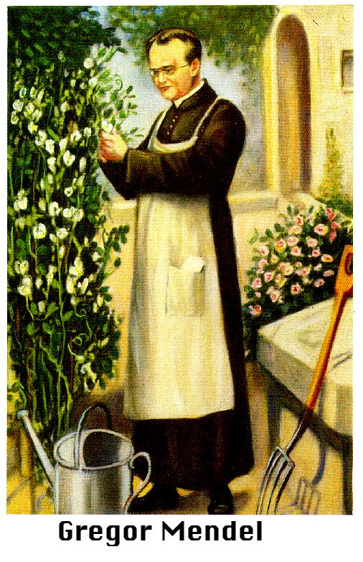
Who was Gregor Mendel?
Gregor Mendel was an Austrian monk (1822-1884).
Mendel was a teacher at the monastery.
Mendel did experiments on thousands of pea plants.
He kept careful records, used mathematics to analyze his observations.

Slide 5
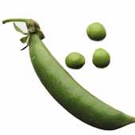
Heredity is the passing of traits from parents to offspring.
Mendel experimented with heredity of certain traits found in peas.
Mendel studied each trait separately and discovered patterns in the way traits are inherited in peas.
Mendel’s work has become the basis of genetics, the study of heredity.

Slide 6
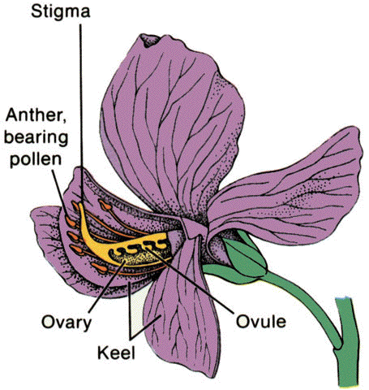
Mendel’s Pea Experiments
Mendel chose pea plants because their traits were easy to see and distinguish.
He crossed plants with two different traits, for example purple flowers with white flowers.
He started his experiments with purebred plants.
Purebred plants ALWAYS produce offspring with the same trait as the parent. For example, if the parent is tall, all offspring will be tall. If the parent is short, all offspring will be short.

Slide 7
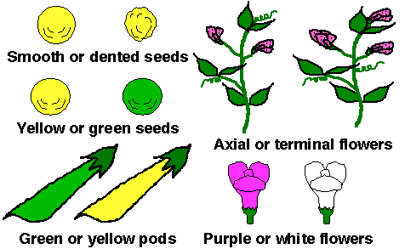
Some Pea Traits that Mendel Studied

Slide 8
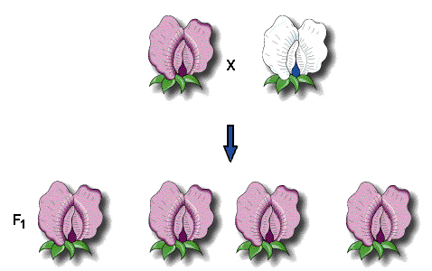
F₁ Generation
Mendel called the parent plants the P generation.
He called the offspring from the parents the F₁ generation.
When Mendel crossed pure pea plants with purple flowers with pure pea plants with white flowers, all the F₁ generation had purple flowers

Slide 9
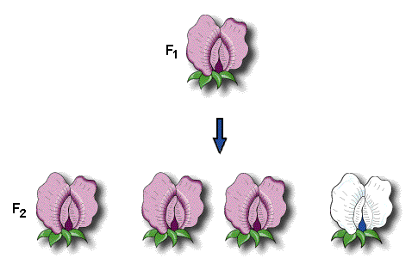
F₂ Generation
When he crossed the F₁ generation peas with one another, only some of the offspring had purple flowers. These formed the F₂ generation.
Mendel found that in the F₂ generation, ¾ of the plants had purple flowers and ¼ of them had white flowers.

Slide 10
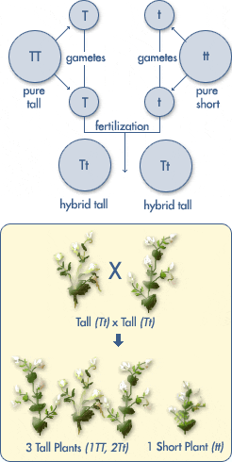
Mendel's Results
For each trait, there is one form that is dominant (shows up)
The other trait (that does not always show up) is recessive.
Principle of dominance

Slide 11
Mendel's Results
Each parent must have a pair of factors that controls the trait
The factors (genes) separate during gamete formation
This separation is called segregation
More complex crosses: Mendel discovered that the gene for flower color wasn't linked to that of tallness, etc
Law of independent assortment: genes for different traits segregate independently during gamete formation

Slide 12
Modern Terminology
Gene: rough equivalent to Mendel's “factors”
Allele: each possible expression of a gene
Genotype: the actual gene combination for a trait
Phenotype: the expression of the genes, or what the organism “looks like”
Homozygous: having the same alleles
Heterozygous: having two different alleles

Slide 13
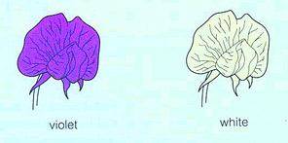
Practice
  We use two letters to represent the genotype. A capital letter represents the dominant form of a gene (allele) and a lowercase letter is the abbreviation for the recessive form of the gene (allele).
  Example below: P=dominant purple and p= recessive white
The phenotype for this flower is violet while its genotype (if homozygous) is PP.
The phenotype for this flower is white while its genotype is pp (to be white the flower must have two of the recessive copies of the allele).

Slide 14
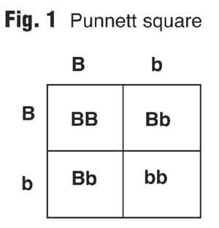
Punnett Squares
The Punnett square is the standard way of working out what the possible offspring of two parents will be.
  It is a helpful tool to show allelic combinations and predict offspring ratios.

Slide 15
Before we go further lets review how to set up a Punnett Square…
We begin by constructing a grid of two sets of perpendicular lines.

Slide 16
Next, put the genotype of one parent across
the top and the other along the left side.
For this example lets consider a genotype of BB crossed with bb.
B B
Notice only one letter goes above each box
It does not matter which parent’s genotype goes on either side.
b
b

Slide 17
Next, fill in the boxes by copying the column and row head-letters down and across into
the empty spaces.
B B
b
B
b
B
b
b
B
b
B
b

Slide 18
Punnett Squares
Now that we have learned the basics of genetics lets walk through some examples using Punnett Squares.

Slide 19
Red hair (R) is dominant over blond hair (r). Make a cross between a heterozygous red head and a blond.
R r
r
r
Rr | rr
Rr | rr
What percentage of the offspring will have red hair?
50%

Slide 20
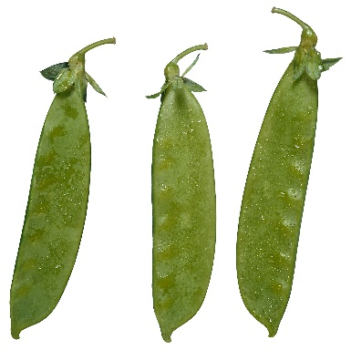
In pea plants, tall pea plants (T) are dominant over short pea plants (t).
Construct a Punnett Square for a heterozygous tall pea plant and a short pea plant.
T t
What are the percentage of phenotypes?
Tt | tt
Tt | tt
t
t
50% tall
50% short

Slide 21
Black eyes (R) is dominant over red eyes (r)
in rats. Make a cross between a homozygous rat with black eyes and a rat with red eyes.
R R
Rr | Rr
Rr | Rr
r
r
What is the possibility of a red eye offspring?
0% ☹
Notes:
Discuss with students other possible answers

Slide 22
Dihybrid crosses
We can predict the result of looking at 2 different traits.
Assuming the traits are on different chromosomes:
Determine the possible gametes the parents will form.
  Each gamete will have one allele for each trait
Put the gametes on a Punnett square, the same as for monohybrid crosses

Slide 23
For example, if the parents are purebred purple flowering, tall pea plants crossed with white flowering , short pea plants:
PPTT x pptt
PT
PT
pt
pt
PT
PT
PT
PT
PT
PT
PT
For the F1 generation:
Genotype: All PpTt
Phenotype: All purple, tall
pt
pt
pt
pt
pt
pt

Slide 24
F2 Generation!
Let’s do that one on the white board!

Slide 25

References
http://www.athro.com/evo/gen/punnett.html
http://www.kidshealth.org/kid/talk/qa/what_is_gene.html
http://brookings.k12.sd.us/biology/ch%2011%20genetics/punnettpractice.ppt#1
http://www.usoe.k12.ut.us/CURR/Science/sciber00/7th/genetics/sciber/punnett.htm
http://www.biotechnologyonline.gov.au/images/contentpages/karyotype.jpg

