Slide 1
Biology: More genetics
Chapter 8 Section 2

Slide 2
Objectives
Use the rules of probability to solve genetics problems
Understand inheritance from multiple alleles, codominance and incomplete dominance

Slide 3
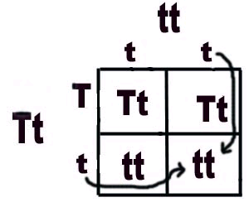
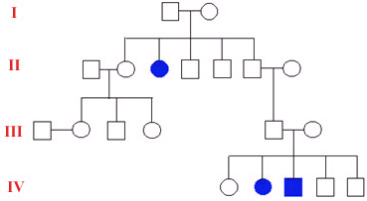
Punnett squares and Pedigree Charts
Both can give us information about inherited traits
www.rcsdk12.org/cms

Slide 4
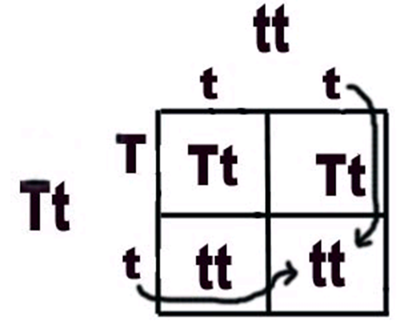
Punnett squares
A chart that shows the chances or probability of a particular trait being expressed in offspring.
Each box of the Punnett square represents a chance for that trait being expressed.
Example: Cross Tt and tt
T = dominant allele = tall
T = recessive allele = short
The Tt and tt along the top and sides of the Punnett square are the genotypes for the parents.
The genotypes for the offspring are inside of the Punnett square.

Slide 5

Pedigree Charts
There are four generations shown on this pedigree chart.
Squares = males and circles = females
if the shape is totally shaded then he/she has the condition; if the shape is shaded ½ way then he/she is a carrier for that condition.
Generation I parents had 2 boys and 3 girls of which only 1 has the condition.

Slide 6
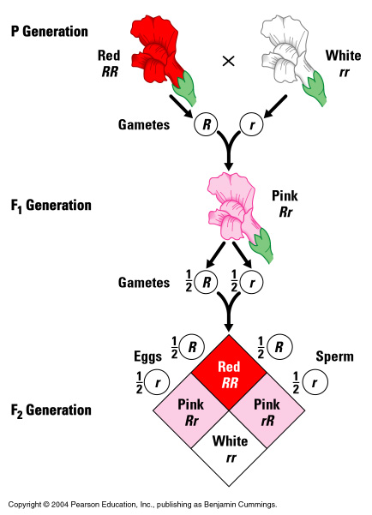
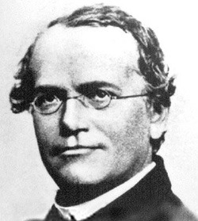
Snapdragons
HUH?
http://www.dobermann-review.com/info/genetics/mendels_genetic_laws/Gregor Mendel.jpg
msthompson1.weebly.com
http://faculty.pnc.edu/pwilkin/incompdominance.jpg

Slide 7
Incomplete Dominance
Neither allele is completely dominant over the other allele.
A ‘heterozygous’ phenotype is a mixture or blending of the two

Slide 8

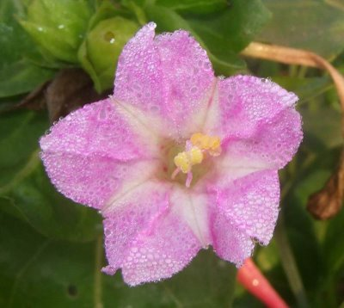
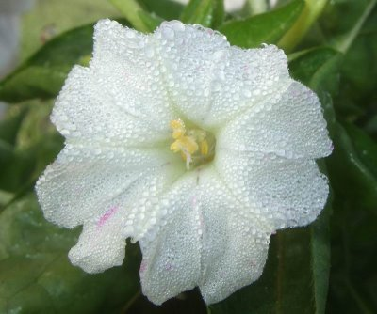
Four-o’ clock flowers
Incomplete dominance
Neither Red (R) or White (W) is dominant
When a homozygous red flower (RR) reproduces with a homozygous white flower (WW), the alleles blend in the hybrid (RW) to produce pink flowers

Slide 9
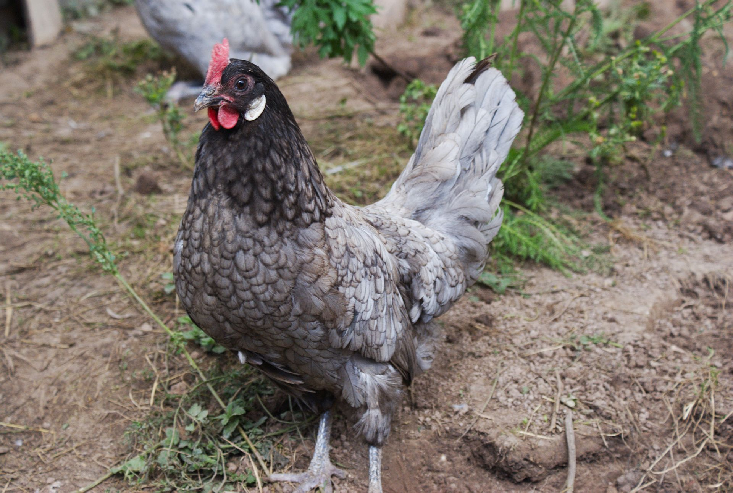
Andalusian Chickens
Incomplete dominance
Neither Black (B) or White (W) are dominant
The offspring of a black feathered chicken (BB) and a white feathered chicken (WW) are blue (BW)

Slide 10
Codominance
Two equally dominant alleles are expressed at the same time.
Heterozygous genotype will have both phenotypes visible

Slide 11
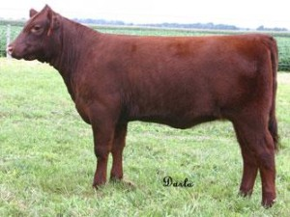
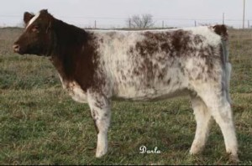
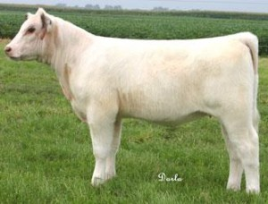
Shorthorn Cattle
Co- dominance
Homozygous red (RR) crossed with Homozygous white (WW)
The offspring of will have both red and white hairs (RW)
The offspring are called roan

Slide 12
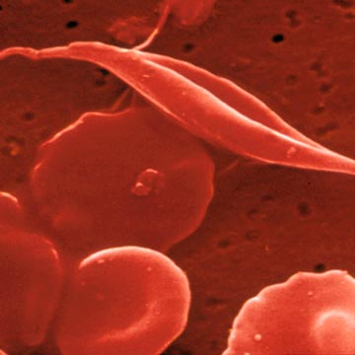
Sickle- Cell Anemia
Codominance
Caused by abnormal hemoglobin, the protein that red blood cells use to carry oxygen
Normal hemoglobin is (AA for HbA gene)
Sickle Cell shaped blood cells (SS for HbS gene)
People who are carriers (heterozygous) for the disease there is a mixture of both normal and sickle cell (AS)

Slide 13
Problem: Codominance
Show the cross between an individual with sickle-cell anemia and another who is a carrier (sickle cell trait)
A S
GENOTYPES:
- AS (2) SS (2)
- ratio 1:1
S
S
AS
SS
PHENOTYPES:
SS
- carrier (2); sick (2)
- ratio 1:1
AS

Slide 14
Let’s Stop and Think…
Let’s say there are two alleles for the hair color trait- red and blue
What would be the resulting phenotype of a heterozygous pair if the alleles showed incomplete dominance?
A. Red
B. Blue
C. Purple
D. Red and Blue patches

Slide 15
Let’s Stop and Think…
Let’s say there are two alleles for the hair color trait- red and blue
What would be the resulting phenotype of a heterozygous pair if the alleles showed codominance?
A. Red
B. Blue
C. Purple
D. Red and Blue patches

Slide 16
MULTIPLE ALLELES
Sometimes there are more than 2 alleles possible for a given gene.
This creates a larger number of genetic and phenotypic possibilities.

Slide 17
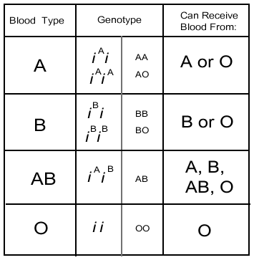
Blood TYPE in humans
Blood types are A, B, O, and AB.
AB blood is a co-dominant trait with a recessive allele also possible.
Both the A blood and the B blood need to be dominant in order to make a combination of blood types, which is AB.
IA IA IA
IB IB
IB i
i
IA IB | IA IB
IA IB | IA IB
IA IB | IB i
IA i | ii

Slide 18
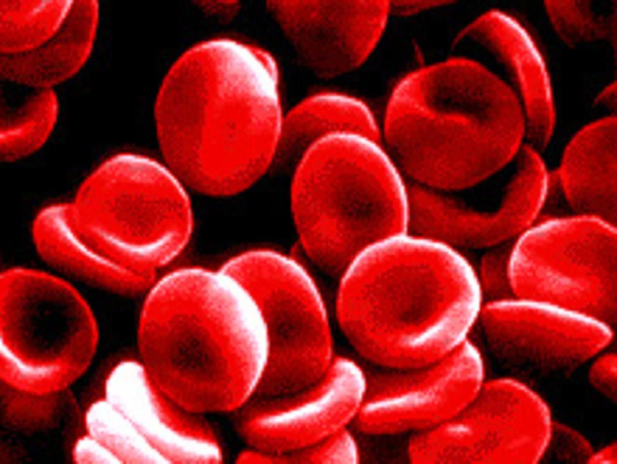
BLOOD TYPES
4 ABO blood types
3 alleles of the I gene
I^{A} = A antigen on RBC
I^{B} = B antigen on RBC
i = neither A nor B antigen
http://sydfish.files.wordpress.com/2008/02/bloodcells.jpg
Genotype
Blood type
Antibody (plasma)
I^{A}I^{A} or I^{A}i
A
Anti – B
I^{B}I^{B} or I^{B}i
B
Anti – A
None
I^{A}I^{B}
AB
Anti – A, Anti – B
ii
O

Slide 19
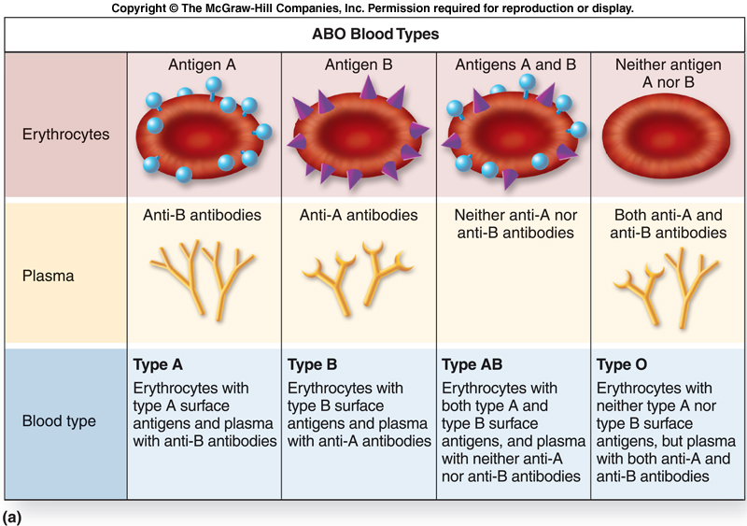
http://www.biologycorner.com/anatomy/blood/images/bloodtypes.jpg

