Slide 1
The Chromosome Theory of Inheritance http://www.biology.usu.edu/courses/biol3060-wolf/
Biology Chapter 8 section 3

Slide 2
Objectives
Discuss the development of the chromosome theory of inheritance
Use Punnett squares and/or pedigrees to solve problems involving sex-linked traits
Explain the effect of the environment on gene expression

Slide 3
Outline of Chromosome Theory of Inheritance
Observations and experiments determined the hereditary material in the nucleus on the chromosomes
Mitosis ensures that every cell in an organism carries same set of chromosomes
Meiosis distributes one member of each chromosome pair to gamete cells
Validation of the chromosome theory of inheritance

Slide 4
Evidence that Genes Reside in the Nucleus
1667 – Anton van Leeuwenhoek
  Semen contains spermatozoa (sperm animals)‏
  Hypothesized that sperm enter egg to achieve fertilization
1854-1874 – confirmation of fertilization through union of eggs and sperm
  Recorded frog and sea urchin fertilization using microscopy and time-lapse drawings and micrographs

Slide 5
Evidence that Genes Reside in Chromosomes
1880s – innovations in microscopy and staining techniques identified thread-like structures
Follow movement of chromosomes during cell division
Mitosis – two daughter cells contained same number of chromosomes as parent cell (somatic cells)
Meiosis – daughter cells contained half the number of chromosomes as the parents (sperm and eggs)

Slide 6
One Chromosome Pair Determines an Individual’s Sex
Walter Sutton – Studied great lubber grasshopper
Parent cells contained 22 chromosomes plus an X and a Y chromosome
  X and Y were not the same size
Daughter cells contained 11 chromosomes and X or Y in equal numbers

Slide 7
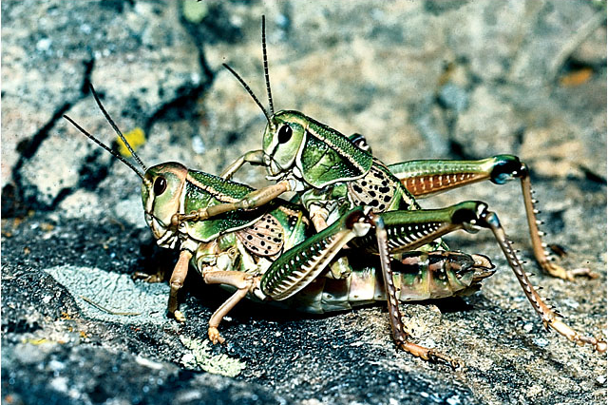
After fertilization
  Cells with XX were females
  Cells with XY were males
Great lubber grasshopper
(Brachystola magna)‏
Fig. 4.2
Notes:
Figure 4.2

Slide 8
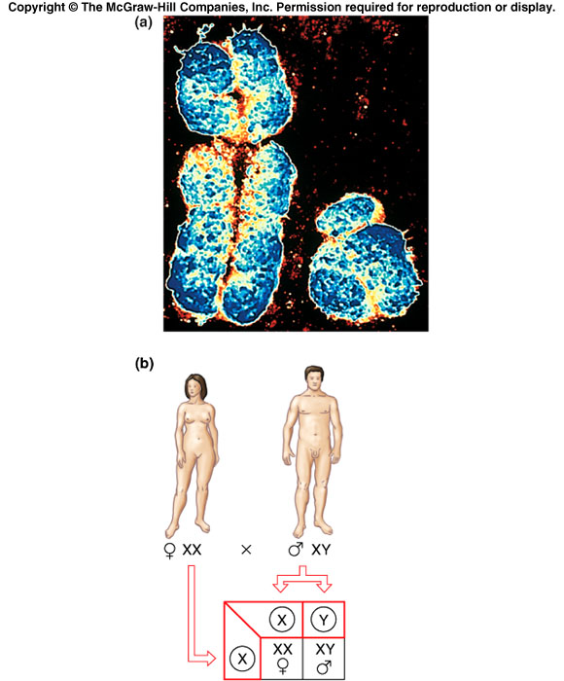
Sex chromosome
  Provide basis for sex determination
  One sex has matching pair
  Other sex has one of each type of chromosome
Photomicrograph of human
X and Y chromosome
Fig. 4.3a
Notes:
Figure 4.3a

Slide 9
Sex determination in humans
  Children receive only an X chromosome from mother but X or Y from father
Fig. 4.3b
Notes:
Figure 4.3b

Slide 10
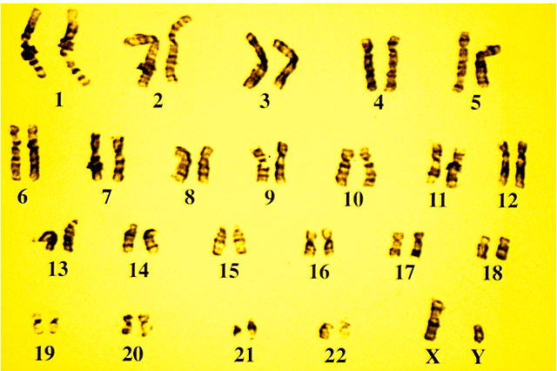
Karyotypes can be produced by cutting micrograph images of stained chromosomes and arranging them in matched pairs
Fig 4.6
Human male karyotype
Notes:
Figure 4.6

Slide 11
Specific traits are transmitted with specific chromosomes
A test of the chromosome theory.
  If genes are on specific chromosomes, then traits determined by the gene should be transmitted with the chromosome
  T.H. Morgan’s experiments demonstrating sex-linked inheritance of a gene determining eye-color demonstrate the transmission of traits with chromosomes
  1910 – T.H. Morgan discovered a white – eyed male Drosophila melanogaster among his stocks

Slide 12
X and Y linked traits in humans are identified by pedigree analysis
X-linked recessive traits exhibit five characteristics seen in pedigrees
  Trait appears in more males than females
  Mutation and trait never pass from father to son
  Affected male does pass X-linked mutation to all daughters, who are heterozygous carriers
  Trait often seems to skip a generation
  Trait only appears in successive generations if sister of an affected male is a carrier. If so, one half of her sons will show trait

Slide 13
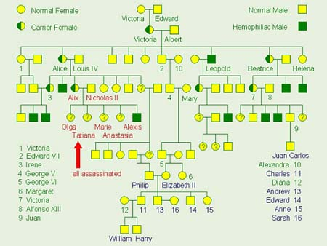
Example of sex-linked recessive trait in human pedigree – hemophilia
Notes:
Figure 4.23 a

Slide 14
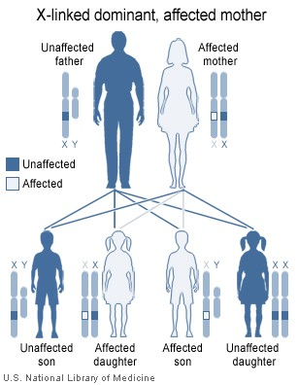
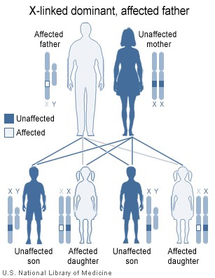
Example of sex-linked dominant trait in human pedigree –x-linked hypophosphatemia
Fig. 4.23 b
Notes:
Figure 4.23 b

Slide 15
Continuous variation
Continuous variation describes the situation in which there are a great many intermediates between the extremes
For example, there is every shade of hair color between black and blond. People do not belong to one or other of a small number of distinct categories.
Variations such as these are under genetic control but there are several pairs of genes involved (multiple genes)
www.biology-resources.com/powerpoints/Genetics/07-variation

Slide 16
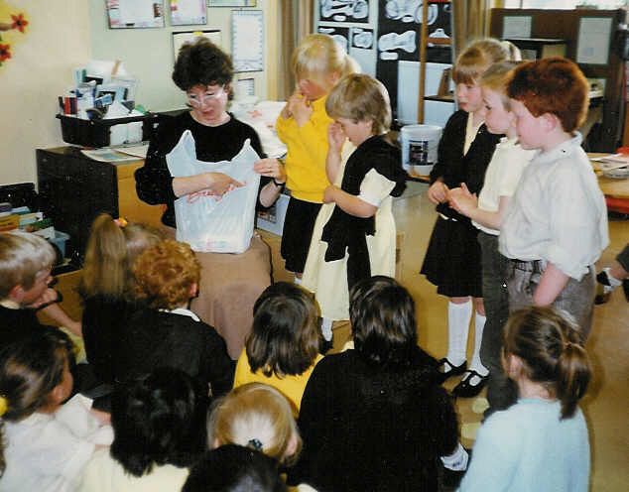
Hair colour variation
17
There are as
many categories
of hair color as
there are children

Slide 17
Continuous variation
Continuous variation also occurs when the characteristics are controlled by the genes and the environment
For example, your height will depend on the genes you inherit and on the amount of food you eat during your growing period.

Slide 18
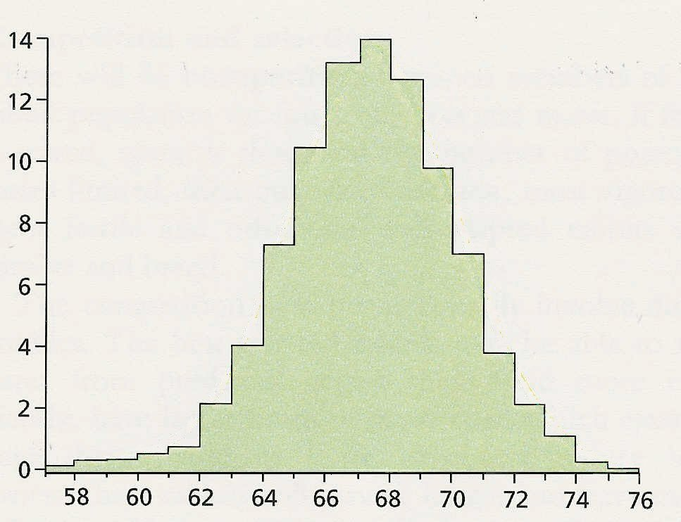
Graph of heights
19
Height of Army Recruits
thousands
of men
height in inches
There seem to be distinct categories of height but this is because
measurements are made to the nearest inch

Slide 19

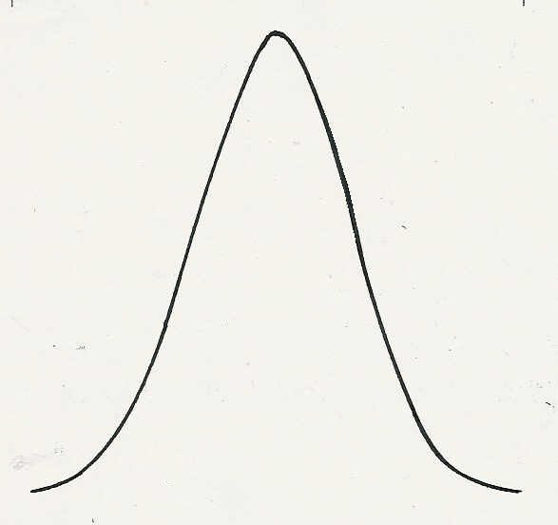
20
If measurements could be made to the nearest millimetre
there would be a smooth transition in the heights

Slide 20
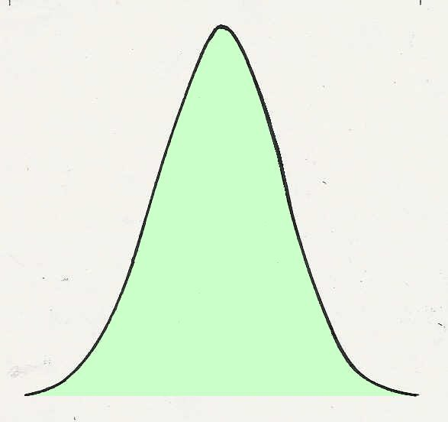
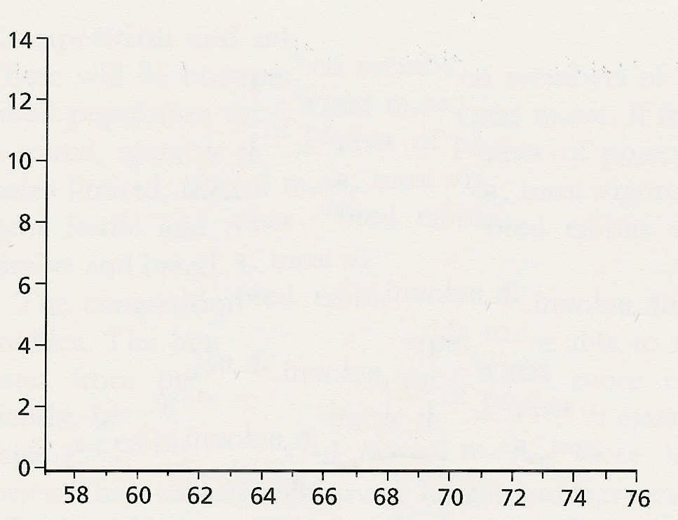
21
This is how continuous variation would appear in a graph

Slide 21
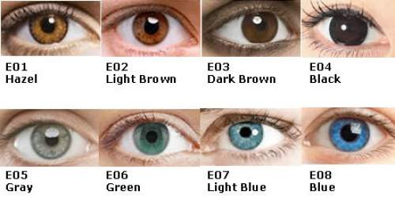
Genes Affect other Genes
A modifier gene is a gene that affects the function of a different gene
Example: Brown vs blue eye color gene is modified by other genes affecting the amount of brown or distribution of brown

