Slide 1
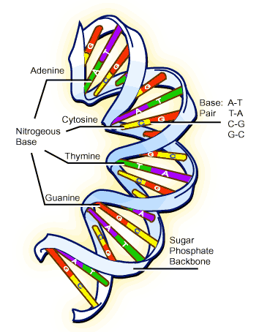
DNA
How did we figure it out?

Slide 2
Objectives
Understand the sequence of events that led to the conclusion that DNA makes up genes

Slide 3
Fred Griffith
Born 1881 in southern England
Died 1941 in an air raid on London
1928: Had distinguished 2 types of pneumococci:
  Rough ( R ), which are nonvirulent
  Smooth (S), which are virulent
Experimented with mice, injecting with the two types

Slide 4
Griffith’s Experiments
Mice injected with S bacteria did get pneumonia
Mice injected with R bacteria did not get pneumonia
Mice injected with heat killed S bacteria did not get pneumonia
Mice injected with both R and heat killed S bacteria did get pneumonia

Slide 5
Griffith’s Conclusion
Something in the S bacteria was taken up by the R and used by them so that they became S and caused pneumonia
Some chemical changed the cells
Experiment showed this was a valid hypothesis

Slide 6
What was this mysterious substance?
Experiments:
  Grind up cells, extract different chemicals
  Chromosomes are suspect
  Chromosomes composed of DNA and protein
  Which is more important: DNA or protein?
  Many scientists believe protein is the cause, since proteins are very complex

Slide 7
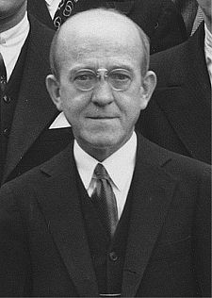
Oswald Theodore Avery
Born 1877 in Nova Scotia, Canada; Died 1955
Worked with Colin MacLeod and Maclyn McCarty at Rockefeller University Hospital in 1943
Treated S bacteria with protease, destroying protein, then added to R strain
Treated S bacteria with deoxyribonuclease, destroying DNA, then added to R strain
Discovery: DNA caused the transformation

Slide 8
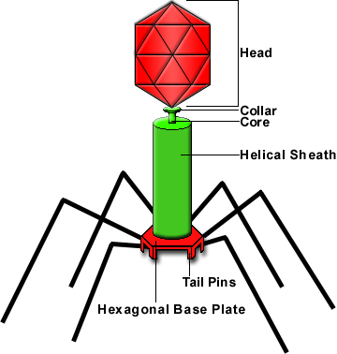
Hershey-Chase Experiment
Alfred Hershey and Margaret Chase
1952: Used bacteriophages for experiment
  Bacteriophages infect and take over bacteria
Labeled DNA of virus with radioactive phosphorus
Labeled protein of virus with radioactive sulfur
Phages infect E. coli, then bacteria analyzed
Bacteria contain radioactive phosphorus only
Conclusion: DNA is the material that is transmitted and controls cells

Slide 9
Further work
Work of Griffith, Avery, Chase and Hershey inspires others to determine what is special about DNA
Read pp 226 - 233

