Slide 1
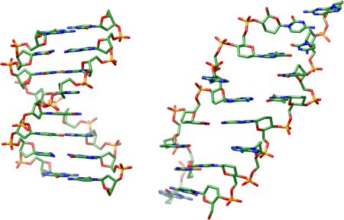
Structure of DNA: Biology Chapter 9

Slide 2
Objectives
Understand and describe the double helix model of DNA

Slide 3
Chemical Components
Sides of the ladder
Sugar: deoxyribose
Phosphate: PO₄
Rungs of the ladder
Nitrogen-containing bases
Component (sugar-phosphate-base) forms a unit called a nucleotide
DNA molecule is a polymer of nucleotides
Diagram animation

Slide 4
How do we know this? Erwin Chargaff
1905-2002
Austrian biochemist emigrated to US during Nazi occupation
Experimented on DNA
Chargaff's rules: imply complexity in the structure of DNA
In DNA, the amount of guanine equals the amount of cytosine, and the amount of adenine equals the amount of thymine
The composition of DNA varies (in the amount of bases) from one species to another

Slide 5
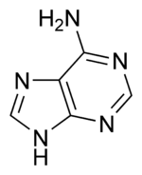
Purine Bases
Adenine
Part of molecules involved in respiration, part of ATP, and part of DNA and RNA
Bonds to thymine in DNA and uracil in RNA

Slide 6
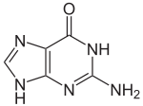
Purine Bases
Guanine
Bonds to cytosine in both DNA and RNA

Slide 7
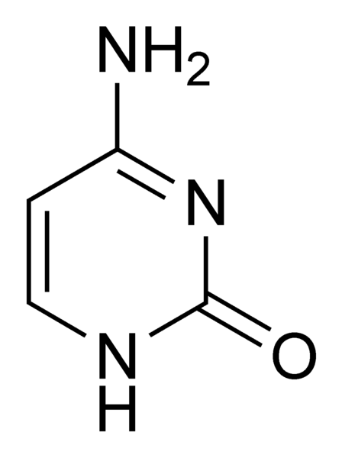
Pyrimidine Bases
Cytosine
Bonds to guanine in DNA and RNA

Slide 8
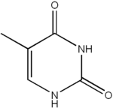
Pyrimidine Bases
Thymine
Bonds to adenine in DNA

Slide 9
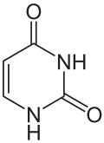
Pyrimidine Bases
Uracil
Bonds to adenine in RNA

Slide 10
What’s the structure of DNA? Linus Pauling
1901-1994
Chemist and biochemist
Used research into the structure of proteins to suggest a helix shape for DNA
Believed that DNA was a single helix, with bases carrying the code of genes
Later revised idea to that of 3 strands in a helix shape

Slide 11
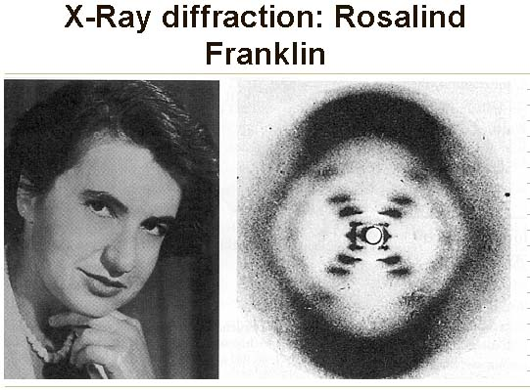
What’s the structure of DNA? Rosalind Franklin
1920-1958
X-ray crystallographer determined basic helical structure of DNA
Also determined structure of many viruses

Slide 12
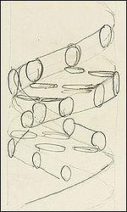
James Watson and Francis Crick
Used ideas of Pauling, data from Franklin and others to construct model of DNA
Double helix
Believed information was carried from DNA to RNA to proteins

Slide 13
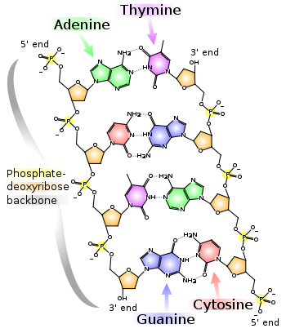
DNA Structure

Slide 14
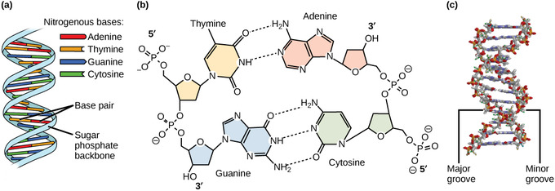
DNA Structure
Pair of polymers, bases joined with hydrogen bonds
Bonding between sugar and phosphate is uneven leading to an orientation of the molecule (read 5’ to 3’)
Opposing chains of nucleotides have opposite orientation
Order of bases is code
Twist creates grooves important in replication

Slide 15
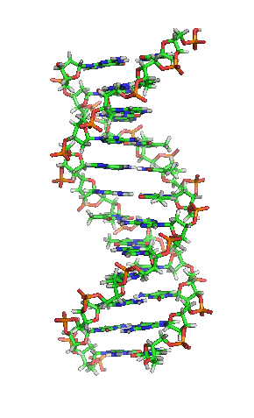

Slide 16
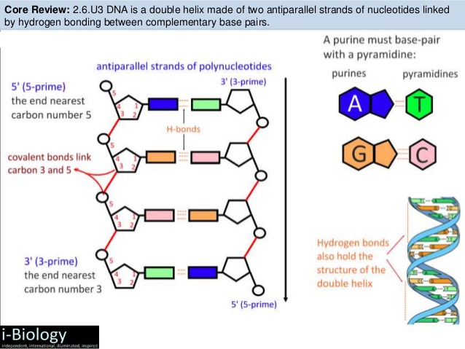
Watch the Video
The Double Helix (http://www.hhmi.org/biointeractive/double-helix)

