Slide 1
Role of DNA
Chapter 9 Section 1 Part 3

Slide 2
Objectives
Understand and describe DNA replication

Slide 3
DNA Nucleotide
Phosphate
Group
O
O=P-O
O
5
CH2
O
N
Nitrogenous base
(A, G, C, or T)
C⁴
C¹
Sugar
(deoxyribose)
C³
C²

Slide 4
DNA Replication
Process of duplication of the entire genome prior to cell division
Biological significance
extreme accuracy of DNA replication is necessary in order to preserve the integrity of the genome in successive generations
In eukaryotes , replication only occurs during the S phase of the cell cycle.
Replication rate in eukaryotes is slower resulting in a higher fidelity/accuracy of replication in eukaryotes
Notes:
www.bath.ac.uk

Slide 5
Synthesis Phase (S phase)
S phase during interphase of the cell cycle
Nucleus of eukaryotes
S
phase
DNA replication takes
place in the S phase.
G₁
G₂
interphase
Mitosis
-prophase
-metaphase
-anaphase
-telophase

Slide 6
Basic rules of replication
Semi-conservative
Starts at the ‘origin’
Synthesis always in the 5-3’ direction
Can be uni or bidirectional
Semi-discontinuous
RNA primers required

Slide 7
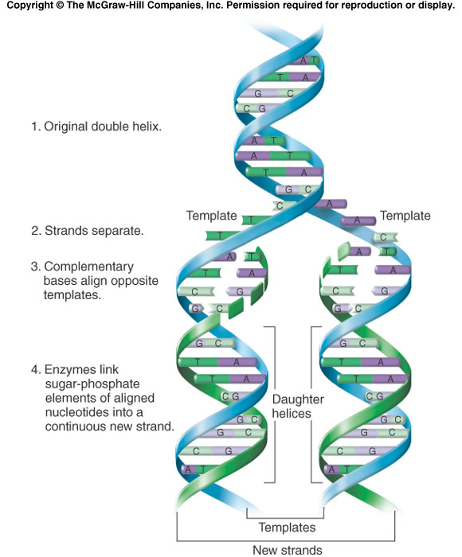
A) Semi-conservative replication:
One strand of molecule passed on unchanged to each of the daughter cells. This 'conserved' strand acts as a template for the synthesis of a new, complementary strand by the enzyme DNA polymerase
Notes:
Figure 6.16

Slide 8
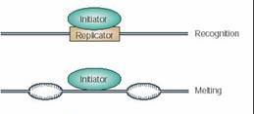
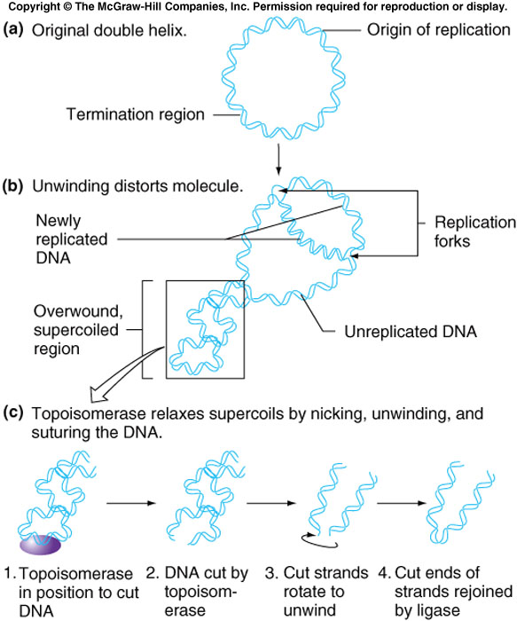
B) Starts at origin
Initiator proteins identify specific base sequences on DNA called sites of origin
Prokaryotes – single origin site Example: E.coli Eukaryotes – multiple sites of origin Example: yeast
Prokaryotes
Eukaryotes

Slide 9
DNA Replication
Begins at Origins of Replication
Two strands open forming Replication Forks (Y-shaped region)
Enzyme helicase unwinds DNA and breaks H bonds (uses ATP)
New strands grow at the forks
3’
Parental DNA Molecule
5’
Replication
Fork
3’
5’

Slide 10
DNA Replication
As the 2 DNA strands open at the origin, Replication Bubbles form
Prokaryotes (bacteria) have a single bubble
Eukaryotic chromosomes have MANY bubbles
Bubbles
Bubbles

Slide 11
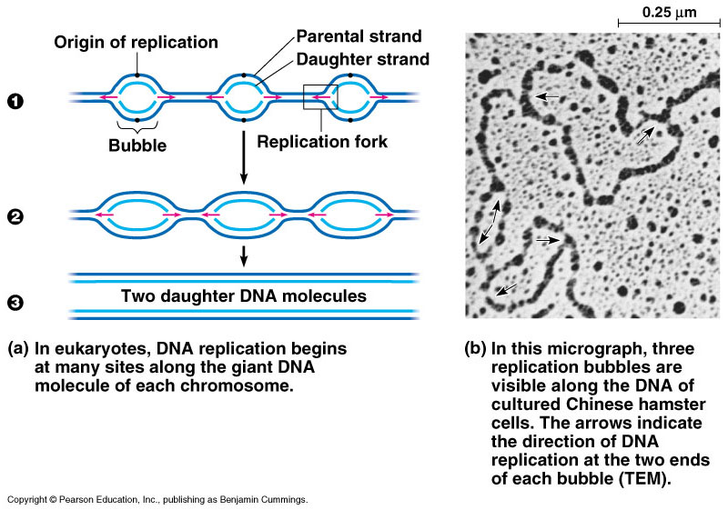
DNA Replication
Large team of enzymes coordinates replication
bealbio.wikispaces.com
Notes:
Enzymes
more than a dozen enzymes & other proteins participate in DNA replication

Slide 12
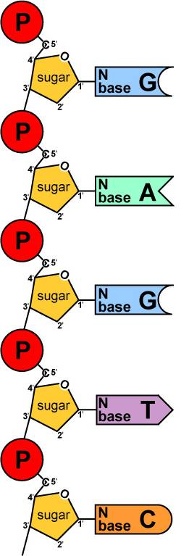
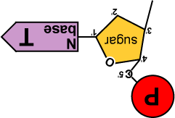
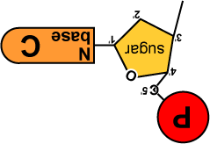
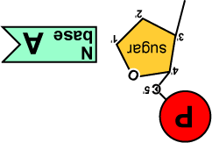
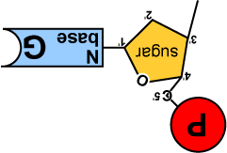
Replication: 2nd step
Build daughter DNA strand
add new complementary bases
DNA polymerase enzyme
DNA
Polymerase III
bealbio.wikispaces.com

Slide 13
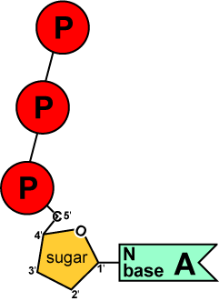
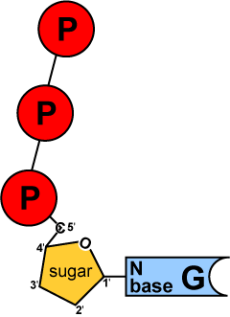
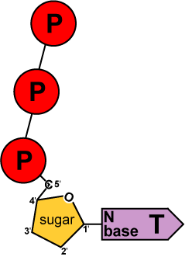
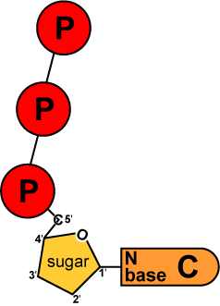
Energy of Replication
The nucleotides arrive as nucleosides
DNA bases with P–P–P
P-P-P = energy for bonding
DNA bases arrive with their own energy source for bonding
bonded by enzyme: DNA polymerase III
ATP
GTP
TTP
CTP
Notes:
Bealbio.wikispaces.com

Slide 14
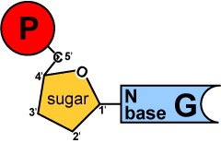

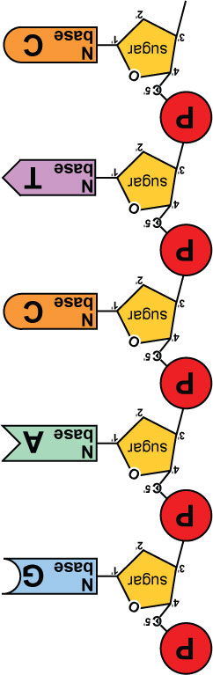
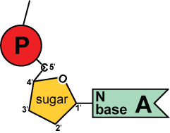
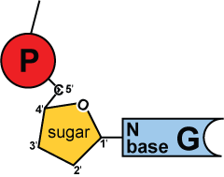
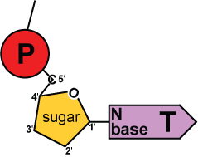
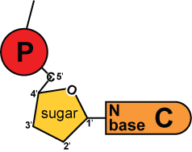
Replication
5′
3′
energy
DNA
Polymerase III
C) Adding bases
can only add nucleotides to 3′ end of a growing DNA strand
need a “starter” nucleotide to bond to
strand only grows 5′→3′
DNA
Polymerase III
energy
DNA
Polymerase III
energy
DNA
Polymerase III
energy
3′
5′
bealbio.wikispaces.com
Notes:
The energy rules the process.

Slide 15
E) Semidiscontinuous Synthesis of the New DNA Strands
The Leading Strand is synthesized as a single strand from the point of origin toward the opening replication fork
5’
3’
5’
RNA
Primer
Nucleotides
DNA Polymerase

Slide 16
Synthesis of the New DNA Strands
The Lagging Strand is synthesized discontinuously against overall direction of replication
This strand is made in MANY short segments
It is replicated from the replication fork toward the origin
5’
Leading Strand
3’
3’
5’
DNA Polymerase
RNA Primer
5’
3’
3’
5’
Lagging Strand

Slide 17
Lagging Strand Segments
Okazaki Fragments - series of short segments on the lagging strand
Must be joined together by an enzyme
DNA
Polymerase
Okazaki Fragment
RNA
Primer
5’
3’
3’
5’
Lagging Strand

Slide 18
Joining of Okazaki Fragments
The enzyme Ligase joins the Okazaki fragments together to make one strand
DNA ligase
5’
Okazaki Fragment 1
Okazaki Fragment 2
3’
3’
5’
Lagging Strand

Slide 19
Fast & accurate!
It takes E. coli <1 hour to copy 5 million base pairs in its single chromosome
divide to form 2 identical daughter cells
Human cell copies its 6 billion bases & divide into daughter cells in only few hours
remarkably accurate
only ~1 error per 100 million bases
~30 errors per cell cycle
Enzymes proofread and correct these mistakes (video)

Slide 20
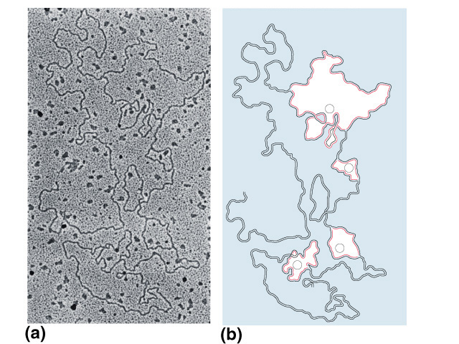
What does it really look like?
1
2
4
3
DNA Replication

