Slide 1
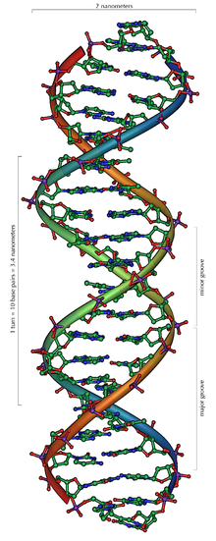
The DNA Code
Biology Chapter 9 Section 2 Part 2

Slide 2
Objectives
Demonstrate an understanding of the DNA code

Slide 3
Proteins, Polypeptides, and DNA
There are 20 amino acids found in proteins
There are 4 bases in DNA
How does DNA code for the 20 amino acids?
Reading the code, pieces, the genetic code
The DNA code is a triplet code (codon)‏

Slide 4
DNA Code
Each codon codes for one amino acid
One amino acid may have more than one code
The code is the same for all cells from prokaryotes to eukaryotes
Copying the code, putting it together, transcription (HHMI)
Reading the code, putting it together, translation (HHMI)

Slide 5
Now you try it!
Use the table on page 241 to write the amino acids that are coded for by this sequence:
TAC CGG GAG AAT TAG
(Just a note: More commonly RNA code is presented in publications, so be CAREFUL!)
What code did you get?
Methionine, Alanine, Leucine, Leucine, Isoleucine

Slide 6
Now you try it!
Use the table on page 241 to write all the possible bases that would code for by this sequence:
valine, proline, glutamine, tryptophan, methionine
What code did you get?
Valine: CAA, CAG, CAT, CAC
Proline: GGA, GGG, GGT, GGC
Glutamine: GTT, GTC
Tryptophan: ACC
Methionine: TAC

Slide 7
Now you know the code!
Make sure you READ pages 239-242!

