Slide 1
Ch 15 Section 2
Energy Transfer

Slide 2
Atmosphere Objectives
Describe the structure and gases of the atmosphere
Explain what happens to the energy Earth receives from the sun
Describe the effects of air movement

Slide 3
Energy Transfer
Heat is energy that flows from an object with a higher temperature to an object with lower temperature
Heat is then transferred through the atmosphere in 3 ways
  Radiation, Conduction and Convection

Slide 4
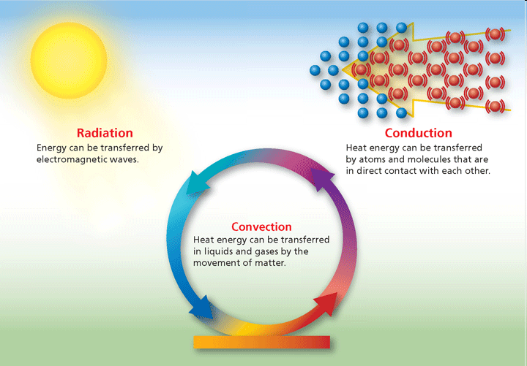
Heat Transfer
Radiation
  Heat transferred in the form of rays or waves
  Earth radiates some energy back
Conduction
  The transfer of energy when molecules bump into each other
  Transfer the energy when they come into contact with each other
Convection
  Transfer of heat by flow of material
  Through the air as a wind current

Slide 5
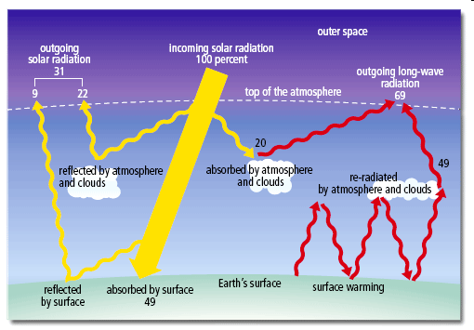
Heat Transfer

Slide 6
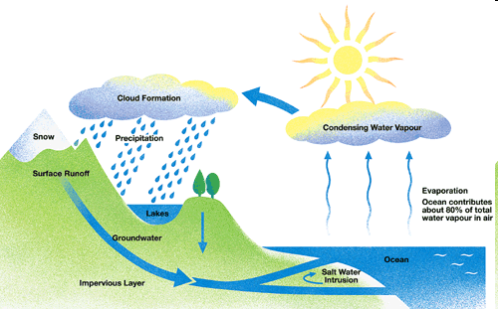
Water Cycle
Hydrosphere is all the water on the earth’s surface
Water evaporation and transpiration from the surface, turn into water vapor.
The water vapor cools back into a liquid by condensation.
Clouds form and as droplets collide to form bigger drops, they fall back to earth by precipitation.

