Slide 1
Ch 15 Section 3
Air Movement

Slide 2
Objectives
Describe the effects of air movement

Slide 3
Air Movement
High pressure areas caused by a phenomenon called subsidence
  as the air in the high altitudes cool, it becomes denser and moves toward the ground.
  Pressure increases.
  evaporates most of the atmosphere's water vapor
  clear skies and calm weather.

Slide 4
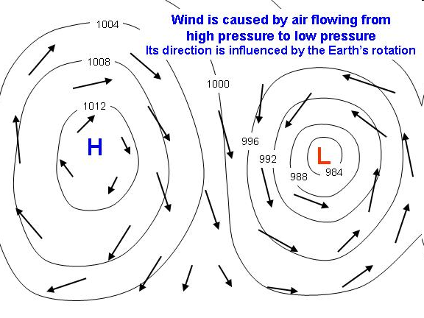
Air Movement
In warm air, molecules are more excited causing the air to expand
  Makes the air less dense
  Less dense air rises
  creates a low pressure
Wind is the movement of air from an area of higher pressure to an area of lower pressure
Cold air moving towards warm air

Slide 5
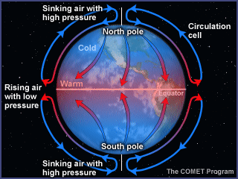
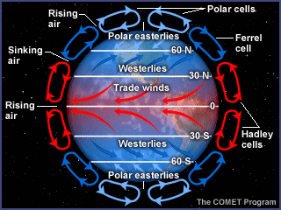
Heated Air at the equator
Areas of the earth receive different amounts of radiation because the earth is curved
  Equator receives more than the poles
  Air is less dense so it is displaced by the denser, colder air from the poles
    Creates convection currents

Slide 6
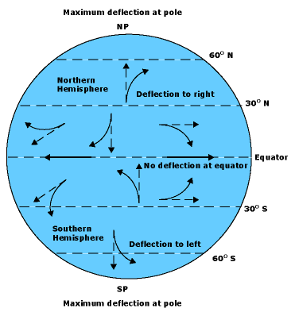
The Coriolis Effect
Coriolis Effect
  Spin of the earth causes the air to also move in a certain way not just straight towards the equator
  Air travels to the right north and left south of the equator

Slide 7
Global Winds
Doldrums – windless, rainy zone near the equator
  Sun heats the air causing it to rise, low pressure and little wind
  The rising air then cools causing rain
Trade winds
  Near the 30 degree N/S latitudes, a steady wind
  Sailors established routes on these dependable winds
Westerlies
  Between 30-60 degrees, blow opposite of the trade winds
  Responsible for weather movement across North America
Polar easterlies
  Blow from the northeast to the southwest at the north pole
  Blow from the southeast to the northwest at the south pole
Jet Streams
  Narrow belts of strong winds neat the top of the troposphere
  Form at the boundary of cold, polar air and warm, moist tropical air
  Moves faster in the winter, difference in the cold and warm air greatest

Slide 8
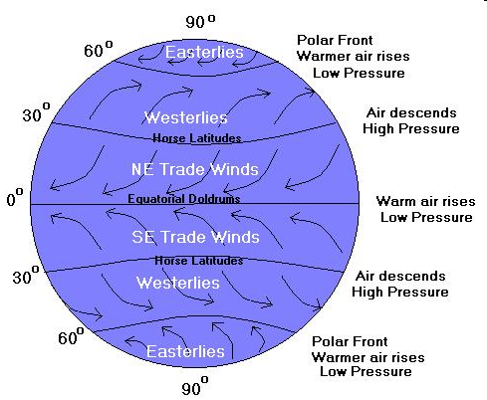
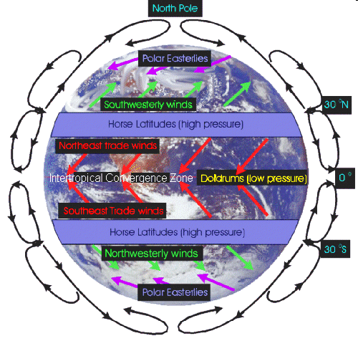
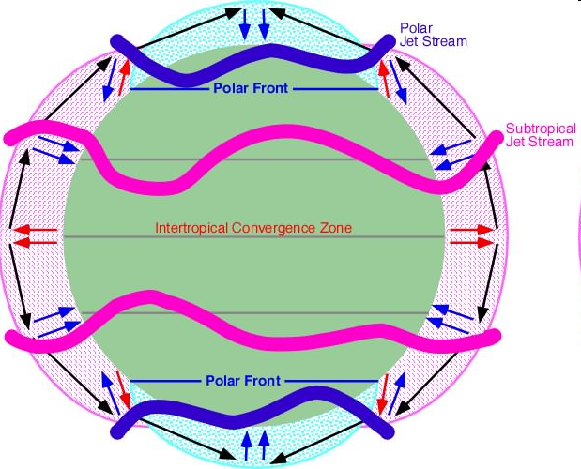

Slide 9
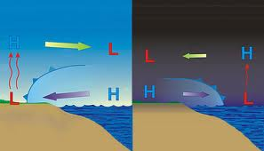
Local Winds
Sea Breeze
  Created during the day because the land is warmer than the water
  The air moves from the ocean to the land creating the wind
Land Breeze
  At night the land cools more rapidly than the ocean, so air moves from the land to the ocean

