Slide 1
Ch15 Sec.2
Atmosphere

Slide 2
Atmosphere Objectives
Describe the structure and gases of the atmosphere
Explain what happens to the energy Earth receives from the sun
Describe the effects of air movement

Slide 3
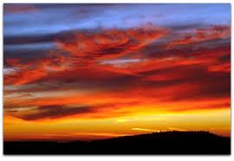

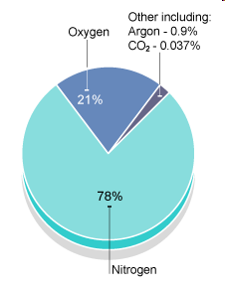
Atmosphere
A thin layer of air that protects the planet
Maintains a balance between heat absorbed and heat released
Protects life from sun’s harmful rays
Made up a gases
  78% Nitrogen
  21% Oxygen
  1% of trace gases such as Hydrogen, Argon, and Carbon Dioxide
Also includes things like dust, salt, pollen, and liquid droplets

Slide 4
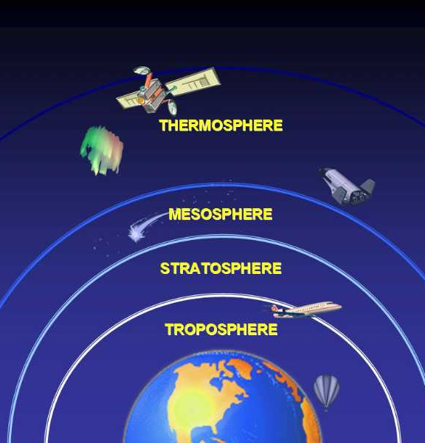
Layers
Troposphere 0-10km
  Lowest layer,
  99% water vapor and 75% gases
  Rain, snow and clouds
Stratosphere 10-50km
  contains ozone layer

Slide 5
Layers
Mesosphere 50-85km
  Where shooting stars occur
    Contains the
    ionosphere –
      a layer of electrically
      charged particles
      that either absorbs
      (by day) or allows
      radio waves to travel
      across the country (by
      night)

Slide 6
Layers
Thermosphere 85-500km
  Thickest and hottest layer
  Also contains ionosphere
  Space shuttles orbit here
  Aurora Borealis or
Exosphere
  Contains few particles
  Satelites orbit here.

Slide 7
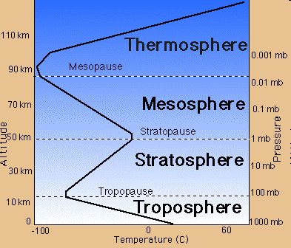
Pressure and Temperature
Air pressure decreases the further away from the surface of the earth you get
  The more gas molecules in an area the greater the pressure
  Less molecules the higher up you get (harder to breath at high altitudes)
Temperature depends on gases that absorb the Sun’s energy
  The more molecules absorb the energy the higher the temperatures

Slide 8
Ozone Layer
Life Depends On It !!!!!!!!!!!!!!!!!!!!!!!!!!!!!!
3 oxygen molecules bound together
This gas absorbs the ultraviolet rays from the sun which harm us

Slide 9
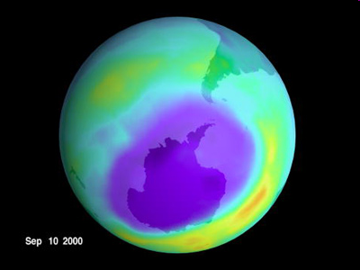
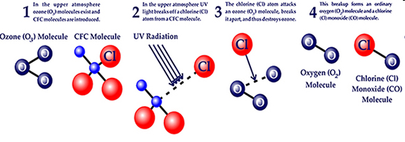
Ozone Layer
CFCs – chlorofluorocrabons destroy ozone by breaking the bonds between the oxygens
Holes have appeared in the ozone layer over the poles…

