Slide 1
Ch 16 Section 2
Weather Patterns

Slide 2
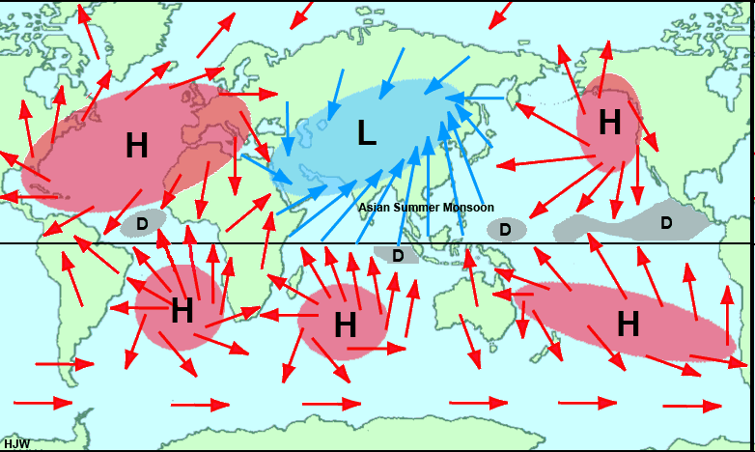
Weather Patterns
Air Mass – a large body of air that has properties similar to the surface it develops over
High Pressure
  Wind blows away from the area forming an anticyclone and fair weather
Low Pressure
  Winds blow into the area and the earth’s rotation causes the winds to swirl in a counterclockwise direction in the northern hemisphere
    Cyclones and stormy weather

Slide 3
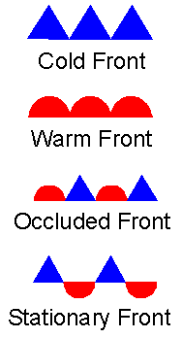
Fronts
A boundary between 2 air masses of different density, moisture or temperature
Clouds, precipitation, and storms occur at frontal boundries

Slide 4
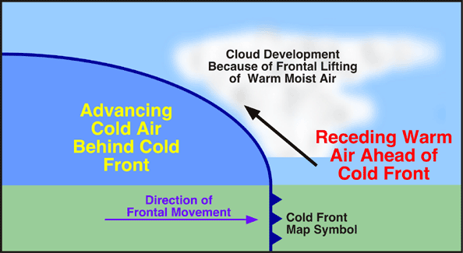
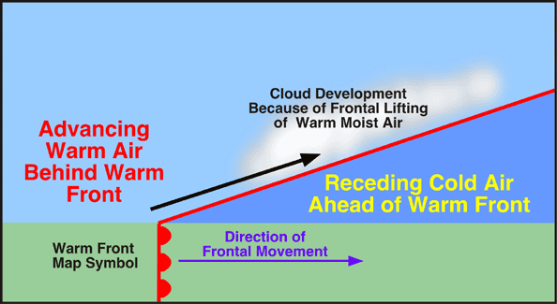
Fronts
Cold
  Cold air moves toward warm air
  Lifts the warm air creating clouds
  When temperature differences are great thunderstorms and tornadoes form
Warm
  Lighter, warmer air moves over heavier, colder air
  Lots of precipitation, no severe weather

Slide 5
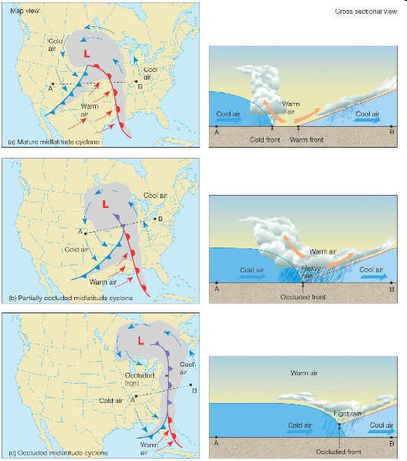
Fronts
Occluded
  3 air masses of different temperatures meet
  Cold air mass moves toward cool air with warm air in-between
  Forces the warm up and closes it off from the surface

Slide 6
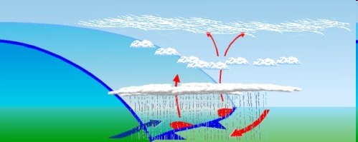
Fronts
Stationary
  Boundary between 2 air masses stops moving
  Produces light wind and precipitation

Slide 7
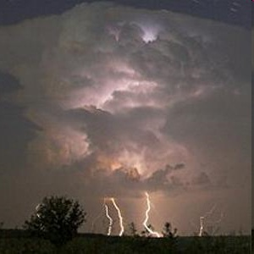
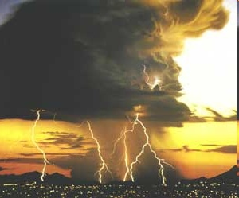
Severe Weather
Thunderstorms
  Warm air forced up, lots of precipitation, lightning
  Damaging winds and hail
Lightning
  Rapid movement of air inside a cloud can cause parts of the cloud to become oppositely charged
  A current flows through and lightning flashes
  Thunder results from the rapid heating or superheating of air around the lightning, movement of the molecules forms sound waves

Slide 8
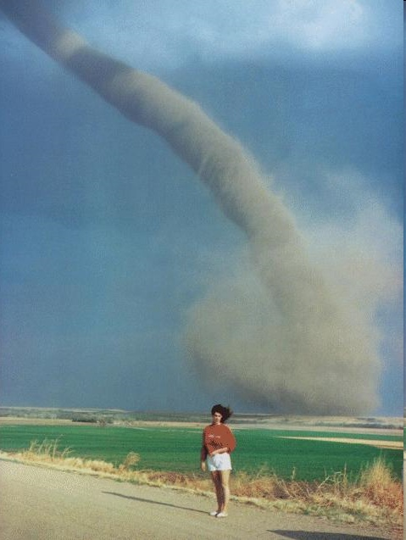
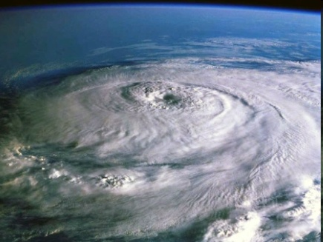
Severe Weather
Tornado
  Violent, whirling wind created by the difference in speed and direction of winds within the cloud called wind shear
Hurricane
  A large, swirling, low-pressure system formed over the warm ocean
  Rotate counterclockwise in the northern hemisphere
  start off Africa and end up at North America!
Blizzards
  Wind and snow that last longer than 3 hours

