Slide 1
Ch 16 Section 3
Weather Forecasts

Slide 2
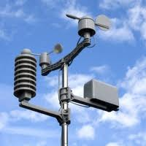
Weather Forecast
Meteorologist make measurements of temperature, air pressure, wind, humidity, and precipitation
The technology used are computers, satellites, doppler radar, and instruments attached to balloons
http://weather.rap.ucar.edu/satellite/
http://www.goes.noaa.gov/

Slide 3
Weather Forecast
Make weather maps, to make weather forecasts
  Show fronts (west to east for the US)
http://weather.rap.ucar.edu/model/

Slide 4
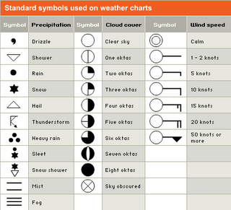
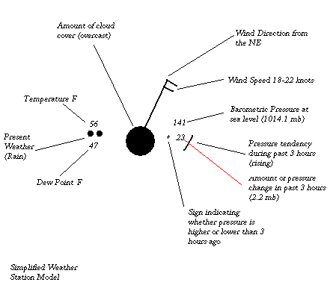
Weather Forecast
Data from the earth’s surface is called a station model
http://weather.rap.ucar.edu/surface/

Slide 5
Weather Forecast
Model temperature with lines called isotherms, equal temperature
http://weather.rap.ucar.edu/surface/

Slide 6
Weather Forecast
Model pressure with lines called isobars, equal atmospheric pressure
http://weather.rap.ucar.edu/upper/

