Slide 1
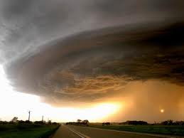
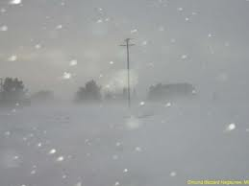
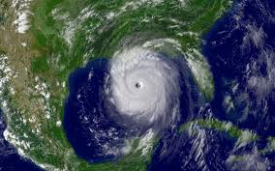
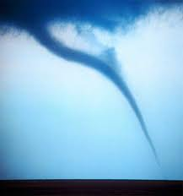
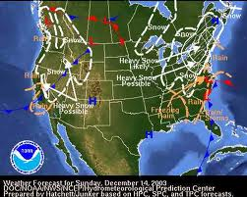
Ch 16
Weather

Slide 2
Ch 16 Section 1
What is Weather

Slide 3
Objectives
Describe types of weather
How weather forms

Slide 4
Weather Factors
The state of the atmosphere at a specific time and place
Describes air pressure, wind, temperature and amount of moisture in the air
Combination of the Sun’s heat and Earth’s air and water

Slide 5
Air Temperature
  molecules move fast and it feels warm
  molecule move slow and it feels cold.

Slide 6
Wind
  As the sun heats air, it expands, becomes less dense, rise,
    low pressure.
  Cooler air is denser and sinks
    high pressure.
  Air moving from an area of _____ pressure to an area of _______ pressure causes wind.
  _______ temperature to an area of _______temperature causes wind.

Slide 7
Humidity
  amount of water vapor in the air
Warmer air can hold more water vapor
  more humid.
When air is cooler, molecules move less and stick together
  forming droplets and possibly precipitation
Relative Humidity –
  measure of the amount of water vapor in the air, compared to the amount needed for saturation (full of water)
Dew Point –
  the temperature at which air is saturated and condensation forms

Slide 8
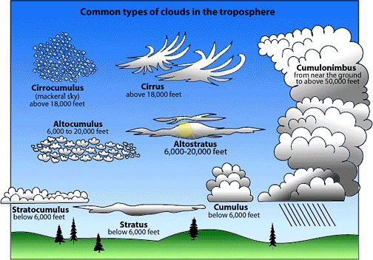
Clouds
Form as warm air is forced upward, expands and cools
Classified by shape and height and vary with the temperature, pressure and amount of water vapor
Height
  Cirro- high clouds, made of ice crystals
  Alto – middle-elevation clouds, very thick
  Strato- Low clouds, can be thick, can touch the ground.
Clouds associated with rain or snow have nimbus attached to them
  Latin for “dark rain cloud”
Stratus
  Form at low altitudes, layers, smooth sheets
  Fair weather, rain or snow
  Cooled near ground = FOG
Cumulus
  Masses of puffy, white clouds with flat bases
  Fair weather or thunderstorms
Cirrus
  Fibrous, curly, high, thin, white and feathery

Slide 9
Precipitation
Water falling from clouds
  Cloud droplets get large enough to fall
Raindrops
  Size depends on updrafts in cloud, rate of evaporation, and air temperature
    Snow – air temperature so cold, water immediately forms solid
    Sleet – drops pass through a freezing layer near earth’s surface
    Hail – lumps of ice formed in cumulonimbus clouds, water freezes in layers around a small nucleus of ice

Slide 10
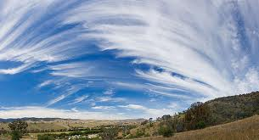
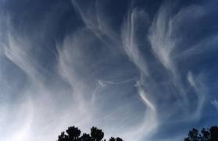

Slide 11
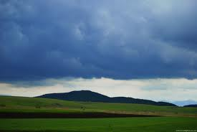
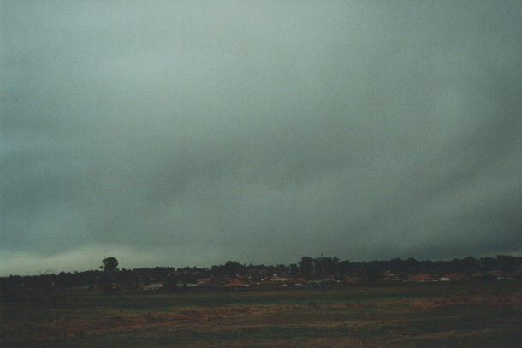

Slide 12
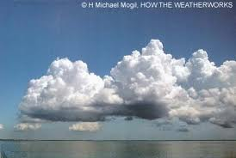

Slide 13
