Slide 1
Chapter 17
Climate

Slide 2
Sect 1
What is Climate

Slide 3
Objectives
Describe what determines climate and a classification system
Explain how organisms adapt to climates

Slide 4
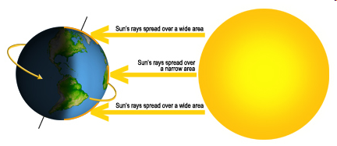
Climate
-The same pattern of weather that occurs in an area over many years
Determines the types of plants and animals that can survive
Latitude
  different latitudes have different climates
  Between the tropics and the polar zones are the temperate zones with moderate weather (us!)

Slide 5
Other Factors
Large Bodies of Water
  Absorb or give off additional heat
  Summer is cooler and winter is warmer on the coasts
Ocean Currents
  Warm currents move north from the equator and warm the land as they pass
  Wetter weather in general

Slide 6
Other Factors
Mountains
  Higher altitudes are cooler, less molecules to absorb heat
Rain Shadows
  On the windward side of a mountain, precipitation is high but on the leeward side the air heats up and climate is dry

Slide 7
Other Factors
Cities
  Heat from buildings and air pollution causes temperatures to rise up to 5 degrees that a rural community

Slide 8
Sec. 2
Climate Types

Slide 9
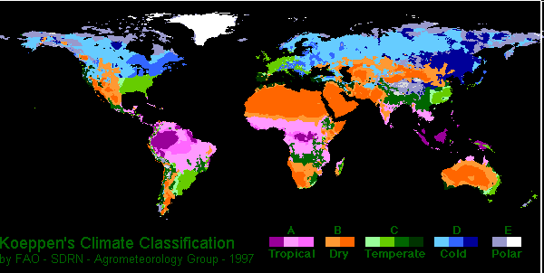
Classification
Koppen developed a system based on the types of plants that live in the region
  Tropical, mild, dry, continental, polar and high elevation

Slide 10
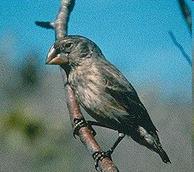
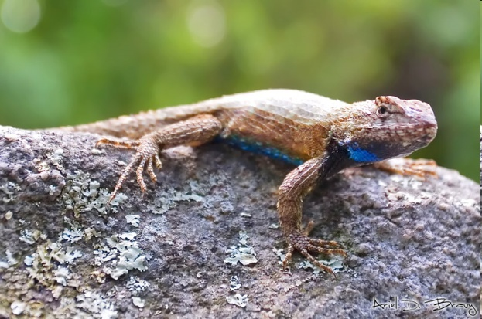
Adaptations
Any structure or behavior that helps an organism survive in its environment
  Structural
    Fur on mammals – keep warm
    Wax covering on cacti – less water loss
  Behavioral
    Hibernation – less activity during winter
    Desert animals hiding under rocks
  Estivation
    Fish burrow into mud to keep cool during periods of hot, dry months.
      Lungfish

Slide 11
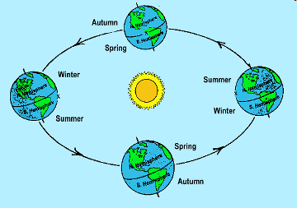
Climate Changes
Seasons
  Short periods of climate change due to the amount of solar radiation received because of the earth’s rotation around the sun

Slide 12
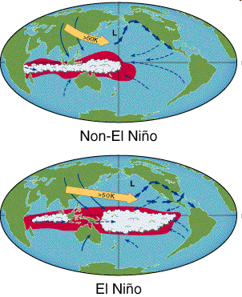
Climate Changes
El Nino and La Nina
  The winds that blow along the equator reverse and push warm or cool water in different directions than normal
  Affects precipitation and droughts across the world
  Pg 502 examples

Slide 13
Climate Changes
Causes
  Atmospheric solids and liquids (volcanic eruptions)
  Energy from the sun, solar enery (glaciers shrinking)
  Earth movements, plate movement (earth’s tilt)

Slide 14
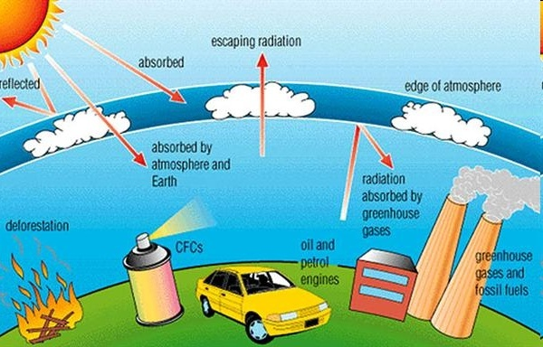
Human Activities
Greenhouse effect
  A natural heating when gases in the atmosphere trap heat from the sun
Global Warming
  Increase in the amount of greenhouse gases in atmosphere
  Burning of fossil fuels releases CO2
  Deforestation
  Average global temperatures are rising

