Slide 1



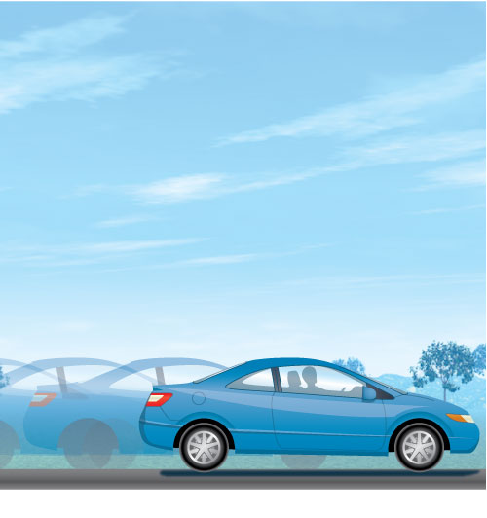




Chapter Menu
Chapter Introduction
Lesson 1 Describing
Motion
Lesson 2 Position
and Motion
Lesson 3 Acceleration
Chapter Wrap-Up

Slide 2


Chapter Introduction
What are some ways to describe motion?

Slide 3

Chapter Introduction
What do you think?
Before you begin, decide if you agree or disagree with each of these statements.
As you view this presentation, see if you change your mind about any of the statements.

Slide 4
Chapter Introduction
Do you agree or disagree?
1. Displacement is the distance an object moves along a path.
2. The description of an object’s position depends on the reference point.
3. Constant speed is the same thing as average speed.

Slide 5
Chapter Introduction
Do you agree or disagree?
4. Velocity is another name for speed.
5. You can calculate acceleration by dividing the change in velocity by the change in distance.
6. An object accelerates when either its speed or its direction changes.

Slide 6


Lesson 1 Reading Guide - KC
Position and Motion
How does the description of an object’s position depend on a reference point?
How can you describe the position of an object in two dimensions?
What is the difference between distance and displacement?

Slide 7

Lesson 1 Reading Guide - Vocab
Position and Motion
reference point
position
motion
displacement

Slide 8
Lesson 1-1
Describing Position
A description of a location usually states the location relative to a certain point (frame of reference).
relative
Science Use compared (to)
Common Use a member of your family

Slide 9
Lesson 1-1
Describing Position (cont.)
A reference point is a starting point that can be used to locate a place or thing (aka frame of reference).
A position is an object’s distance in a certain direction from a reference point.

Slide 10
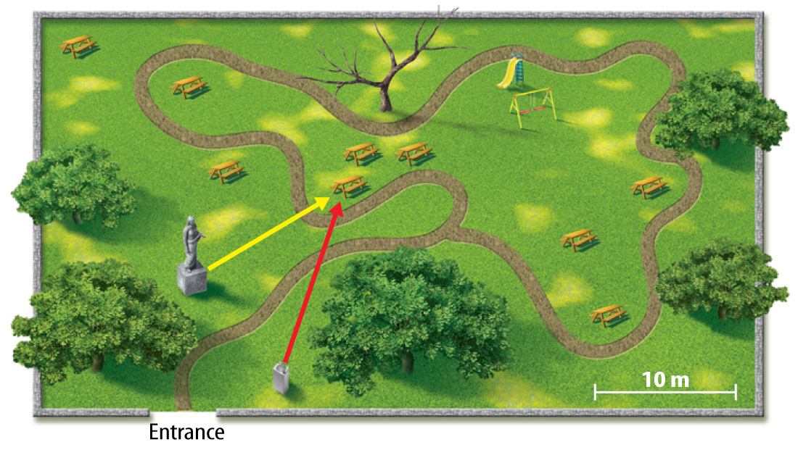
Lesson 1-1
Describing Position (cont.)
A complete description of your position includes a distance, a direction, and a reference point.

Slide 11
Lesson 1-1
Describing Position (cont.)
An object’s position is described by a reference direction, such as toward the slide.

Slide 12
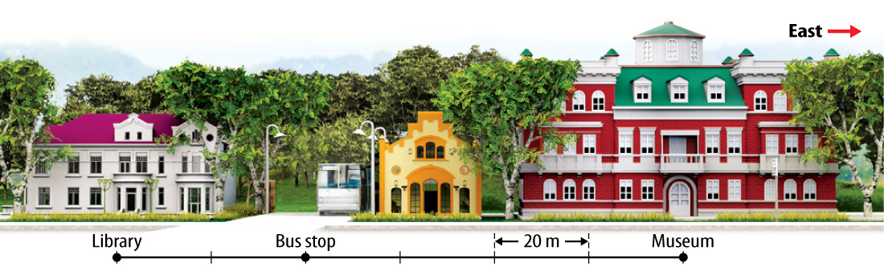
Lesson 1-1
Describing Position (cont.)
The reference direction is the positive (+) direction and the opposite direction is the negative (-) direction.

Slide 13
Lesson 1-2
Describing Position in Two Dimensions
When you describe a position using two directions, you are using two dimensions.
To find a position in two dimensions you must choose a reference point, specify reference directions, and then determine the distance along each reference direction.

Slide 14
Lesson 1-3
Describing Changes in Position
Motion is the process of changing position.
motion
from Latin motere, means “to move”

Slide 15
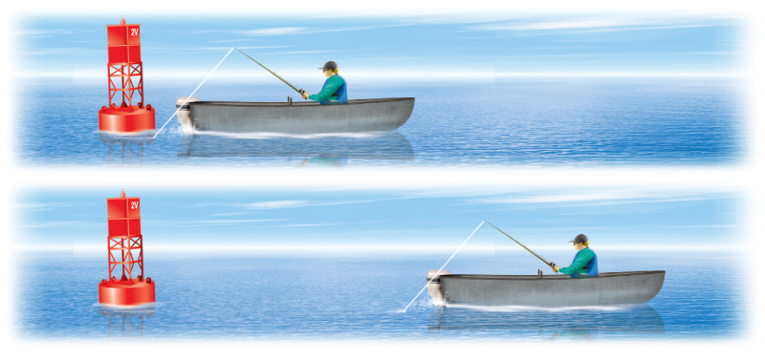
Lesson 1-3
The man in the boat is not in motion compared to his fishing pole.
He is in motion compared to the buoy.

Slide 16
Lesson 1-3
Describing Changes in Position (cont.)
Displacement is the difference between the initial (first) position and the final position of an object.
Distance depends on the path taken.
Displacement depends only on the initial and final positions.
Displacement has a distance AND direction!

Slide 17
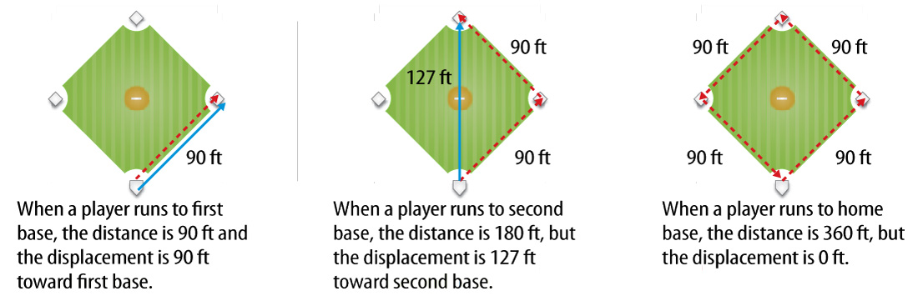
Lesson 1-3

Slide 18
Lesson 1-3

Slide 19

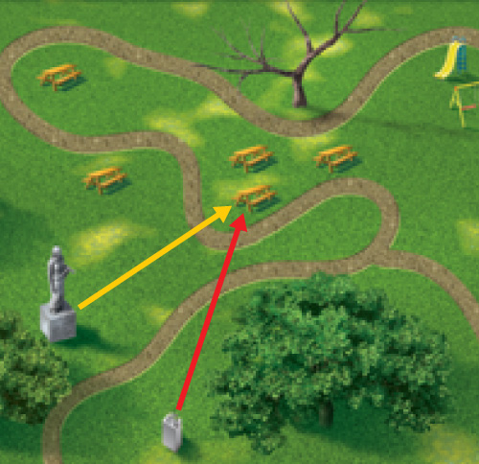
Lesson 1 - VS
A reference point,
a reference direction,
and distance are
needed to describe
the position of an
object.

Slide 20
Lesson 1 - VS
An object is in motion if its position changes relative to a reference point.

Slide 21
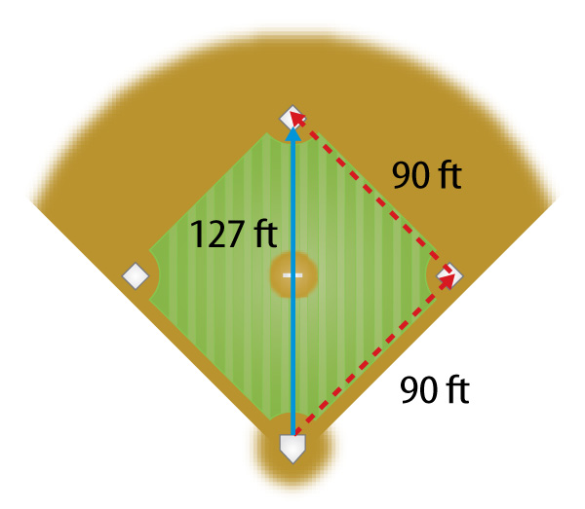
Lesson 1 - VS
The distance an object moves and the object’s displacement are not always the same.

Slide 22

Lesson 1 – LR1
When you describe a position using two directions, how many dimensions are you using?
A. one
B. two
C. three
D. none of the above

Slide 23
Lesson 1 – LR2
Which of these refers to the difference between the initial position and the final position of an object?
A. motion
B. reference point
C. displacement
D. direction

Slide 24
Lesson 1 – LR3
When describing an object’s position, the reference direction is which of these?
A. the positive direction
B. the negative direction
C. both of these
D. none of these

Slide 25

Lesson 1 - Now
Do you agree or disagree?
1. Displacement is the distance an object moves along a path.
2. The description of an object’s position depends on the reference point.

