Slide 1



Lesson 2 Reading Guide - KC
Speed and Velocity
What is speed?
How can you use a distance-time graph to calculate average speed?
What are ways velocity can change?

Slide 2

Lesson 2 Reading Guide - Vocab
Speed and Velocity
speed
constant speed
instantaneous speed
average speed
velocity

Slide 3
Lesson 2-1
What is speed?
Speed is a measure of the distance an object travels in a unit of time.

Slide 4
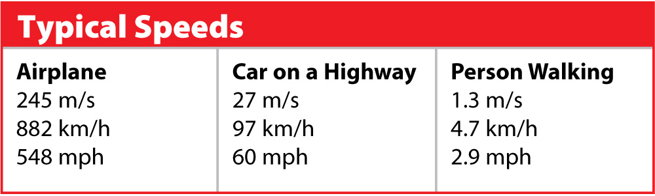
Lesson 2-1
What is speed? (cont.)
You can calculate speed by dividing the distance traveled by the time it takes to go that distance.

Slide 5
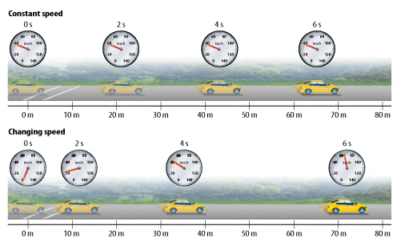
Lesson 2-1
What is speed? (cont.)
Constant speed is the rate of change of position in which the same distance is traveled each second.

Slide 6
Lesson 2-1
What is speed? (cont.)
When the car’s speed changes, it moves a different distance each period of time.

Slide 7

Lesson 2-1
What is speed? (cont.)
Instantaneous speed is speed at a specific instant in time.
Average speed is the total distance traveled divided by the total time taken to travel that distance.

Slide 8
Math skills problem p 19
Melissa shot a model rocket 360 m into the air. It took the rocket 4 s to fly that far. What was the average speed of the rocket?

Slide 9
Practice!
It takes Ahmed 50 s to reach his friend’s house 250 m away when he rides his bicycle. What is his average speed?

Slide 10
Practice again!
A truck driver makes a trip that covers 2380 km in 28 hours. What is the driver’s average speed?

Slide 11
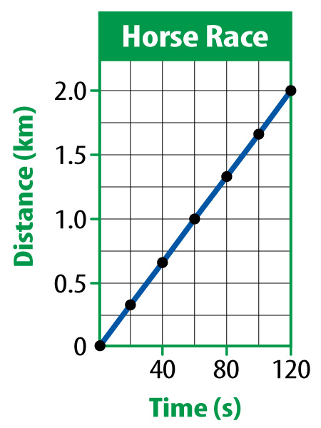
Lesson 2-2
Distance-Time Graphs
Graphs that show comparisons between distance and time are called distance-time graphs.
Constant speed is shown as a straight line on a distance-time graph.
Distance/Time Graph Video

Slide 12
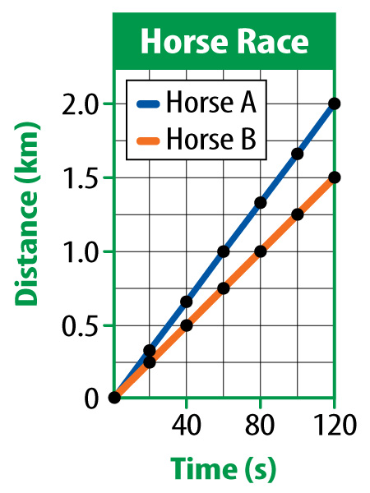
Lesson 2-2
Distance-Time Graphs (cont.)
You can use distance-time graphs to compare the motion of two different objects.
The steeper line indicates a faster speed.

Slide 13
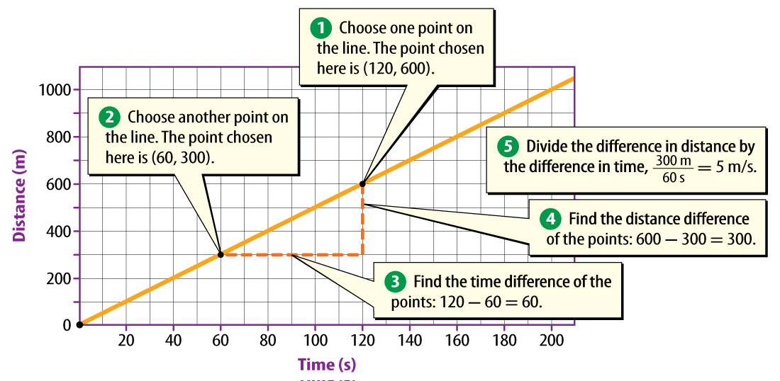
Lesson 2-2
You can use distance-time graphs to calculate the average speed of an object.

Slide 14
An example: Graph the data collected by Grok showing Reeee’s movement, then calculate the average speed:
Distance (m) | Time (s)
0 | 0
15 | 20
45 | 60
45 | 90
60 | 120
90 | 200
100 | 240

Slide 15
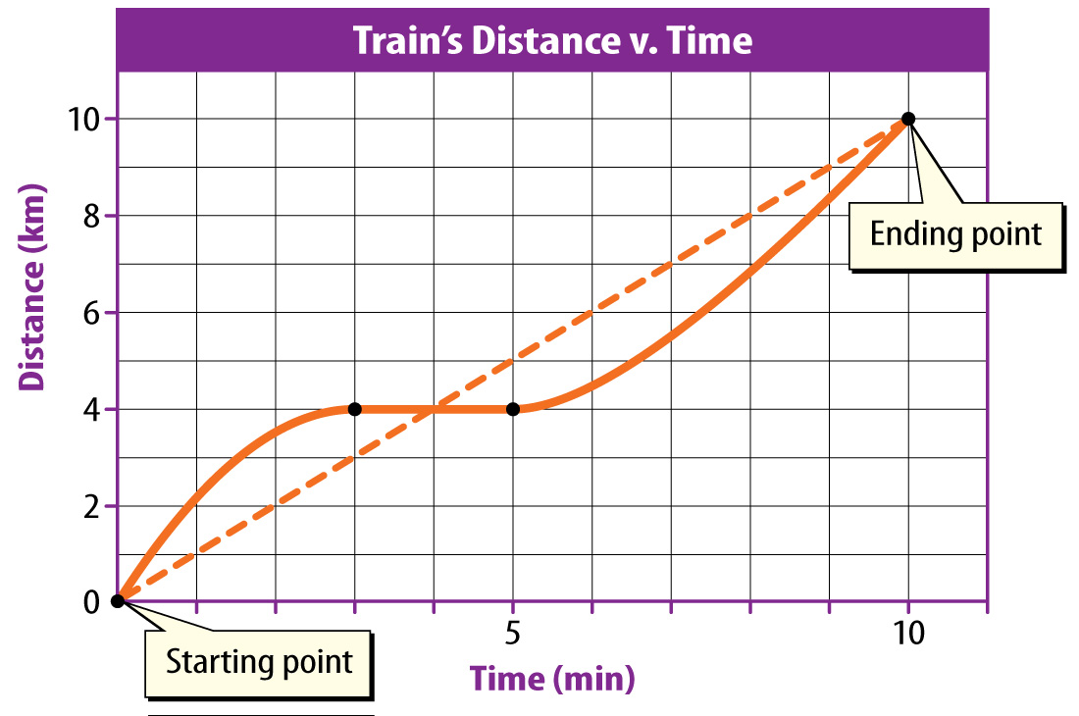
Lesson 2-2
Distance-Time Graphs (cont.)
If the speed of an object changes instead of being constant, its motion on a distance-time
graph is a
curved line.

Slide 16
Lesson 2-3
Velocity
Velocity is the speed and the direction of a moving object.
velocity
from Latin velocitas, means “swiftness, speed”

Slide 17
Lesson 2-3
Velocity (cont.)
The velocity of an object can be represented by an arrow.
A greater speed is shown by a longer arrow.
The arrow points in the direction of the object’s movement.

Slide 18
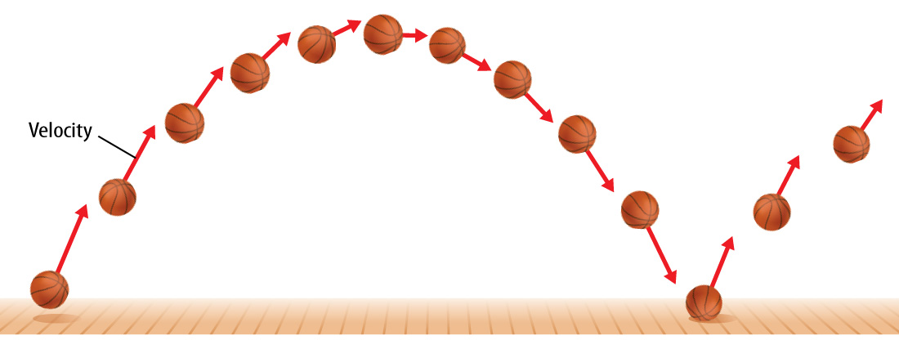
Lesson 2-3
Velocity (cont.)
Velocity changes when the speed of an object changes, when the direction that the object moves changes, or when both the speed and the direction change.

Slide 19

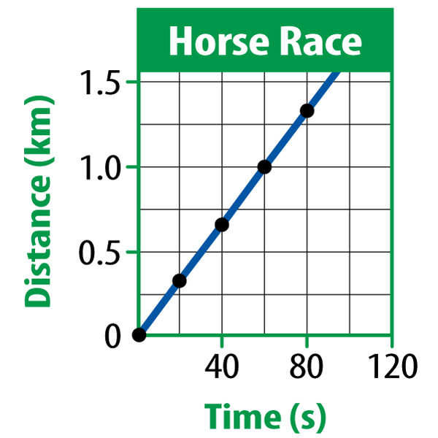
Lesson 2 - VS
Speed is a measure of the distance an object travels in a unit of time. You can describe an object’s
constant speed,
instantaneous
speed, or average
speed.
A distance-time
graph shows the
speed of an object.

Slide 20
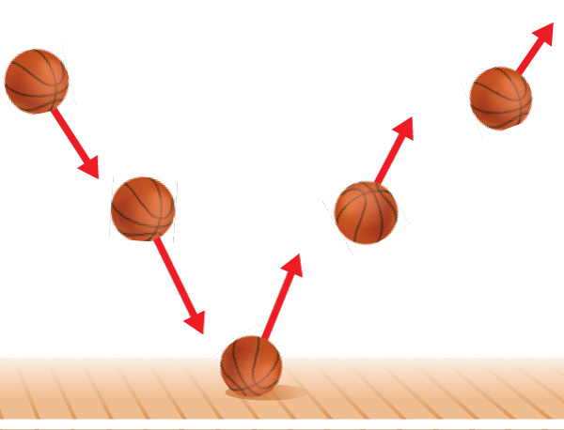
Lesson 2 - VS
Velocity includes both the speed and the direction of motion.

Slide 21

Lesson 2 – LR1
The total distance traveled divided by the total time taken to travel that distance is known as which of these?
A. speed
B. constant speed
C. instantaneous speed
D. average speed

Slide 22
Lesson 2 – LR2
Units of speed are units of distance divided by which of these?
A. units of speed
B. constant speed
C. units of time
D. average speed

Slide 23
Lesson 2 – LR3
How is constant speed represented on a distance-time graph?
A. a wavy line
B. a crooked line
C. a straight line
D. a curved line

Slide 24

Lesson 2 - Now
Do you agree or disagree?
3. Constant speed is the same thing as average speed.
4. Velocity is another name for speed.

