Slide 1



Lesson 3 Reading Guide - KC
Acceleration
What are three ways an object can accelerate?
What does a speed-time graph indicate about an object’s motion?

Slide 2

Lesson 3 Reading Guide - Vocab
Acceleration
acceleration

Slide 3
Lesson 3-1
Acceleration—Changes in Velocity
Acceleration is a measure of how much the velocity of an object changes in a unit of time.
  RATE of change of velocity
An object accelerates when its velocity changes as a result of changing speed or direction.

Slide 4
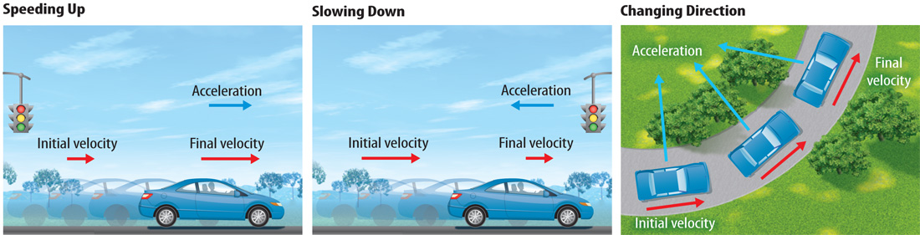
Lesson 3-1
Acceleration—Changes in Velocity (cont.)
Acceleration has a direction and can be represented by an arrow.

Slide 5

Lesson 3-1
Acceleration—Changes in Velocity (cont.)
What are the ways an object can accelerate?

Slide 6
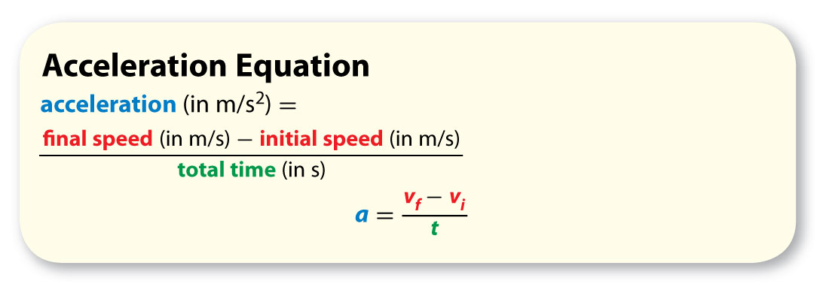
Lesson 3-2
Calculating Acceleration
Acceleration is a change in velocity divided by the time interval during which the velocity changes.

Slide 7
Lesson 3-2
Calculating Acceleration (cont.)
Acceleration is in the direction of motion if it is positive.
Acceleration is opposite the direction of motion if it is negative.

Slide 8
Lesson 3-3
Speed-Time Graphs
A speed-time graph shows how speed changes over time.
A speed-time graph has time on the horizontal axis (the x-axis), and speed on the vertical axis (the y axis).

Slide 9
Lesson 3-3
Speed-Time Graphs (cont.)
horizontal
from Greek horizein, means “limit, divide, separate”
vertical
from Latin verticalis, means “overhead”

Slide 10
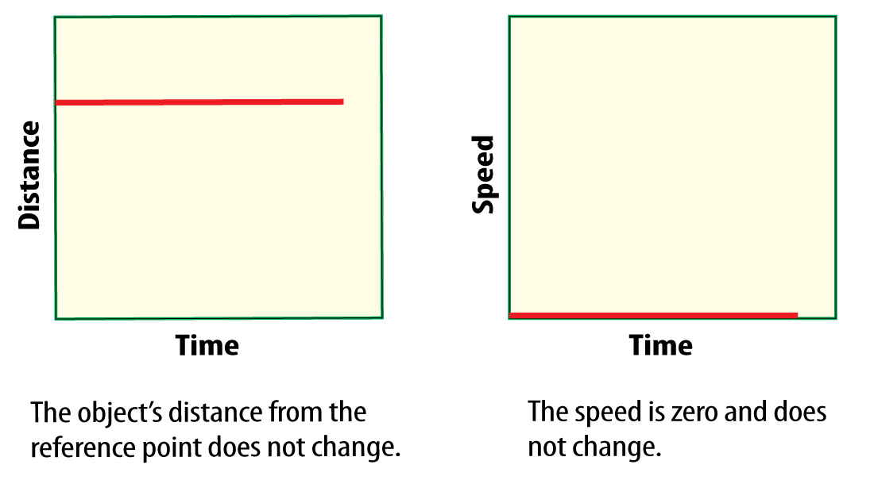
Lesson 3-3
Speed-Time Graphs (cont.)
An object at rest is not moving, so its speed is always zero.

Slide 11
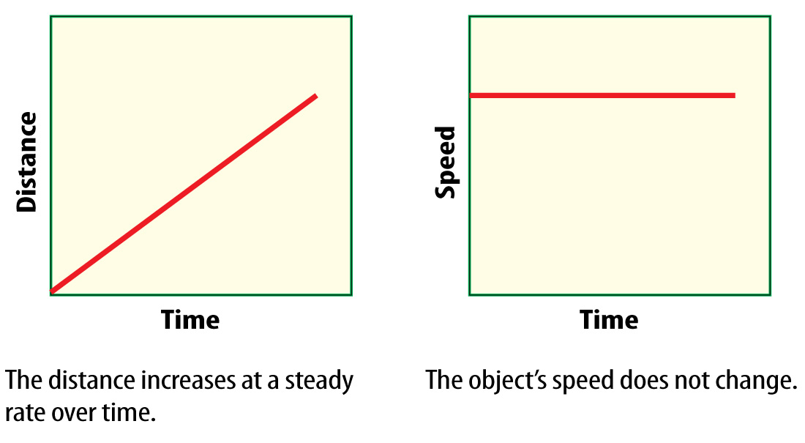
Lesson 3-3
Speed-Time Graphs (cont.)
If an object is moving at constant speed, the speed-time graph is a horizontal line.

Slide 12
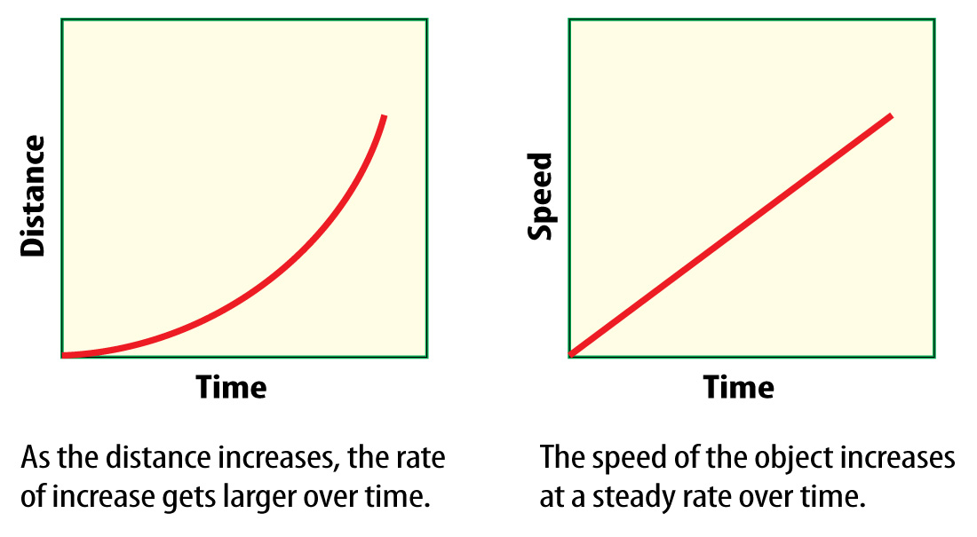
Lesson 3-3
Speed-Time Graphs (cont.)
The line on the speed-time graph for an object that is speeding up has an upward (positive) slope.

Slide 13
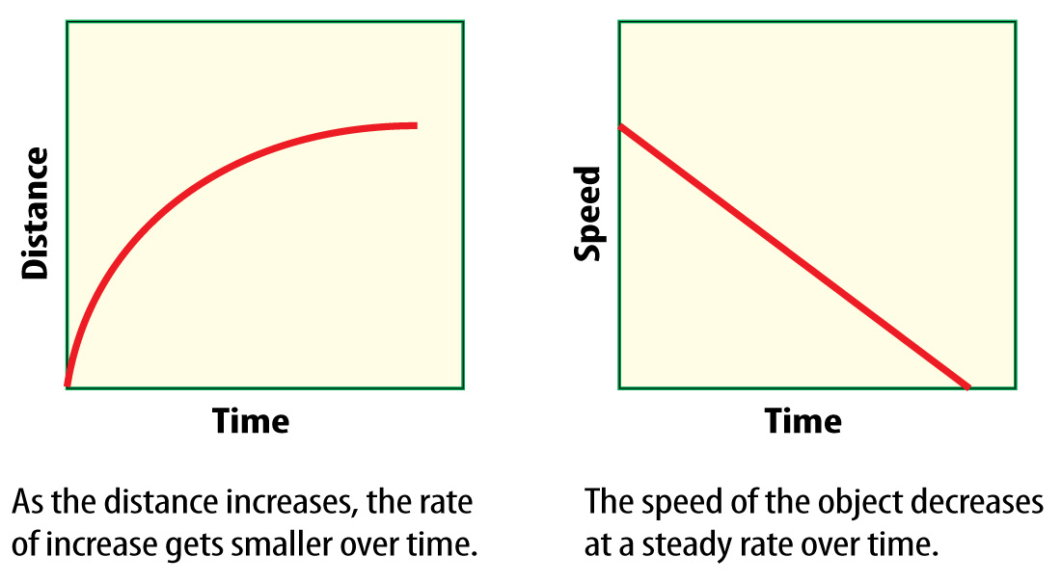
Lesson 3-3
Speed-Time Graphs (cont.)
The line on the speed-time graph for an object that is slowing down has a downward (negative) slope.

Slide 14
Lesson 3-4
Summarizing Motion
There are several ways to describe motion.
You can describe position by direction and distance from a reference point.
You can compare distance and displacement to find average speed.
You can describe velocity by speed and direction.

Slide 15

Lesson 3 - VS
An object accelerates if it speeds up, slows down, or changes direction.

Slide 16
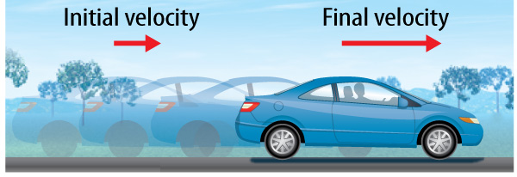
Lesson 3 - VS
Acceleration in a straight line can be calculated by dividing the change in speed by the change in time.

Slide 17
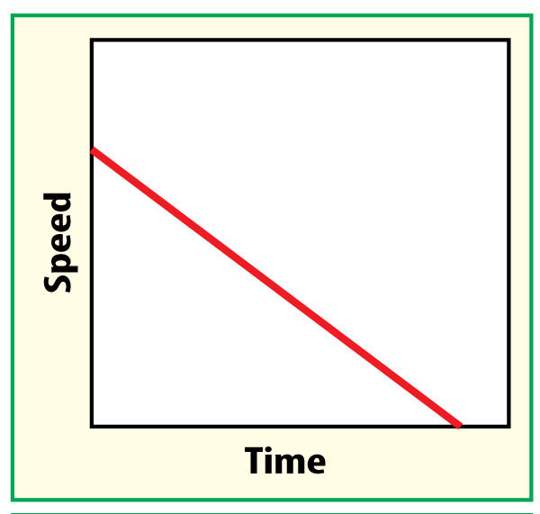
Lesson 3 - VS
A speed-time graph shows how an object’s speed changes over time (acceleration).

Slide 18

Lesson 3 – LR1
An objects accelerates when its velocity changes as a result of which of these?
A. increasing speed
B. decreasing speed
C. a change in direction
D. all of the above

Slide 19
Lesson 3 – LR2
On a speed-time graph, where is time located?
A. the horizontal axis (the x-axis)
B. the vertical axis (the y-axis)
C. both of these
D. neither of these

Slide 20
Lesson 3 – LR3
Which of these refers to a change in velocity during a time interval divided by the time interval during which the velocity changes?
A. acceleration
B. speed
C. velocity
D. none of these

Slide 21

Lesson 3 - Now
Do you agree or disagree?
5. You can calculate acceleration by dividing the change in velocity by the change in distance.
6. An object accelerates when either its speed or its direction changes.

