Slide 1



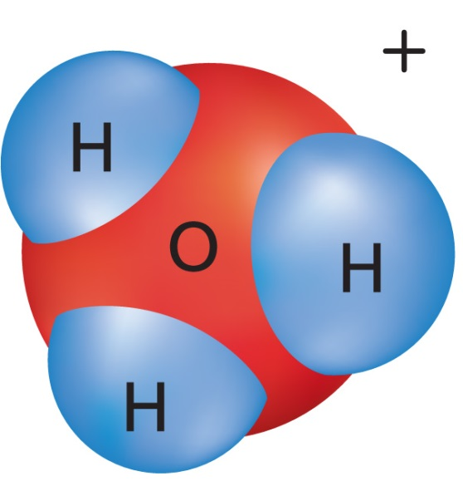




Chapter Menu
Chapter Introduction
Lesson 1 Substances
and Mixtures
Lesson 2 Properties
of Solutions
Lesson 3 Acid and Base
Solutions
Chapter Wrap-Up

Slide 2



Lesson 1 Reading Guide - KC
Substances and Mixtures
How do substances and mixtures differ?
How do solutions compare and contrast with heterogeneous mixtures?
In what three ways do compounds differ from mixtures?

Slide 3
Lesson 1-1
Matter: Substances and Mixtures
Two categories for matter:
A substance is matter that is always made up of the same combination of atoms.
  Two kinds of substance:
  Element
  Compound
    2 or more elements chemically bonded

Slide 4
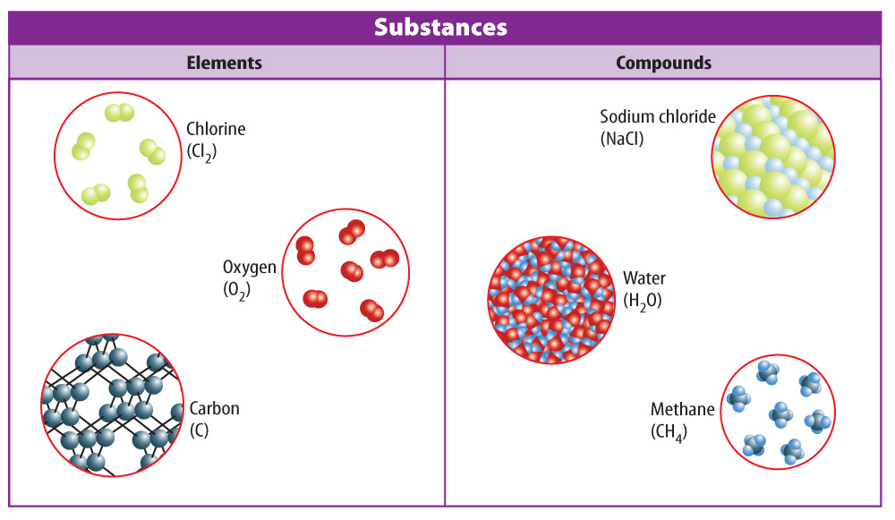
Lesson 1-1
There are two types of substances—elements and compounds.

Slide 5
Lesson 1-1
Matter: Substances and Mixtures (cont.)
A mixture is two or more substances that are physically blended but NOT chemically bonded.
The amounts of each substance in a mixture can vary.
There are two different types of mixtures—heterogeneous and homogeneous.

Slide 6
Lesson 1-1
Matter: Substances and Mixtures (cont.)
A heterogeneous mixture is a mixture in which substances are not evenly mixed.
A homogeneous mixture is a mixture in which two or more substances are evenly mixed but not bonded together.
Another name for a homogeneous mixture is solution.

Slide 7
Lesson 1-1
Matter: Substances and Mixtures (cont.)
heterogeneous
from Greek heteros, means “different”; and genos, means “kind”
homogeneous
from Greek homos, means “same”; and genos, means “kind”

Slide 8
Lesson 1-2
How do compounds and mixtures differ?
Substances that make up a mixture are not changed chemically, so some of their properties are observed in the mixture.
The properties of a compound are different from the properties of the elements that make it up.

Slide 9
Lesson 1-2
How do compounds and mixtures differ? (cont.)
Because the substances that make up a mixture are not bonded together, they can be separated from each other using physical methods.
Physical properties such as boiling points, magnetism and freezing point can be used to separate the substances.

Slide 10
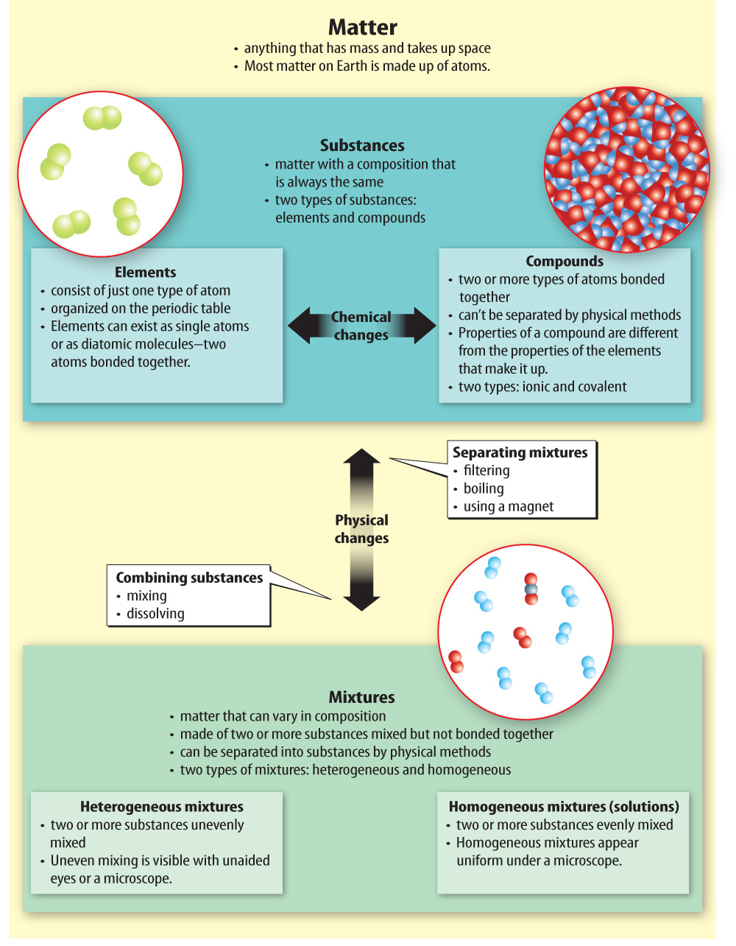
Lesson 1-2

Slide 11
Lesson 1-2

Slide 12

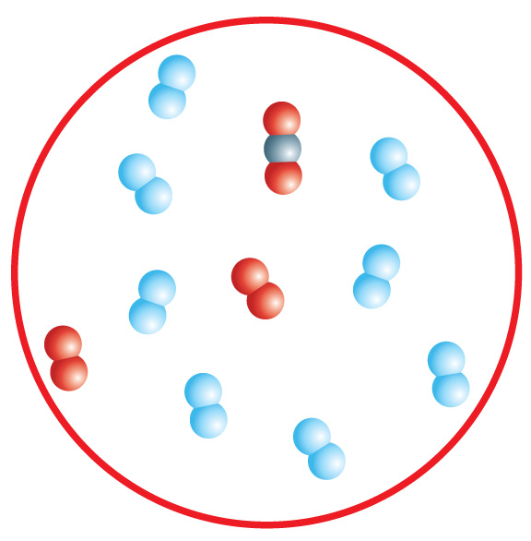
Lesson 1 - VS
Substances have a composition that does not change. The composition of mixtures can vary.
Solutions (homogeneous
mixtures) are mixed at
the atomic level.

Slide 13
Lesson 1 - VS
Mixtures contain parts that are not bonded together. These parts can be separated using physical means.

Slide 14

Lesson 1 – LR1
What are the two types of substances?
A. mixtures and compounds
B. mixtures and solutions
C. elements and compounds
D. elements and solutions

Slide 15
Lesson 1 – LR2
Which term refers to a mixture in which substances are not evenly mixed?
A. heterogeneous mixture
B. homogeneous mixture
C. solution
D. compound

Slide 16
Lesson 1 – LR3
How can substances that make up a mixture be separated?
A. by using chemical changes
B. by using chemical properties
C. by using physical changes
D. by using physical properties

Slide 17

Lesson 1 - Now
Do you agree or disagree?
1. You can identify a mixture by looking
at it without magnification.
2. A solution is another name for a homogeneous mixture.

