Slide 1


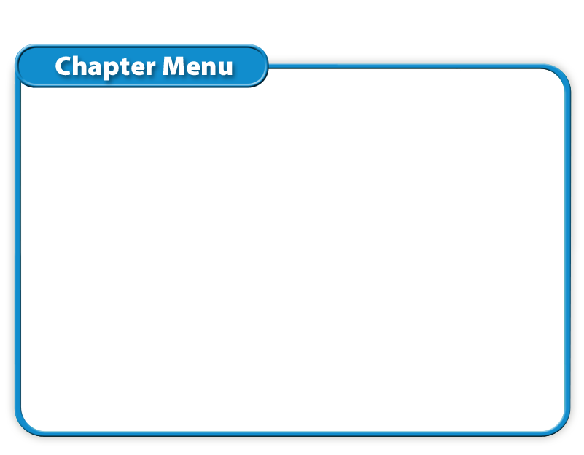
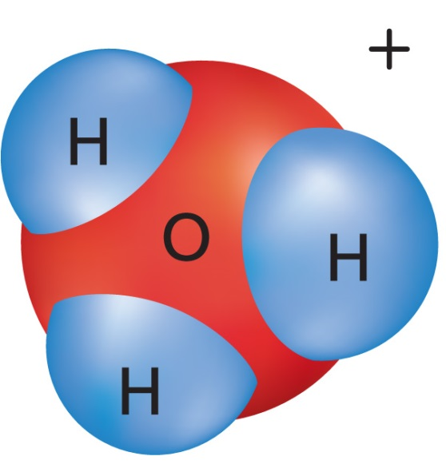




Chapter Menu
Chapter Introduction
Lesson 1 Substances
and Mixtures
Lesson 2 Properties
of Solutions
Lesson 3 Acid and Base
Solutions
Chapter Wrap-Up

Slide 2



Lesson 2 Reading Guide - KC
Properties of Solutions
Why do some substances dissolve in water and others do not?
How do concentration and solubility differ?
How can the solubility of a solute be changed?

Slide 3
Lesson 2-1
Parts of Solutions
Remember: A solution is a homogeneous mixture!
The solvent is the substance that exists in the greatest quantity in a solution.
All other substances in a solution are solutes.

Slide 4
Lesson 2-2
Types of Solutions
Solutions can exist in all three states of matter—solid, liquid, or gas.
The state of the solvent, because it exists in the greatest quantity, determines the state of the solution

Slide 5
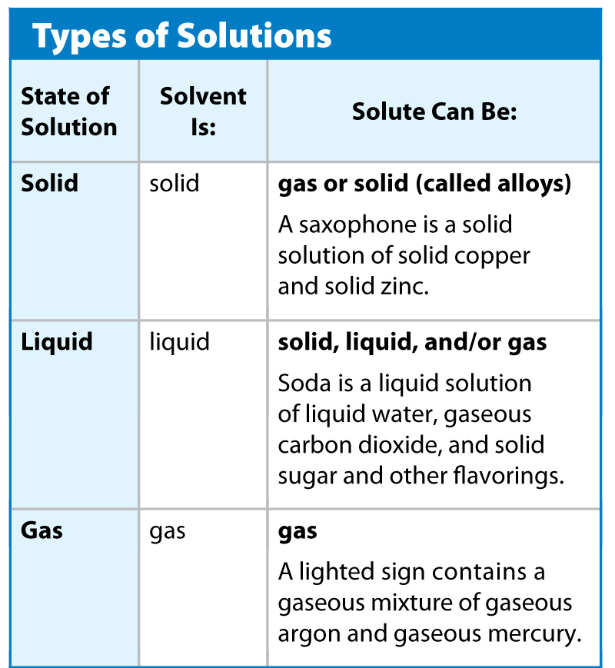
Lesson 2-2

Slide 6
Lesson 2-3
Water as a Solvent
Water is one of the few substances on Earth that exists naturally in all three states—solid, liquid, and gas.
In nature, water almost always exists as a solution; it contains dissolved solutes.
A water molecule is a covalent compound, but polar, so it can dissolve:
  Ionic solutes
  Covalent solutes

Slide 7
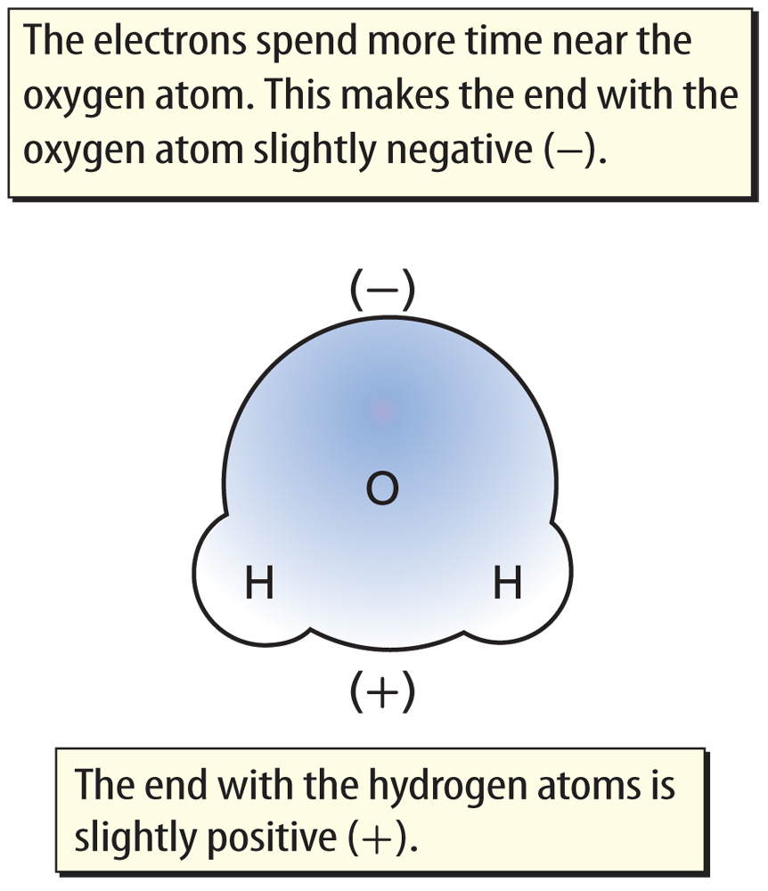
Lesson 2-3
Water is a polar molecule—a molecule with a slightly negative end and a slightly positive end.
Polar molecules attract other things with charges.

Slide 8
Lesson 2-4
Like Dissolves Like
Water is often called the universal solvent because it dissolves many different substances.
Polar solvents dissolve polar solutes easily. Nonpolar solvents dissolve nonpolar solutes easily.
Because water is a polar solvent and also covalent, it dissolves most polar and ionic solutes AND many covalent solutes.

Slide 9
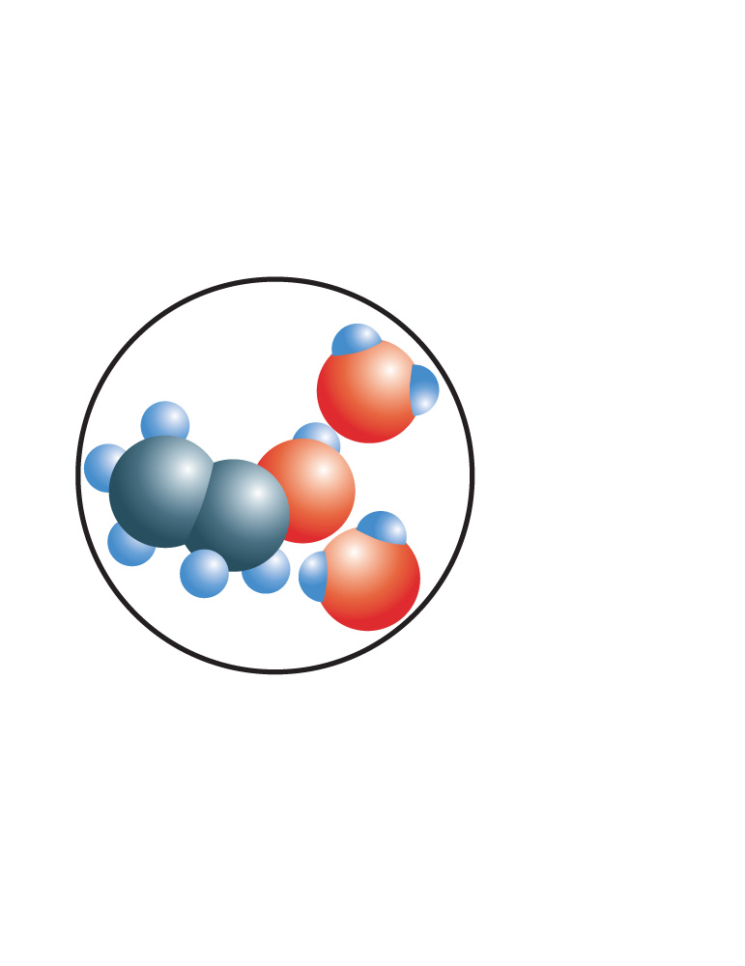
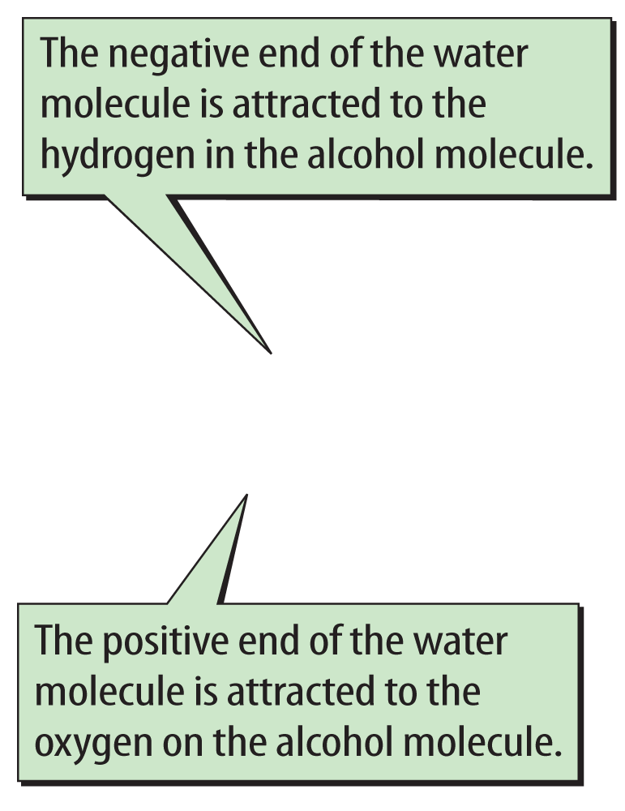
Lesson 2-4
When a polar solute, such as rubbing alcohol, dissolves in a polar solvent, such as water, the poles of the solvent are attracted to the oppositely charged poles of the solute.

Slide 10
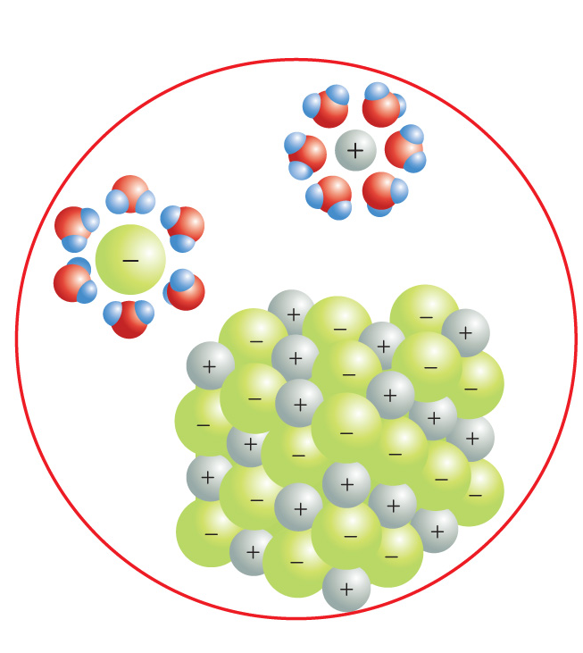
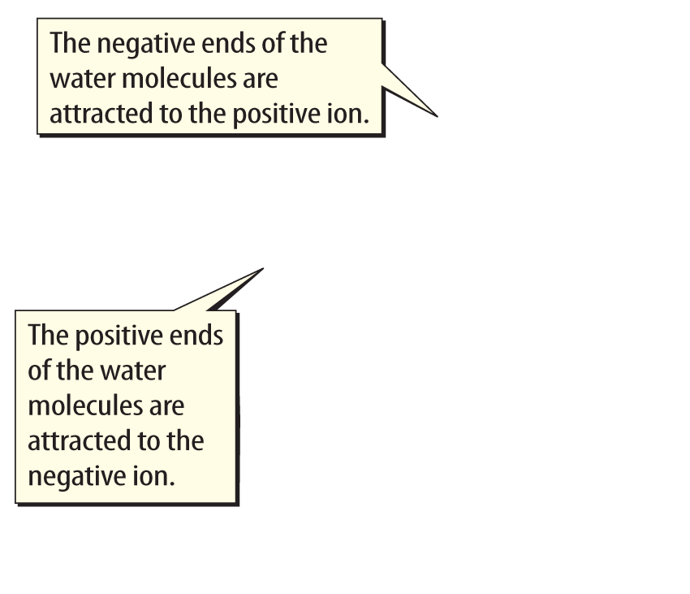
Lesson 2-4
When ionic solutes dissolve, the positive poles
of the solvent are attracted to the negative ions.
The negative
poles of the
solvent are
attracted to the positive ions.

Slide 11
Lesson 2-5
Concentration—How much is dissolved?
Concentration is the amount of a solute in a specific amount of solution.
The terms concentrated and dilute are one way to describe how much solute is dissolved in a solution.
  These terms are not precise.

Slide 12
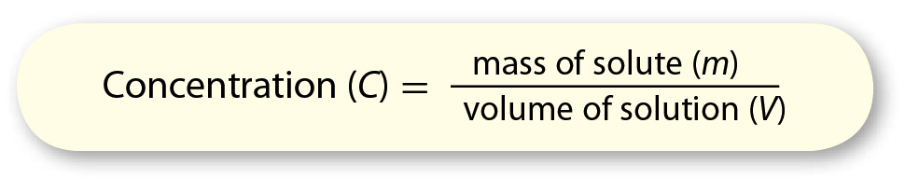
Lesson 2-5
Concentration—How much is dissolved? (cont.)
One way to calculate concentration:

Slide 13
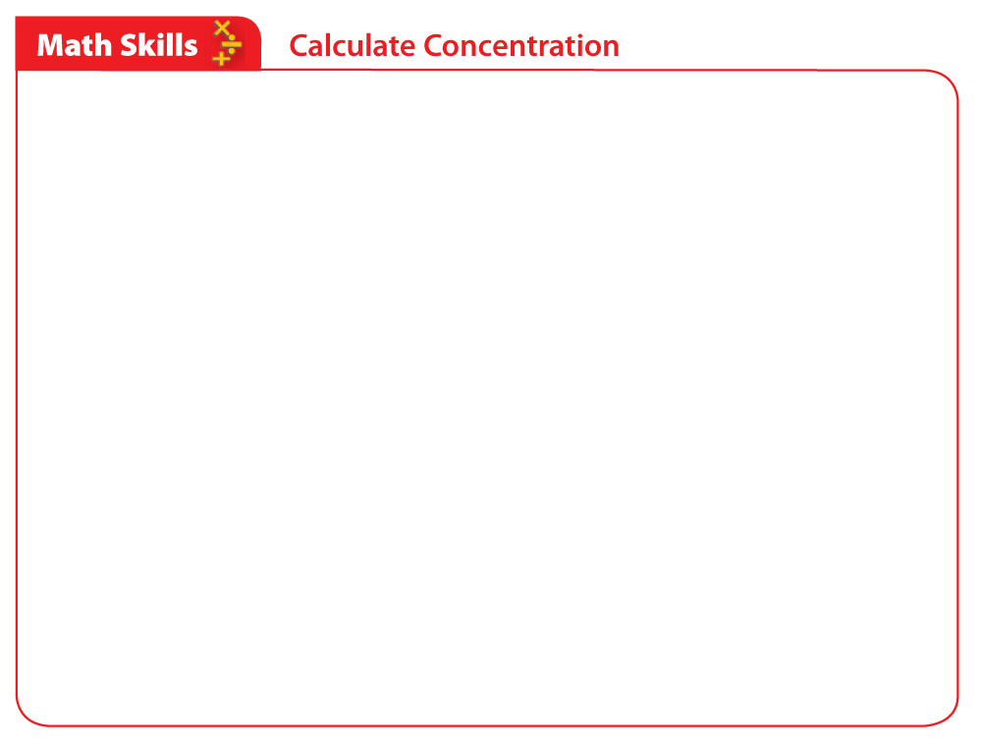
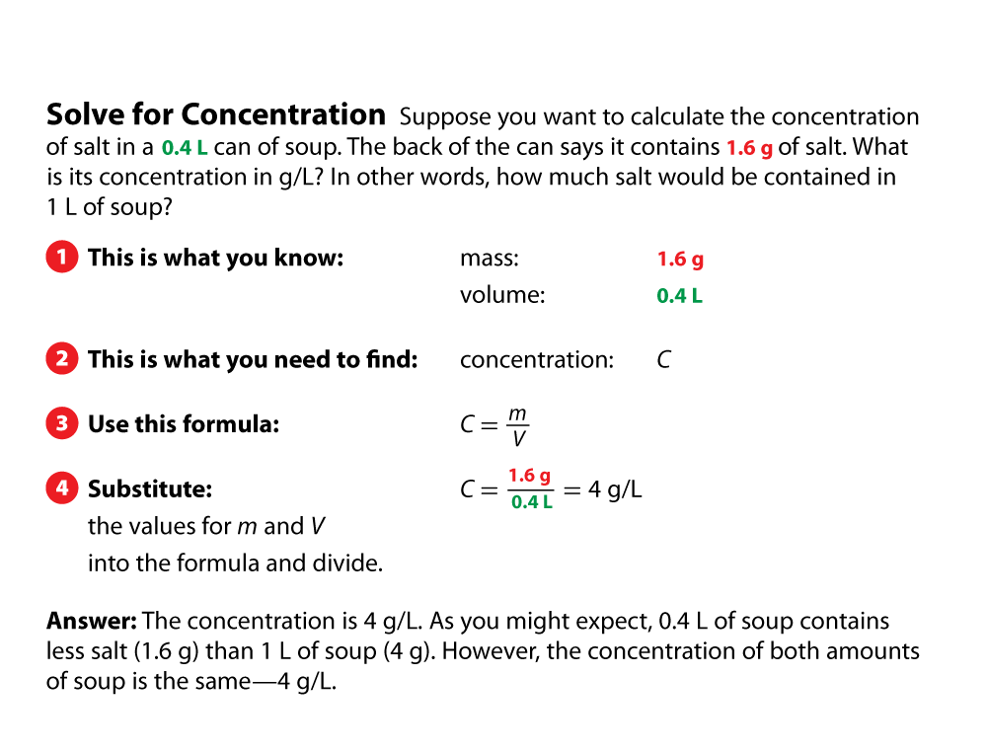
Lesson 2-5

Slide 14
Lesson 2-5
Concentration—How much is dissolved? (cont.)
If a solution contains only liquids or gases, its concentration is stated as the volume of solute in a given volume of solution.
Percent by volume is calculated by dividing the volume of the solute by the total volume of solution and then multiplying the quotient by 100.

Slide 15
Lesson 2-6
Solubility—How much can dissolve?
Solubility is the maximum amount of solute that can dissolve in a given amount of solvent at a given temperature and pressure.
solubility
from Latin solvere, means
“to loosen”

Slide 16
Lesson 2-6
Solubility—How much can dissolve?
(cont.)
A saturated solution is a solution that contains the maximum amount of solute the solution can hold at a given temperature and pressure.
An unsaturated solution is a solution that can still dissolve more solute at a given temperature and pressure.

Slide 17
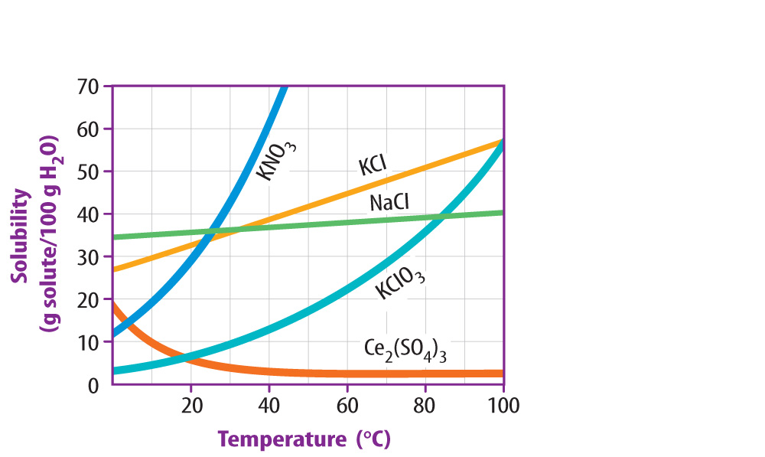
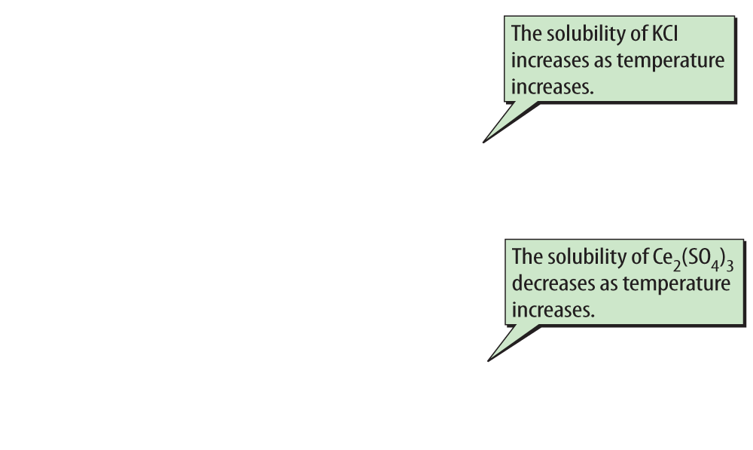
Lesson 2-6
Changing either temperature or pressure changes how much solute can dissolve in a solvent.

Slide 18
Lesson 2-6
How Fast a Solute Dissolves
If solute and solvent particles come into contact more often, the solute dissolves faster.
Stirring a solution, crushing the solute, and increasing the temperature are three ways to increase how often solute particles contact solvent particles.

Slide 19
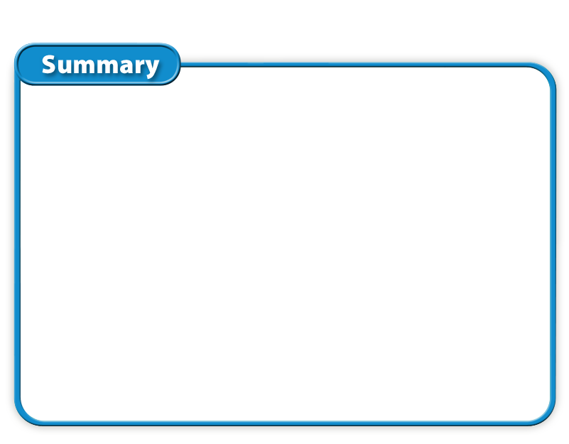
Lesson 2 - VS
Substances dissolve in other substances that have similar polarity. In other words, like dissolves like.

Slide 20
Lesson 2 - VS
Concentration is the amount of substance that is dissolved. Solubility is the maximum amount that can dissolve.
Both temperature and pressure affect the solubility of solutes in solutions.

Slide 21
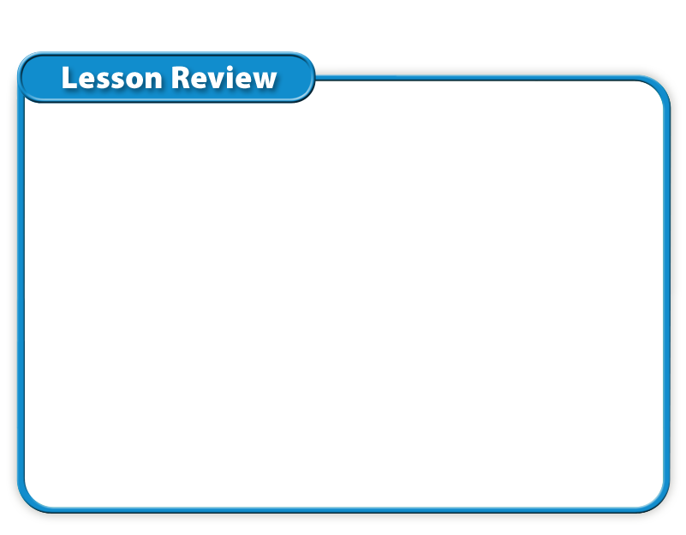
Lesson 2 – LR1
Which refers to a molecule with
a slightly negative end and a slightly positive end?
A. concentrated molecule
B. nonpolar molecule
C. polar molecule
D. saturated molecule

Slide 22
Lesson 2 – LR2
Which term refers to a solution that can still dissolve more solute at a given temperature and pressure?
A. unsaturated solution
B. saturated solution
C. polar solution
D. concentrated solution

Slide 23
Lesson 2 – LR3
A solid might become less soluble in a liquid when you decrease what?
A. particle size
B. pressure
C. temperature
D. stirring

Slide 24

Lesson 2 - Now
Do you agree or disagree?
3. Solutions can be solids, liquids, or gases.
4. A teaspoon of soup is less concentrated than a cup of the same soup.

