Slide 1



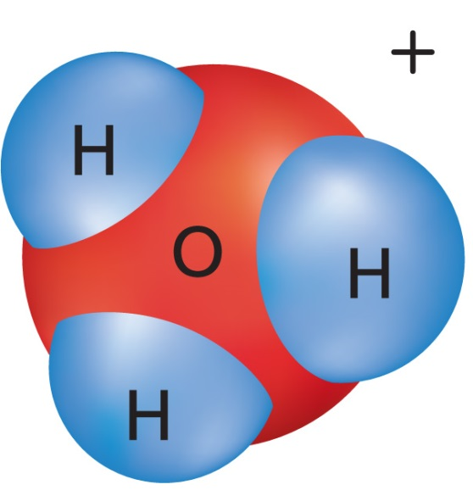




Chapter Menu
Chapter Introduction
Lesson 1 Substances
and Mixtures
Lesson 2 Properties
of Solutions
Lesson 3 Acid and Base
Solutions
Chapter Wrap-Up

Slide 2



Lesson 3 Reading Guide - KC
Acid and Base Solutions
What happens when acids and bases dissolve in water?
How does the concentration of hydronium ions affect pH?
What methods can be used to measure pH?

Slide 3
Lesson 3-1
What are acids and bases?
An acid is a substance that produces a hydronium ion (H₃O⁺) when dissolved in water.
Nearly all acid molecules contain one or more hydrogen atoms.
A hydronium ion, H₃O⁺, is a positively charged ion formed when an acid dissolves in water.

Slide 4
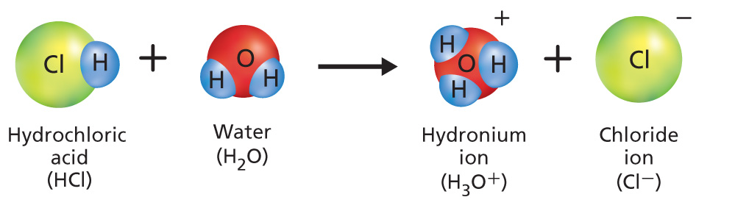
Lesson 3-1
When an acid mixes with water, the hydrogen atom separates from the acid and quickly combines with a water molecule, resulting in a hydronium ion.

Slide 5
Lesson 3-1
What are acids and bases? (cont.)
A base is a substance that produces hydroxide ions (OH–) when dissolved in water.
When a hydroxide compound mixes with water, hydroxide ions separate from the base and form hydroxide ions in water.

Slide 6
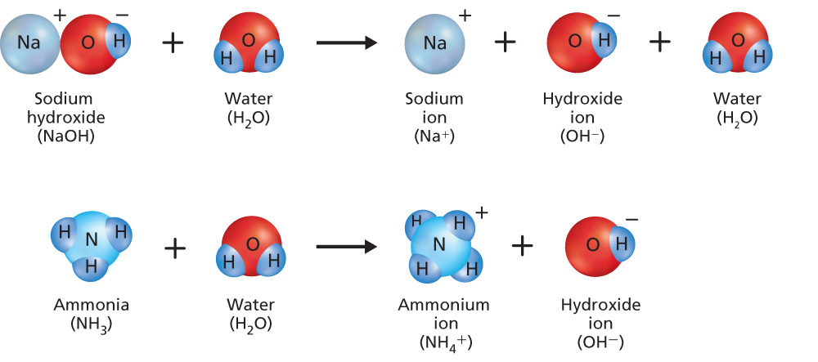
Lesson 3-1
When a hydroxide compound mixes with water, hydroxide ions separate from the base and form hydroxide ions in water.

Slide 7
Lesson 3-1
Bases that do not contain hydroxide ions produce hydroxide ions by taking hydrogen atoms away from water, leaving hydroxide ions.

Slide 8
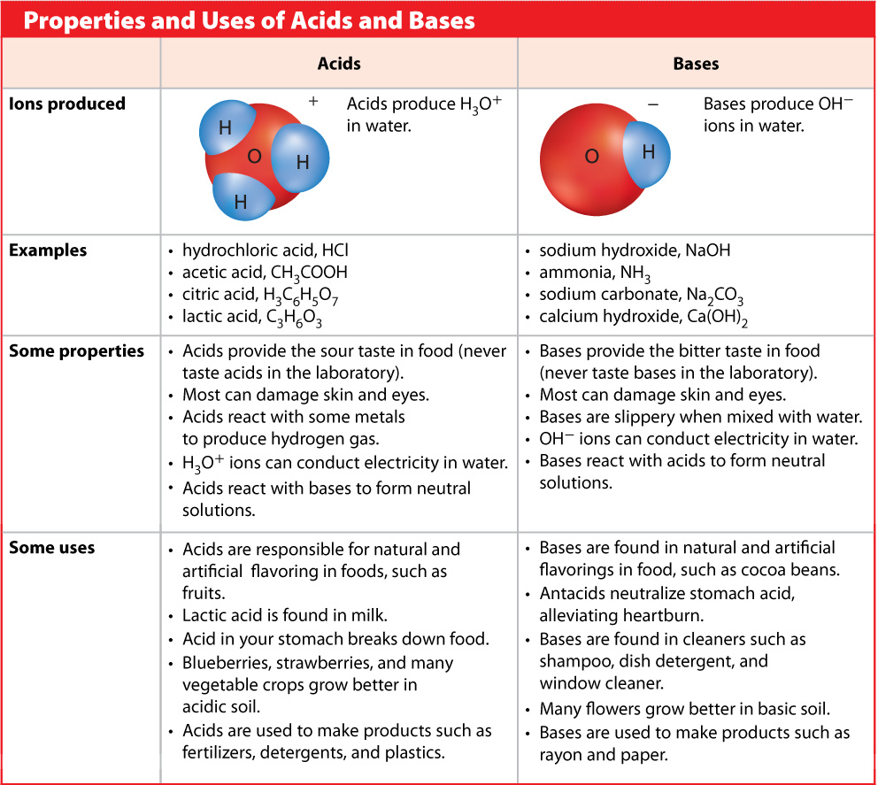
Lesson 3-1

Slide 9
Lesson 3-2
What is pH?
The pH is an inverse measure of the concentration of hydronium ions (H₃O⁺) in a solution.
A solution with a lower pH is more acidic.

Slide 10
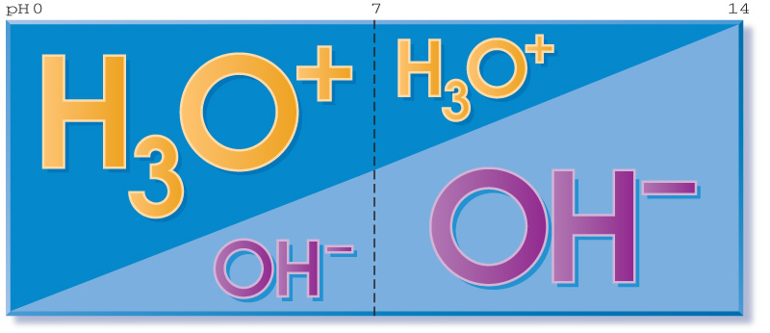
Lesson 3-2
As the concentration of hydronium ions decrease, the pH increases.

Slide 11
Lesson 3-2
What is pH? (cont.)
All acid and base solutions contain both hydronium and hydroxide ions.
In a neutral solution, such as water, the concentrations of hydronium and hydroxide ions are equal.
Acids have a greater concentration of hydronium ions than hydroxide ions.
Bases have a greater concentration of hydroxide ions than hydronium ions.

Slide 12
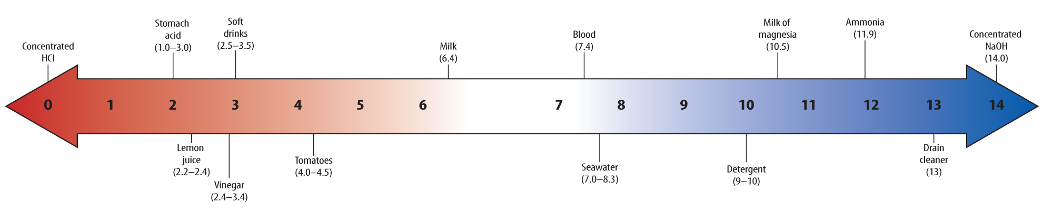
Lesson 3-2
The pH scale helps classify solutions as acidic or basic.

Slide 13
Lesson 3-2
The pH scale helps classify solutions as acidic or basic.

Slide 14
Lesson 3-2
What is pH? (cont.)
The pH scale is used to indicate how acidic or basic a solution is.
The pH scale contains values that range from below 0 to above 14.
On the pH scale acids have a pH below 7.
Bases have a pH above 7.

Slide 15
Lesson 3-2
What is pH? (cont.)
Solutions that are neutral have a pH
of 7—they are neither acidic nor basic.
A change in one pH unit represents a tenfold change in the acidity or basicity of a solution.

Slide 16
Lesson 3-3
How is pH measured?
An indicator is a compound that changes color at different pH values when it reacts with acidic or basic solutions.
There are many different indicators—each indicator changes color over a specific range of pH values.

Slide 17
Lesson 3-3
How is pH measured? (cont.)
The pH of a solution can be measured by dipping a pH testing strip into the solution.
A more accurate way to measure pH is to use a pH meter.

Slide 18

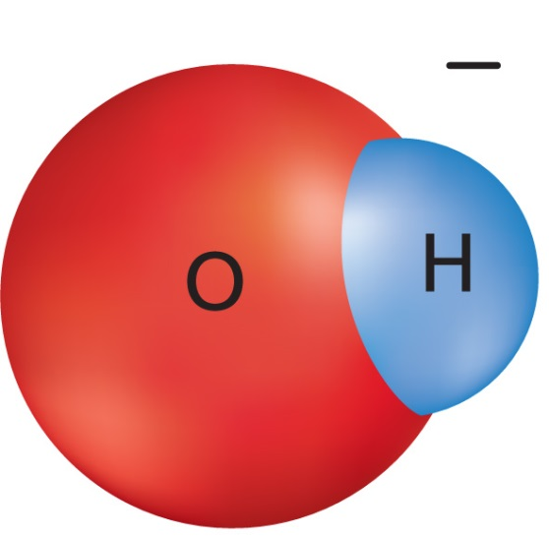
Lesson 3 - VS
Acids contain hydrogen ions that are released and form hydronium ions in water. Bases are substances that form hydroxide ions when dissolved in water.

Slide 19
Lesson 3 - VS
Hydronium ion concentration changes inversely with pH. This means that as hydronium ion concentration increases, the pH decreases.

Slide 20

Lesson 3 - VS
pH can be measured using indicators or digital pH meters.

Slide 21

Lesson 3 – LR1
Which substance produces hydroxide ions when dissolved
in water?
A. acetic acid
B. ammonia
C. hydrochloric acid
D. lactic acid

Slide 22
Lesson 3 – LR2
One solution has a pH of 2. Another solution has a pH of 5. What is the difference in acidity?
A. 3
B. 10
C. 100
D. 1000

Slide 23
Lesson 3 – LR3
Which term describes a compound that changes color at different pH values when it reacts with acidic or basic solutions?
A. base
B. acid
C. hydroxide ion
D. indicator

Slide 24

Lesson 3 - Now
Do you agree or disagree?
5. Acids are found in many foods.
6. You can determine the exact pH of a solution by using pH paper.

