Slide 1



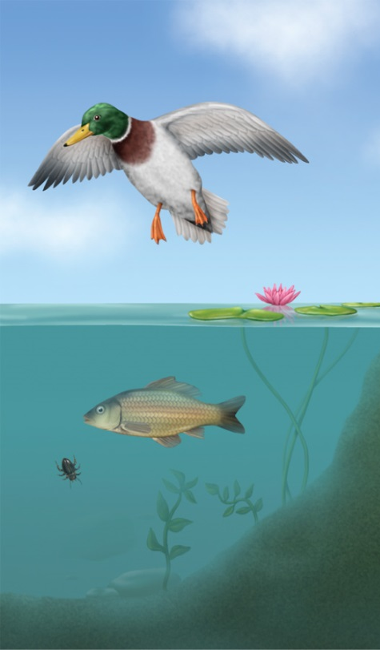




Chapter Menu
Chapter Introduction
Lesson 1 Ecosystems
Lesson 2 Energy and
Matter
Lesson 3 Humans and
Ecosystems
Chapter Wrap-Up

Slide 2



Lesson 1 Reading Guide - KC
Ecosystems
How can you describe an ecosystem?
In what ways do living organisms interact?
How do population changes affect ecosystems?

Slide 3
Lesson 1-1
Abiotic and Biotic Factors
Ecosystems contain all the nonliving and living parts of the environment in a given area.
The nonliving parts—called abiotic factors—include sunlight, water, soil, and air.
The living or once-living parts of an ecosystem—called biotic factors—include living organisms and the decayed remains of dead organisms.

Slide 4

Lesson 1-2
Habitats
A habitat is the area within an ecosystem that provides the biotic and abiotic factors an organism needs to survive and reproduce.

Slide 5
Lesson 1-3
Populations and Communities
A population is the number of individual organisms of the same species that live in an ecosystem at the same time.
  Species: a group of organisms that are similar genetically and which can reproduce to produce viable offspring
All the populations living in an area at the same time form a community.

Slide 6
Lesson 1-4
Interactions of Living Things
More than one population can live in the same habitat because each species has a different way of using the resources.
A niche is the way a species interacts with abiotic and biotic factors to obtain food, find shelter, and fulfill other needs.

Slide 7
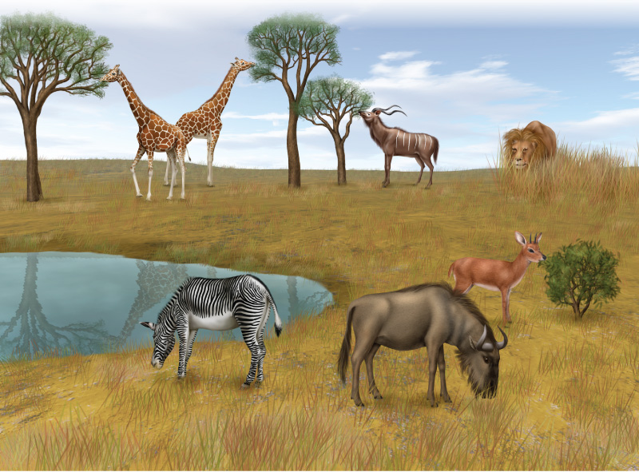
Lesson 1-3
Giraffes, kudus, and steenboks have different niches. Each has a different way of using the resources.

Slide 8
Lesson 1-4
Interactions of Living Things (cont.)
A predator is an organism that hunts and kills other organisms for food.
Prey is an organism caught and eaten by a predator.
Predation is the act of one organism, the predator, feeding on another organism, its prey.

Slide 9
Lesson 1-4
Interactions of Living Things (cont.)
Symbiosis is a close, long-term relationship between two species that usually involves an exchange of food or energy.
The three types of symbiosis are mutualism, commensalism, and parasitism.

Slide 10
Lesson 1-4
Interactions of Living Things (cont.)
In mutualism, both species benefit from the relationship.
In commensalism, one species benefits from the relationship and the other species is neither harmed nor benefited.
In parasitism, one species (the parasite) benefits and the other (the host) is harmed.

Slide 11
Lesson 1-4
Interactions of Living Things (cont.)
Organisms that share the same habitat often compete for resources.
Competition describes interactions between two or more organisms that need the same resource at the same time.
Organisms compete for:

Slide 12
Lesson 1-5
Population Changes
Populations increase when offspring are produced or when new individuals move into a community.
Populations decrease when individuals die or move away.

Slide 13
Lesson 1-5
Population Changes (cont.)
Changes in the abiotic factors of an ecosystem affect population size.
If a drought reduces plant growth, less food is available for plant eaters, which can lead to a decrease in plant-eater populations.

Slide 14
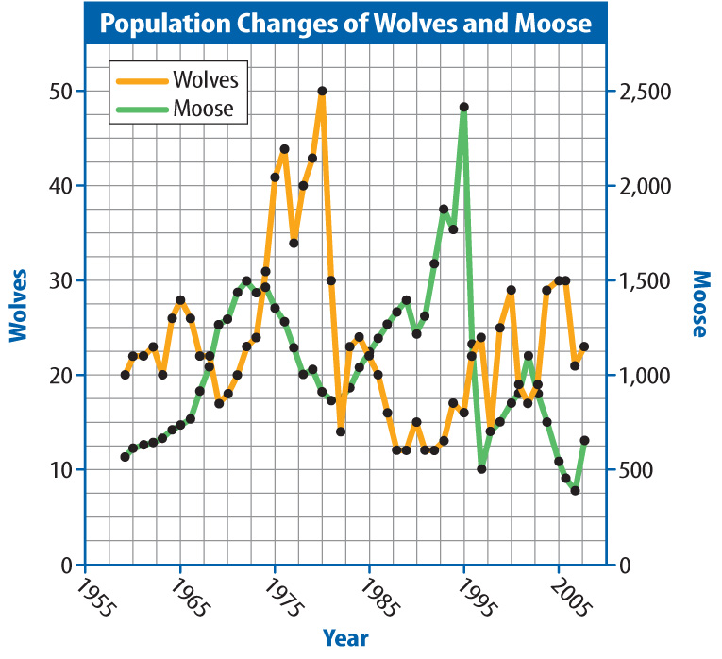
Lesson 1-5
Population Changes (cont.)
Interactions between organisms also affect population size.
For example, the
wolf population can
keep increasing
until there are no
longer enough
moose to support it.

Slide 15
Lesson 1-5
Population Changes (cont.)
Population density is the size of a population compared to the amount of space available.
A high population density can increase competition and make it easier for disease to be transmitted from one individual to another.

Slide 16
Lesson 1-5
Population Changes (cont.)
There is a limit to resources an ecosystem can provide.
Carrying capacity is the largest number of individuals of one species that an ecosystem can support over time.
If a population exceeds its carrying capacity the area becomes over-populated.

Slide 17
Lesson 1-5
Population Changes (cont.)
If all the members of a population die or move away from an area, that population becomes extinct.
If all populations of a species disappear from Earth, the entire species becomes extinct.

Slide 18

Lesson 1 - VS
Ecosystems are all the living and nonliving things in a given area.

Slide 19
Lesson 1 - VS
Species in the
same habitat have
different niches.
Populations can
increase and
decrease.

Slide 20

Lesson 1 – LR1
Which term refers to an organism that hunts and kills other organisms for food?
A. niche
B. parasite
C. predator
D. prey

Slide 21
Lesson 1 – LR2
Which term refers to interactions between organisms that need the same resource at the same time?
A. competition
B. mutualism
C. predation
D. symbiosis

Slide 22
Lesson 1 – LR3
Which is the largest number of individuals of one species that an ecosystem can support over time?
A. carrying capacity
B. community
C. population density
D. symbiosis

Slide 23

Lesson 1 - Now
Do you agree or disagree?
1. In symbiosis, two species cooperate in a way that benefits both species.
2. Overpopulation can be damaging to an ecosystem.

