Slide 1



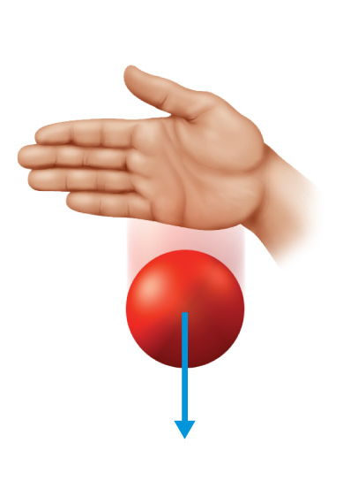




Chapter Menu
Chapter Introduction
Lesson 1 Gravity and Friction
Lesson 2 Newton’s
First Law
Lesson 3 Newton’s
Second Law
Lesson 4 Newton’s Third Law
Chapter Wrap-Up

Slide 2


Chapter Introduction
How do forces change the motion of objects?

Slide 3

Chapter Introduction
What do you think?
Before you begin, decide if you agree or disagree with each of these statements.
As you view this presentation, see if you change your mind about any of the statements.

Slide 4
Chapter Introduction
Do you agree or disagree?
1. You pull on objects around you with the force of gravity.
2. Friction can act between two unmoving, touching surfaces.
3. Forces acting on an object cannot be added.

Slide 5
Chapter Introduction
Do you agree or disagree?
4. A moving object will stop if no forces act on it.
5. When an object’s speed increases,
the object accelerates.
6. If an object’s mass increases, its acceleration also increases if the net force acting on the object stays the same.

Slide 6
Chapter Introduction
Do you agree or disagree?
7. If objects collide, the object with more mass applies more force.
8. Momentum is a measure of how hard it is to stop a moving object.

Slide 7


Lesson 1 Reading Guide - KC
Gravity and Friction
What are some contact forces and some noncontact forces?
What is the law of universal gravitation?
How does friction affect the motion of two objects sliding past each other?

Slide 8

Lesson 1 Reading Guide - Vocab
Gravity and Friction
force
contact force
noncontact force
gravity
mass
weight
friction

Slide 9
Lesson 1-1
Types of Forces
A push or a pull is called a force.
An object or a person can apply a force to another object or person.
force
from Latin fortis, means “strong”

Slide 10
Lesson 1-1
Types of Forces (cont.)
A contact force is a force that is applied when two objects touch.
  Example:
A force that one object can apply to another object without touching it is a noncontact force.
  Gravity and magnetic force are examples of noncontact forces.

Slide 11
Lesson 1-2
What is gravity?
Gravity is an attractive force that exists between all objects that have mass.
Objects fall to the ground because Earth exerts gravity on them.
Mass is the amount of matter in an object.
  The SI unit for mass is the kilogram (kg).

Slide 12
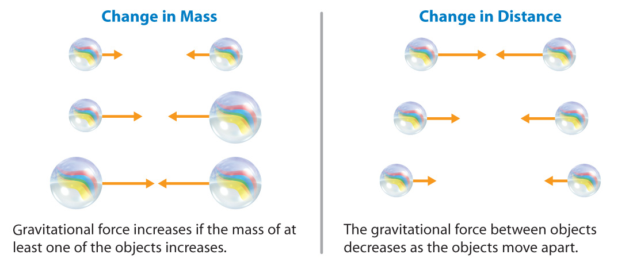
Lesson 1-1
The SI unit for force is the Newton (N).
Arrows can be used to show both the strength and direction of force.

Slide 13
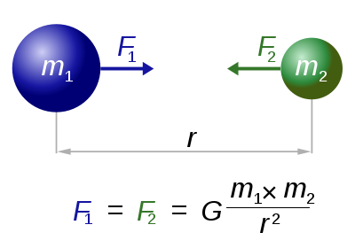
Lesson 1-2
Sir Isaac Newton developed the law of universal gravitation in the late 1600s.
The law of universal gravitation states that all objects are attracted to each other by a gravitational force.
The gravitational force varies:
  Directly with mass
  Inversely with distance

Slide 14
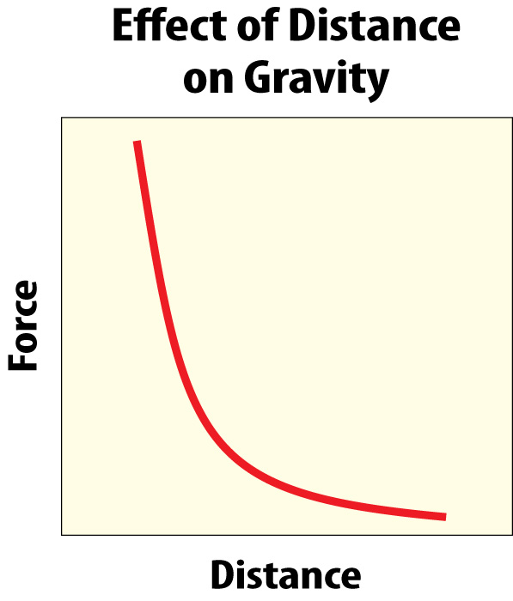
Lesson 1-2
What is gravity? (cont.)
The strength of force
depends on the mass
of each object and the
distance between them.
When the mass of one
or both objects increases,
the gravitational force
between them also increases.
What happens when the distance increases?

Slide 15
Lesson 1-2
What is gravity? (cont.)
Weight is the gravitational force exerted on an object.
  Near Earth’s surface, an object’s weight is the gravitational force exerted on the object by Earth.
  Because weight is a force, it is measured in Newtons.

Slide 16
Lesson 1-3
Friction
Friction is a force that opposes the movement between two touching surfaces.
There are several types of friction.
  static friction
  sliding friction
  rolling friction
  fluid friction

Slide 17
Lesson 1-3
Static Friction
Static friction prevents surfaces from sliding past each other even before they are moving.
Up to a limit, the strength of static friction changes to match the applied force.

Slide 18
Lesson 1-3
Sliding, Rolling, Fluid Friction
Sliding friction opposes the motion of surfaces sliding past each other.
Rolling friction opposes the motion of one surface rolling over another.
Fluid friction is friction between a surface and a fluid—any material, such as water or air, that flows.
  Fluid friction between a surface and air is called air resistance.

Slide 19
Lesson 1-3
Friction (cont.)
What causes friction between surfaces?
When the microscopic dips and bumps on one surface catch the dips and bumps on another surface, the microscopic roughness slows motion.

Slide 20
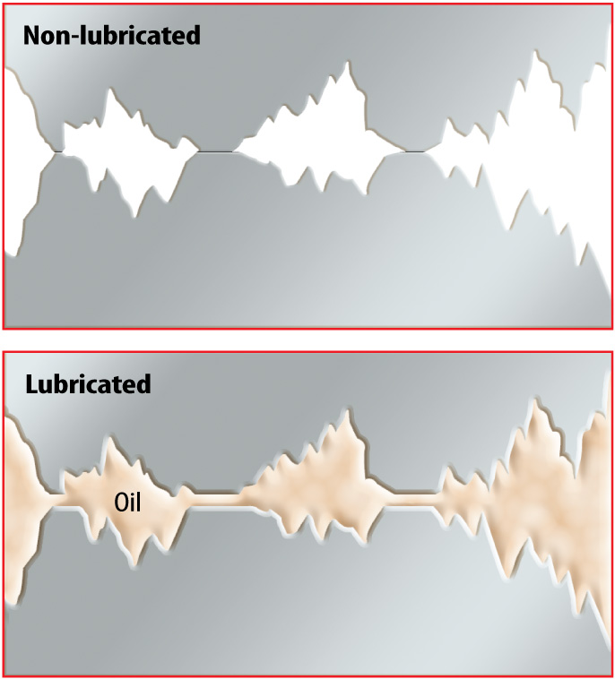
Lesson 1-3
Reducing Friction
Lubricants decrease friction and with less friction, it is easier for surfaces to slide past each other.

Slide 21

Lesson 1 - VS
Forces can be either contact, such as a karate chop, or noncontact, such as gravity.
Each force is described by its magnitude (size) and direction.

Slide 22
Lesson 1 - VS
Gravity is an attractive force that acts between any two objects that have mass.
The attraction is stronger for objects with greater mass.
The attraction is greater when the objects are closer together.

Slide 23
Lesson 1 - VS
Friction can reduce the speed of objects sliding past each other.
Friction is due to roughness of surfaces.

Slide 24

Lesson 1 – LR1
Which refers to gravitational force exerted on an object?
A. contact force
B. gravity
C. mass
D. weight

Slide 25
Lesson 1 – LR2
Which is directly proportional to an object’s weight?
A. gravitational force
B. length
C. mass
D. noncontact force

Slide 26
Lesson 1 – LR3
Which is a force that opposes the movement between two touching surfaces?
A. net force
B. lubricant
C. gravity
D. friction

Slide 27

Lesson 1 - Now
Do you agree or disagree?
1. You pull on objects around you with the force of gravity.
2. Friction can act between two unmoving, touching surfaces.

