Slide 1



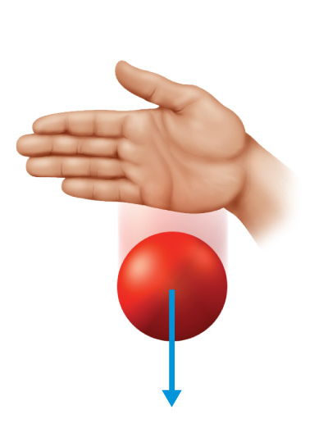




Chapter Menu
Chapter Introduction
Lesson 1 Gravity and Friction
Lesson 2 Newton’s
First Law
Lesson 3 Newton’s
Second Law
Lesson 4 Newton’s Third Law
Chapter Wrap-Up

Slide 2



Lesson 2 Reading Guide - KC
Newton’s First Law
What is Newton’s first law of motion?
How is motion related to balanced and unbalanced forces?
What effect does inertia have on the motion of an object?

Slide 3

Lesson 2 Reading Guide - Vocab
Newton’s First Law
net force
balanced forces
unbalanced forces
Newton’s first law of motion
inertia

Slide 4
Lesson 2-1
Identifying Forces
The sum of all the forces acting on an object is the net force.
The net force depends on the magnitude and directions of the forces applied to an object.
Because forces have direction, you have to specify a reference direction when you calculate net force.

Slide 5

Lesson 2-1
Identifying Forces (cont.)
A force moving in the reference direction is positive, and a force in the opposite direction is negative.
When the forces applied to an object act in the same direction, the net force is the sum of the individual forces.

Slide 6
Lesson 2-1
Identifying Forces (cont.)
When forces act in opposite direction on an object, the net force is still the sum of the forces.
The net force is the sum of the positive and negative forces.

Slide 7

Lesson 2-1
Identifying Forces (cont.)
Balanced forces are forces that have a net force of zero.
Forces that have a net force that is not zero are unbalanced forces.

Slide 8
Lesson 2-2
Newton’s First Law of Motion
Newton’s first law of motion: if the net force on an object is zero, an object at rest will stay at rest, and a moving object will continue moving with constant velocity.
  There is no acceleration if forces are balanced.
Balanced forces and unbalanced forces have different results when they act on an object.

Slide 9
Lesson 2-2
Newton’s First Law of Motion (cont.)
The tendency of an object to resist a change in its motion is called inertia.
inertia
from Latin iners, means “without skill, inactive”

Slide 10
Lesson 2-3
Why do objects stop moving?
For an object to start moving, a force greater than static friction must be applied to it.
To keep an object in motion, a force at least as strong as friction (sliding, rolling, etc.) must be applied continuously.
Objects stop moving because friction or another unbalanced force acts on them.

Slide 11

Lesson 2 - VS
Unbalanced forces cause an object to change motion.
According to Newton’s first law of motion, if the net force on an object is zero, the object’s velocity does not change.
  There is no acceleration.
Inertia is a property that resists a change in the motion of an object.

Slide 12

Lesson 2 – LR1
Which refers to forces that combine and form a net force that is NOT zero?
A. balanced forces
B. inertia
C. net force
D. unbalanced forces

Slide 13
Lesson 2 – LR2
Which could cause an object to stop moving?
A. friction
B. inertia
C. balanced forces
D. velocity

Slide 14
Lesson 2 – LR3
When equal forces act on an object in opposite directions, what is the net force on the object?
A. zero
B. one
C. equal
D. balanced

Slide 15

Lesson 2 - Now
Do you agree or disagree?
3. Forces acting on an object cannot be added.
4. A moving object will stop if no forces act on it.

