Slide 1


Lesson 3 Reading Guide - Vocab
Newton’s Second Law
Newton’s second law of motion
circular motion
centripetal force

Slide 2
Lesson 3-1
How do forces change motion?
Forces change an object’s motion by changing its speed, its direction, or both its speed and its direction.
  Remember: velocity is speed in a certain direction.
Only unbalanced forces cause acceleration!

Slide 3
A 24 N force acts on a 8 kg rock. What is the acceleration?

Slide 4
A 30 N force on a skater produces an acceleration of 0.6 m/s². What is the mass of the skater?

Slide 5
What net force acting on a 14 kg wagon produces an acceleration of 1.5 m/s²?

Slide 6
Lesson 3-1
How do forces change motion? (cont.)
When unbalanced forces act on an object at rest, the object begins moving in the direction of the net force.
If the net force acting on a moving object is in the direction that the object is moving, the object will speed up.
If the direction of the net force on an object is opposite to the direction the object moves, the object slows down.

Slide 7
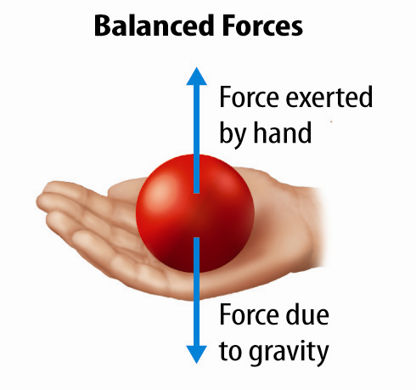
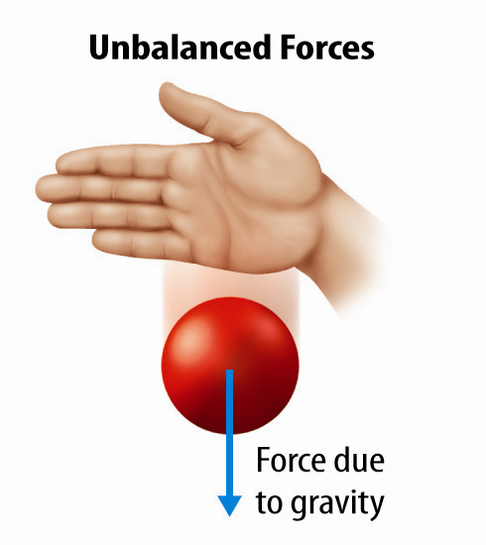
Lesson 3-1
When unbalanced forces act on a ball at rest, it moves in the direction of the net force.
Acceleration!

Slide 8
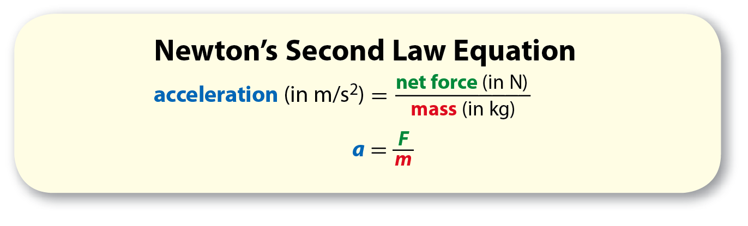
Lesson 3-2
Newton’s Second Law of Motion
According to Newton’s second law of motion, the acceleration of an object is equal to the net force acting on the object divided by the object’s mass.

Slide 9
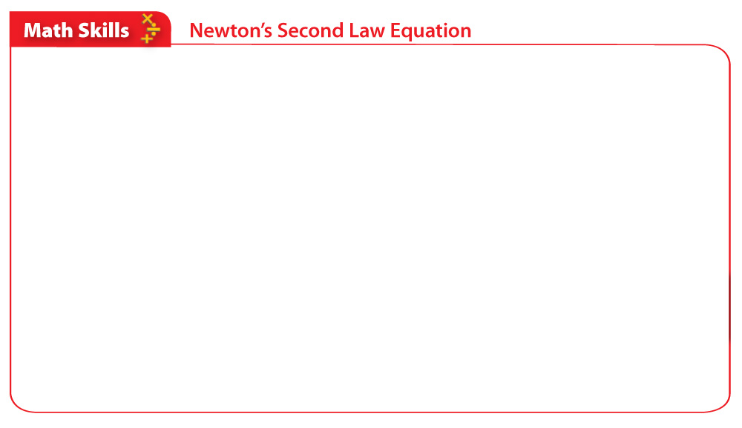
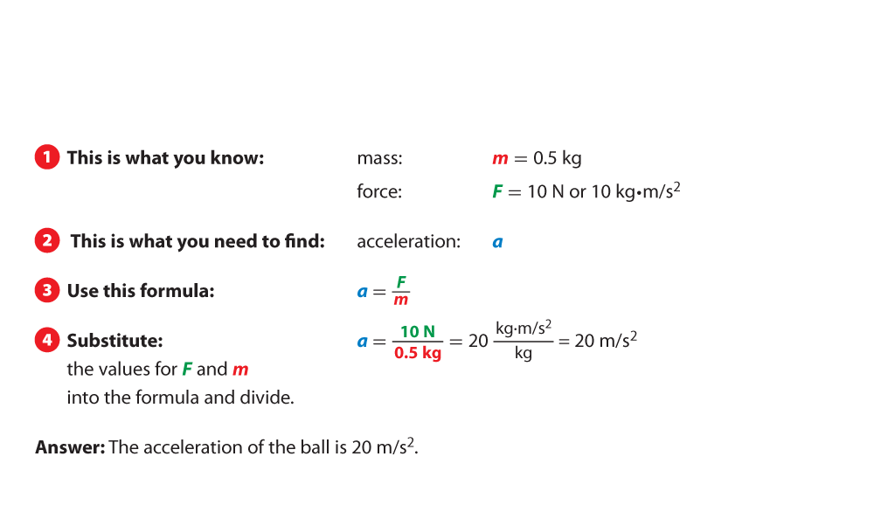
Lesson 3-2
You throw a 0.5 kg basketball with a force of 10N What is the acceleration?

Slide 10
Lesson 3-2
Newton’s Second Law of Motion (cont.)
The direction of acceleration is the same as the direction of the net force.
Acceleration is expressed in meters per second squared (m/s²), mass in kilograms (kg), and force in Newtons (N).

Slide 11
Lesson 3-3
Circular Motion
Circular motion is any motion in which an object is moving along a curved path.
In circular motion, a force that acts perpendicular to the direction of motion (toward the center of the curve) is centripetal force.

Slide 12
Lesson 3-3
Circular Motion (cont.)
centripetal
from Latin centripetus, means “toward the center”

Slide 13
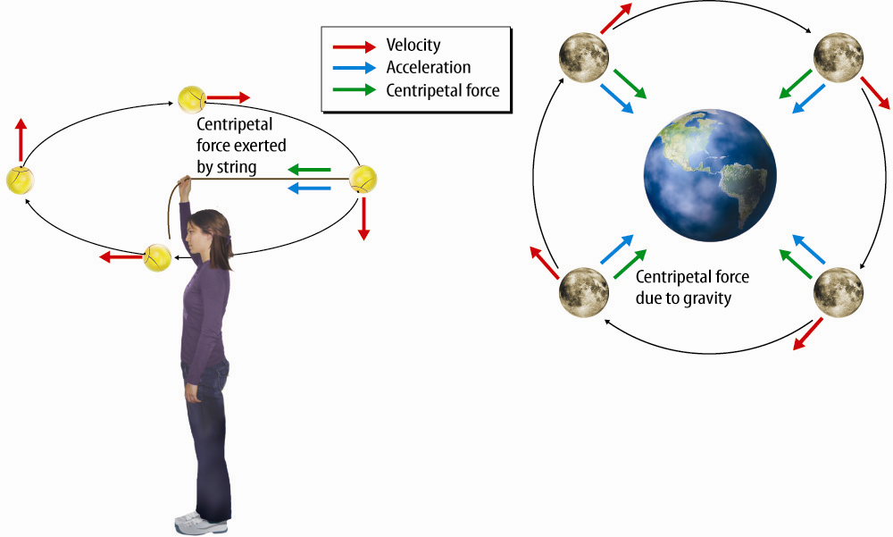

Lesson 3-3
Circular Motion (cont.)

Slide 14
Lesson 3-3
Circular Motion (cont.)
A satellite is an object that orbits a larger object.
Gravity is the centripetal force that keeps a satellite in orbit by changing its direction.
Inertia pulls at right angles to gravity.

Slide 15

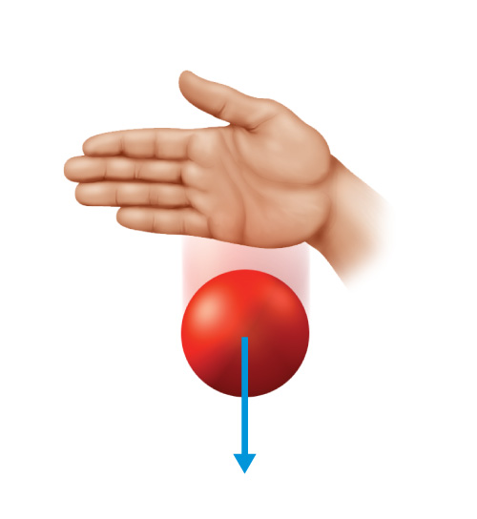
Lesson 3 - VS
Unbalanced forces cause an object to speed up, slow down, or change direction.

Slide 16
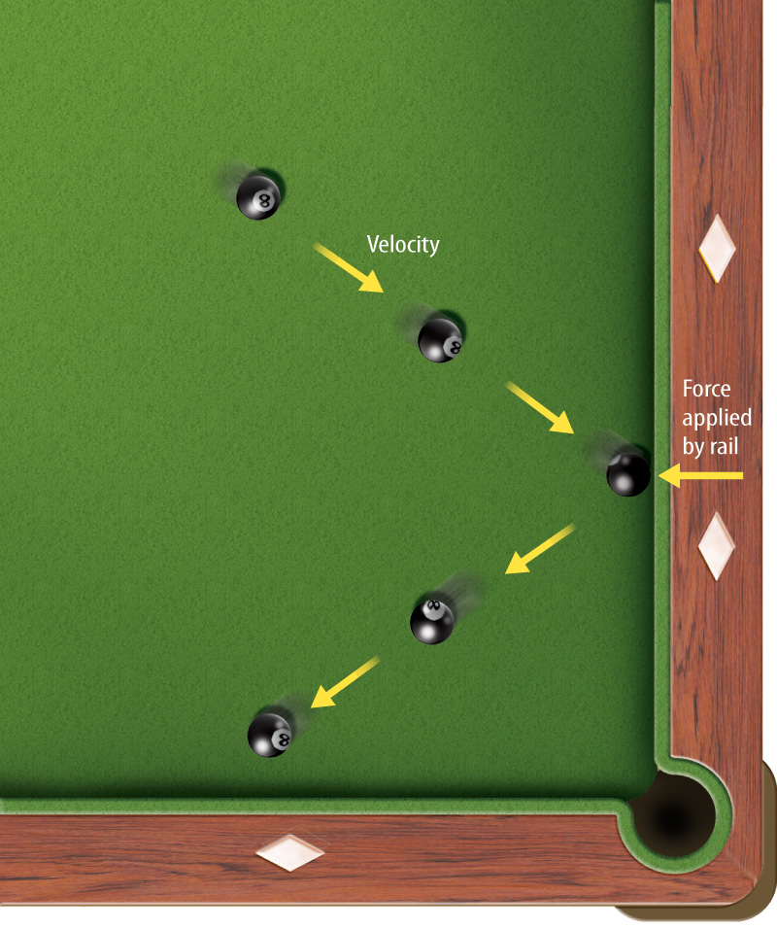
Lesson 3 - VS
Newton’s second law of motion relates an objects acceleration
to its mass and the net force on the object.
F=ma

Slide 17
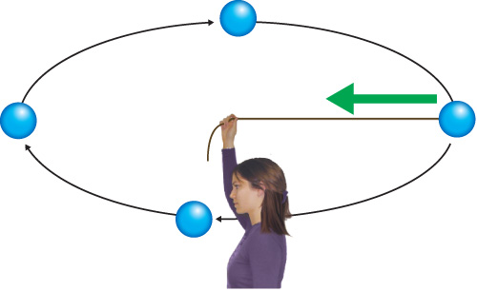
Lesson 3 - VS
Any motion in which an object is moving along a curved path is circular motion.

Slide 18

Lesson 3 – LR1
Which term refers to speed in a certain direction?
A. acceleration
B. centripetal force
C. inertia
D. velocity

Slide 19
Lesson 3 – LR2
Which refers to motion along a curved path?
A. acceleration
B. centripetal
C. circular
D. unbalanced

Slide 20
Lesson 3 – LR3
Which refers to a change in velocity over time?
A. inertia
B. acceleration
C. circulation motion
D. centripetal force

Slide 21

Lesson 3 - Now
Do you agree or disagree?
5. When an object’s speed increases,
the object accelerates.
6. If an object’s mass increases, its acceleration also increases if the net force acting on the object stays the same.

