Slide 1



Lesson 4 Reading Guide - KC
Newton’s Third Law
What is Newton’s third law of motion?
Why don’t the forces in a force pair cancel each other?
What is the law of conservation of momentum?

Slide 2

Lesson 4 Reading Guide - Vocab
Newton’s Third Law
Newton’s third law of motion
force pair
momentum
law of conservation of momentum

Slide 3
Lesson 4-1
Opposite Forces
When an object applies a force on another object, the second object applies a force of the same strength on the first object, but the force is in the opposite direction.

Slide 4
Lesson 4-2
Newton’s Third Law of Motion
Newton’s third law of motion: when one object applies a force on a second object, the second object applies an equal force in the opposite direction on the first object.
For every action force, there is an equal and opposite reaction force.

Slide 5
Lesson 4-2
Newton’s Third Law of Motion (cont.)
A force pair describes the forces two objects apply to each other.
If the forces of a force pair always act in opposite directions and are always the same strength, they do not cancel each other out because each force acts on a different object.

Slide 6
Lesson 4-3
Using Newton’s Third Law of Motion
When you push against an object, the force you apply is called the action force.
The force applied by the object back against you is called the reaction force.
According to Newton’s third law of motion, every action force has a reaction force in the opposite direction.

Slide 7
Lesson 4-4
Momentum
Momentum is a measure of how hard it is to stop a moving object.
momentum
from Latin momentum, means “movement, impulse”

Slide 8
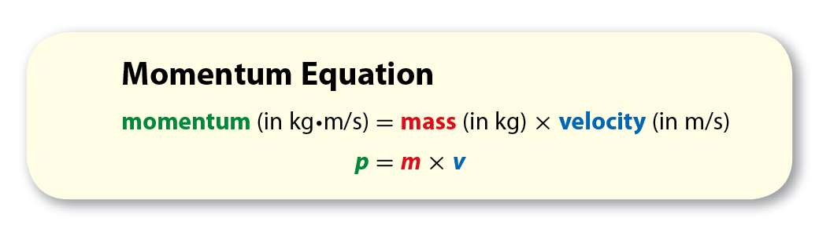
Lesson 4-4
Momentum (cont.)
Momentum is the product of an object’s mass and velocity.

Slide 9

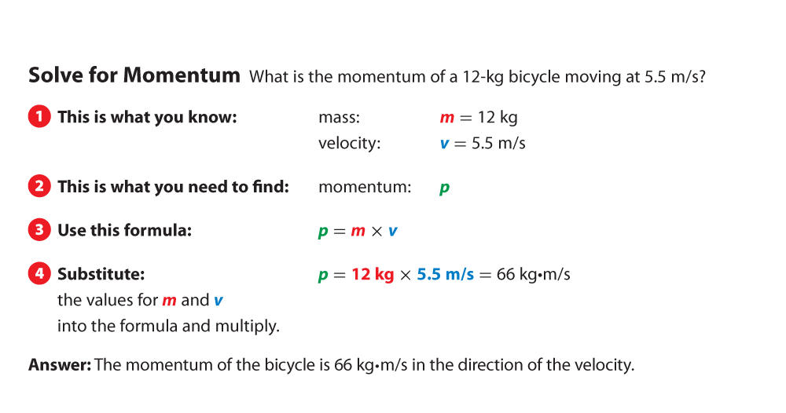
Lesson 4-4

Slide 10
Lesson 4-4
Momentum (cont.)
An object’s momentum has the same direction as its velocity.
According to Newton’s first law, if the net force on an object is zero, neither its velocity nor its momentum change.
Because momentum is the product of mass and velocity, the force on an object equals its change in momentum.

Slide 11
Lesson 4-5
Conservation of Momentum
According to the law of conservation of momentum, the total momentum of a group of objects stays the same unless unbalanced outside forces (such as friction) act on the objects.

Slide 12
Lesson 4-5
Conservation of Momentum (cont.)
When colliding objects bounce off each other, it is an elastic collision.
If objects collide and stick together, the collision is inelastic.
No matter the type of collision, the total momentum will be the same before and after the collision.

Slide 13

Lesson 4 - VS
Newton’s third law of motion describes the force pair between two objects.
For every action force, there is a reaction force that is equal in strength but opposite in direction.
In any collision, momentum is transferred from one object to another.

Slide 14

Lesson 4 – LR1
Which law explains that every force has a reaction force in the opposite direction?
A. Newton’s third law of motion
B. Newton’s second law of motion
C. Newton’s first law of motion
D. law of conservation of momentum

Slide 15
Lesson 4 – LR2
Which is a measure of how hard it is to stop a moving object?
A. velocity
B. momentum
C. inertia
D. elastic collision

Slide 16
Lesson 4 – LR3
Which refers to the forces two objects apply to each other?
A. velocity
B. momentum
C. force pair
D. collision

Slide 17

Lesson 4 - Now
Do you agree or disagree?
7. If objects collide, the object with more mass applies more force.
8. Momentum is a measure of how hard it is to stop a moving object.

