Slide 1



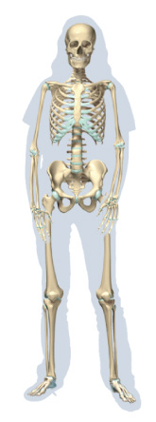




Chapter Menu
Chapter Introduction
Lesson 1 The Human
Body
Lesson 2 How Body
Systems
Interact
Chapter Wrap-Up

Slide 2



Lesson 1 Reading Guide - KC
The Human Body
What are the functions of inorganic substances in the human body?
What are the functions of organic substances in the human body?
How does the body’s organization enable it to function?

Slide 3
Lesson 1-1
Life and Chemistry
During a chemical reaction, bonds are broken and new bonds are formed.
Chemical reactions that occur in the human body take place in the body’s cells and are essential for human life.

Slide 4
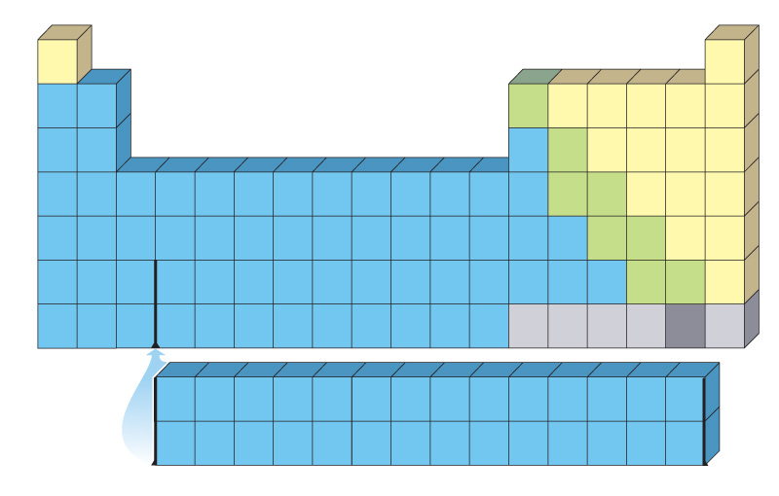
Lesson 1-2
Elements and Compounds
Elements are substances that cannot be broken down or transformed into another element during a chemical reaction.
Six elements—carbon, oxygen, hydrogen, nitrogen, calcium, and phosphorus—make
up 99 percent of
your body’s mass.

Slide 5
Lesson 1-2
Elements and Compounds (cont.)
Compounds can be made by binding elements together in two different ways—ionic or covalent bonds.
Ionic bonds are formed when electrons travel from one element to another.
Covalent bonds are formed when the electrons in each element are shared.

Slide 6
Lesson 1-2
Elements and Compounds (cont.)
Inorganic compounds are substances that do not contain carbon-hydrogen bonds.
Organic compounds contain C-H
Water and oxygen gas are inorganic compounds that humans need to survive.

Slide 7
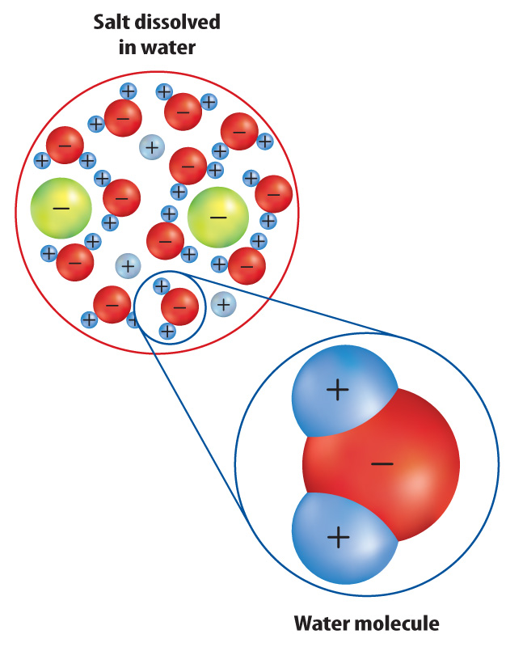
Lesson 1-2
Elements and Compounds (cont.)
Ions to travel easily through the body dissolved in water because water is a polar molecule (universal solvent).

Slide 8
Lesson 1-2
Elements and Compounds (cont.)
Substances that form from joining many small molecules together are called macromolecules.
The four macromolecules in the body are carbohydrates, lipids, proteins, and nucleic acids.

Slide 9
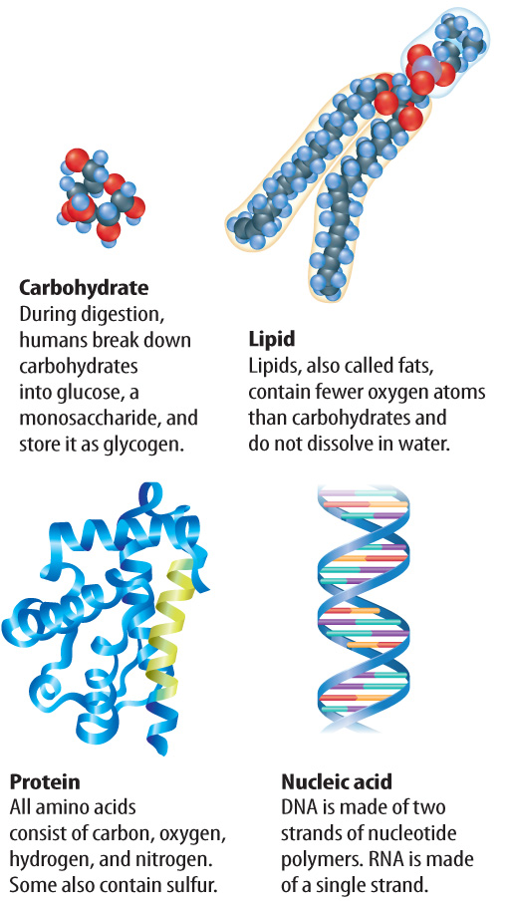
Lesson 1-2
Elements and Compounds (cont.)
Sugars, starches, and cellulose are carbohydrates.
Carbohydrates are formed
when simple sugars, called monosaccharides, are
joined together.

Slide 10
Lesson 1-2
Elements and Compounds (cont.)
Lipids are made from carbon, hydrogen, and oxygen.
Triglycerides, cholesterol, and hormones such as estrogen and testosterone are lipids.

Slide 11
Lesson 1-2
Elements and Compounds (cont.)
Proteins form when amino acids join together.
Some proteins give cells structure, some help cells communicate, and some are enzymes (organic catalysts).

Slide 12
Lesson 1-2
Elements and Compounds (cont.)
Nucleic acids are formed when nucleotides, molecules made of a nitrogen base, a sugar, and a phosphate group, join together.
The body contains two types of nucleic acids, DNA and RNA.

Slide 13
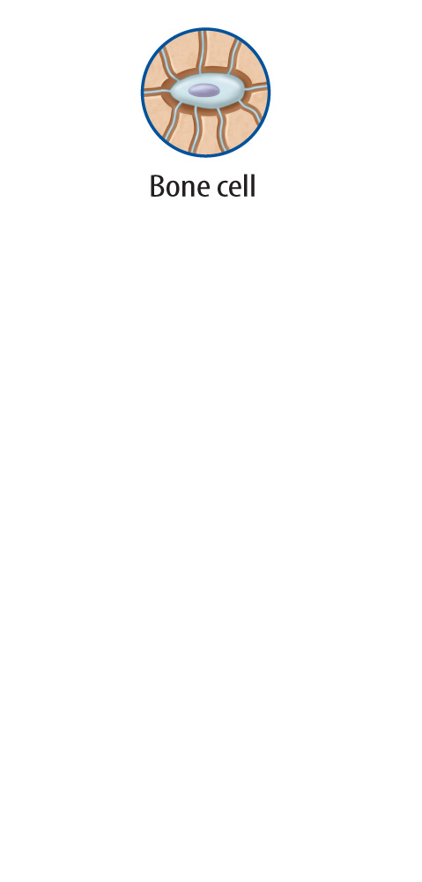
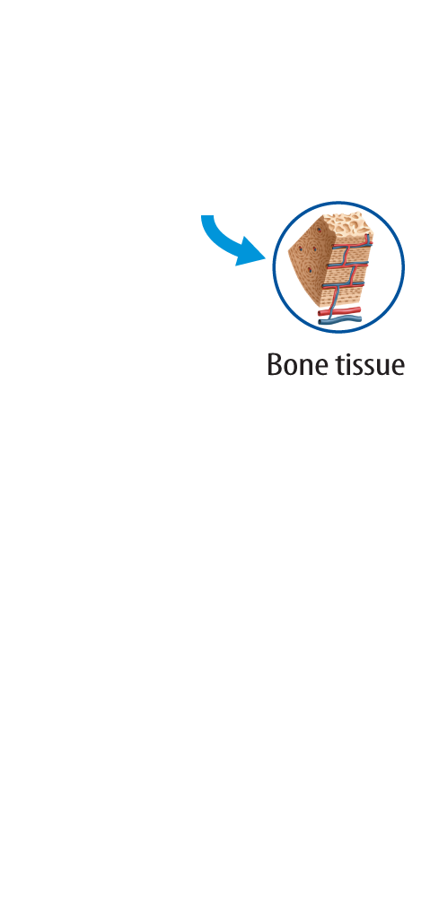
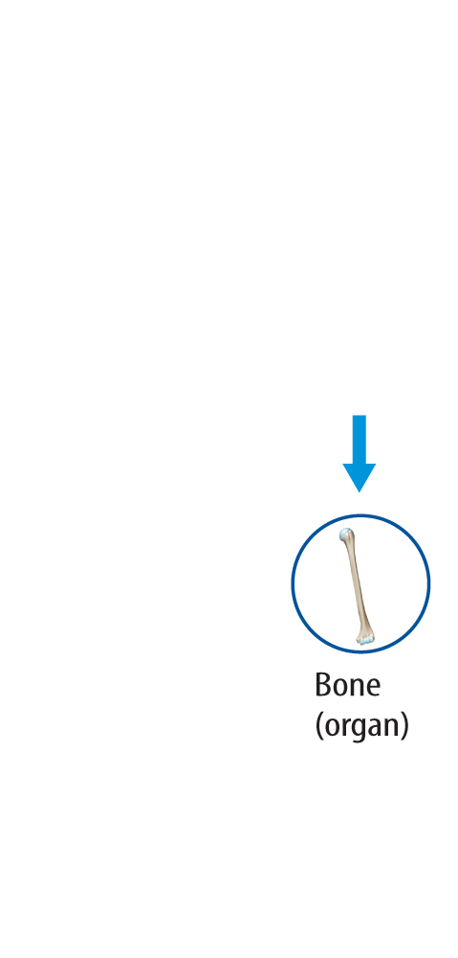
Lesson 1-3
The Body’s Organization
Cells are the building blocks of all living things.
Tissues are made of a group of similar cells that work together and perform a function.
An organ is a group of different tissues that work together and perform a function.

Slide 14
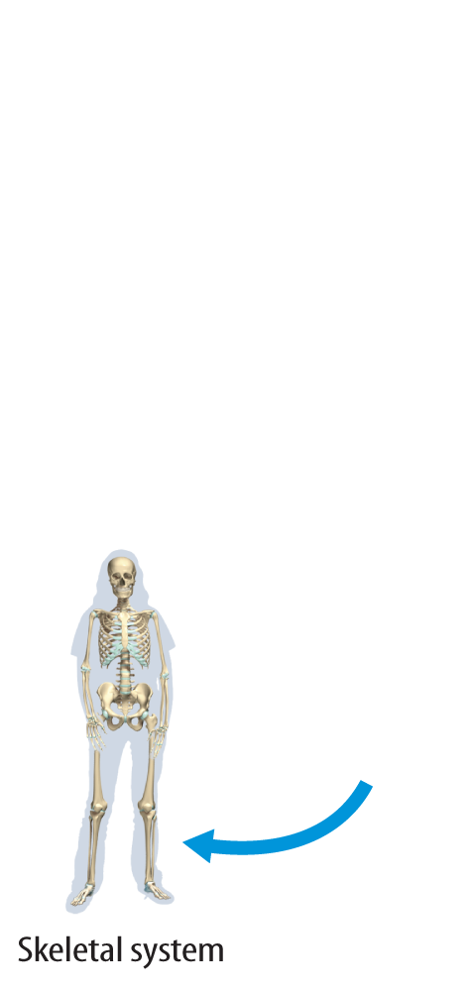
Lesson 1-3
The Body’s Organization (cont.)
An organ system is a group of organs that works together and performs a specific task.
Organ systems work together to make a living thing.
Living:

Slide 15

Lesson 1 - VS
Elements are substances that cannot be broken down or transformed into other elements during chemical reactions.

Slide 16
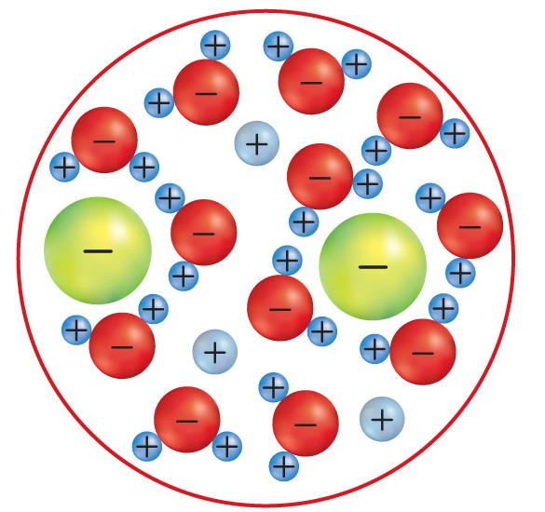
Lesson 1 - VS
Water dissolves ionic substances easily.

Slide 17
Lesson 1 - VS
Organ systems are groups of organs that work together and perform a specific task.

Slide 18

Lesson 1 – LR1
Which are compounds that contain carbon and other elements held together by covalent bonds?
A. covalent
B. inorganic
C. ionic
D. organic

Slide 19
Lesson 1 – LR2
Sugars, starches, and cellulose are all which type of macromolecule?
A. carbohydrates
B. lipids
C. nucleic acids
D. proteins

Slide 20
Lesson 1 – LR3
Which is a group of cells that work together and perform a function?
A. lipid
B. organ
C. nucleic acid
D. tissue

Slide 21

Lesson 1 - Now
Do you agree or disagree?
1. Elements can be broken down into smaller parts.
2. Organic compounds are foods grown without pesticides.
3. Organ systems work together.

