Slide 1



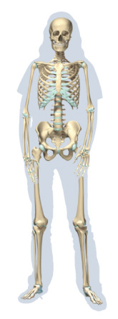




Chapter Menu
Chapter Introduction
Lesson 1 The Human
Body
Lesson 2 How Body
Systems
Interact
Chapter Wrap-Up

Slide 2



Lesson 2 Reading Guide - KC
How Body Systems Interact
How are nutrients processed in the body?
How does the body transport and process oxygen and wastes?
How does the body coordinate movement and respond to stimuli?

Slide 3
Lesson 2 Reading Guide - Vocab
How Body Systems Interact
How do feedback mechanisms help maintain homeostasis?

Slide 4
Lesson 2-1
Homeostasis
Your body’s organ systems work together and maintain temperature, nutrient levels, oxygen, fluid levels, pH, and many other conditions.
Homeostasis is the ability to maintain constant internal conditions when outside conditions change.

Slide 5
Lesson 2-2
Processing Nutrients
The digestive system and the circulatory system work together to process and distribute nutrients from food.
All body systems need nutrients.

Slide 6
Lesson 2-2
Processing Nutrients (cont.)
Food enters the body through the digestive system and is broken down into nutrients that can be absorbed into the body.
The circulatory system distributes the nutrients.
The muscular system is needed to get food through the digestive system.

Slide 7
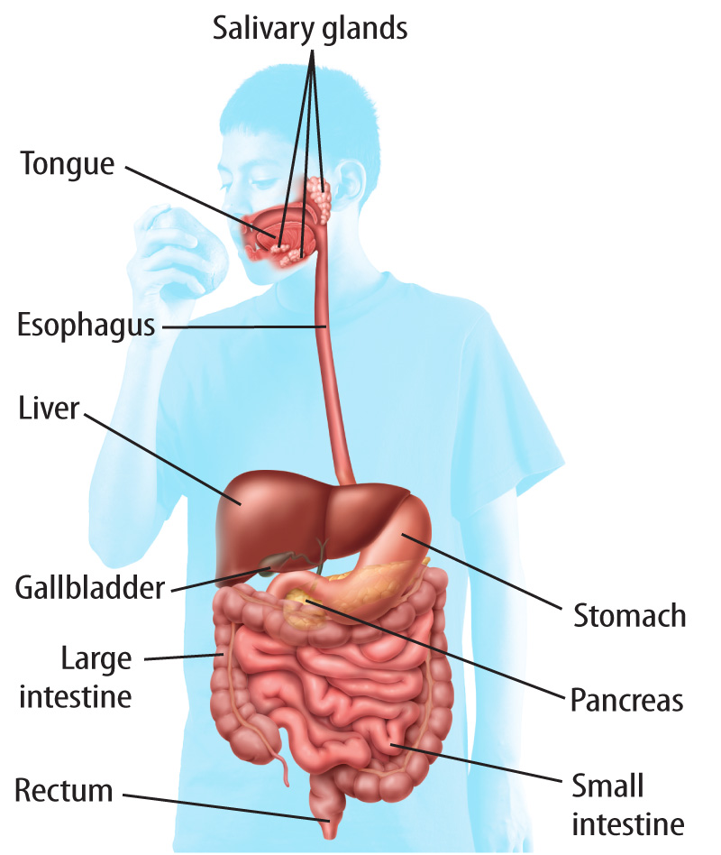
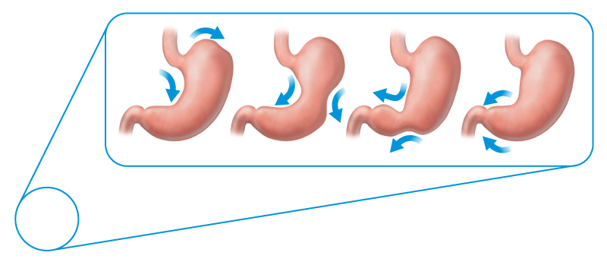

Lesson 2-2
Muscles that surround the stomach contract and move food to the small intestine. These contractions are called peristalsis.
Hutchings Photography/Digital Light Source

Slide 8
Lesson 2-2
Processing Nutrients (cont.)
The circulatory system works closely with the small intestine.
Nutrients are absorbed by small fingerlike projections of the small intestine called villi.
The villi have blood vessels inside them. Nutrients enter these blood vessels and are then transported to the rest of the body.

Slide 9
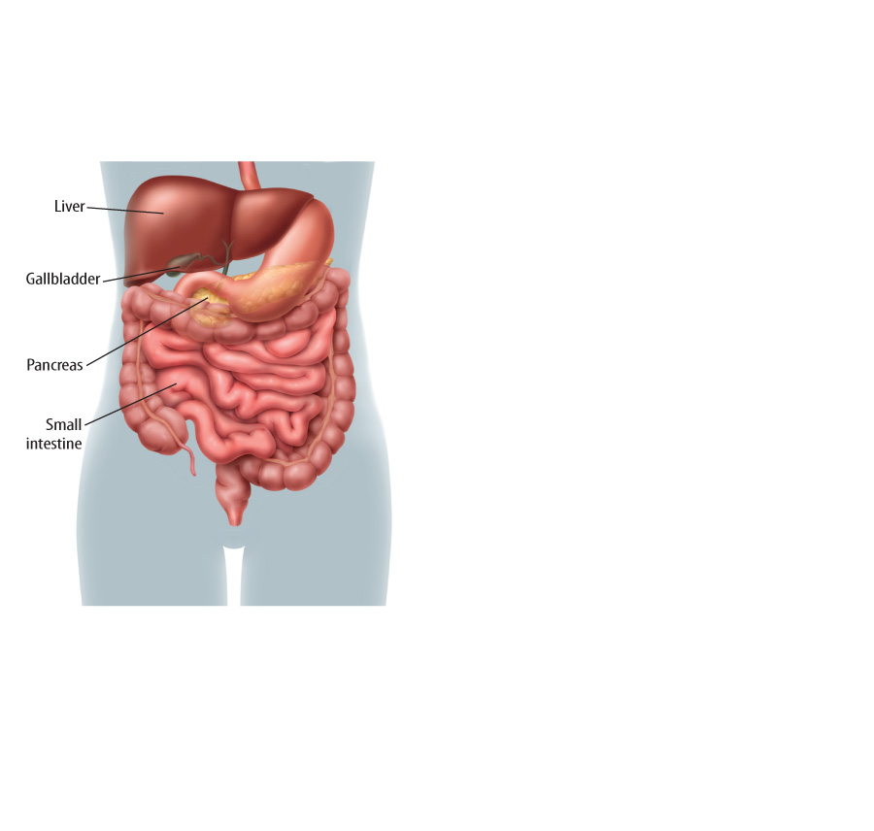
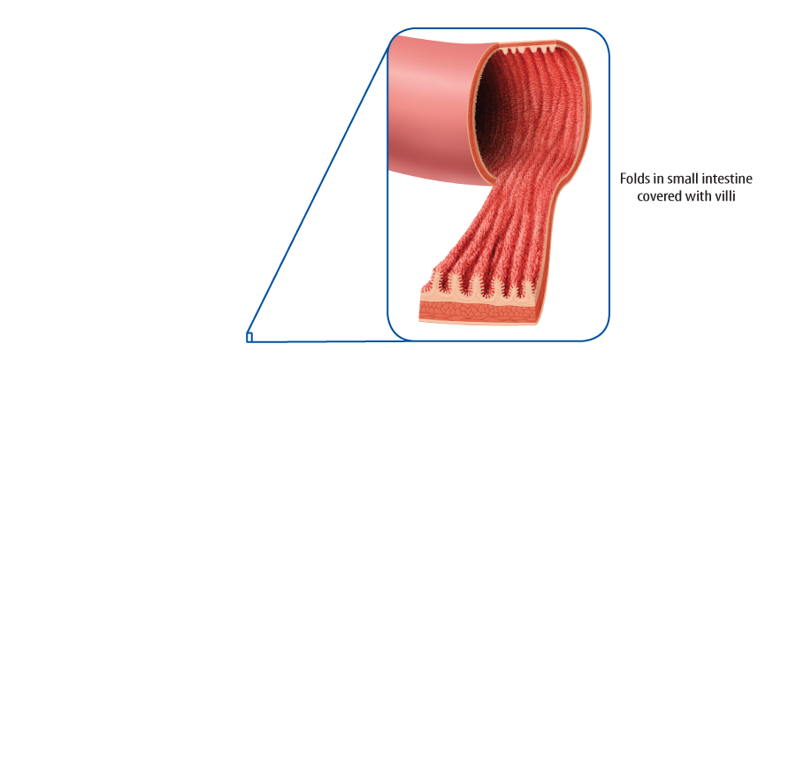
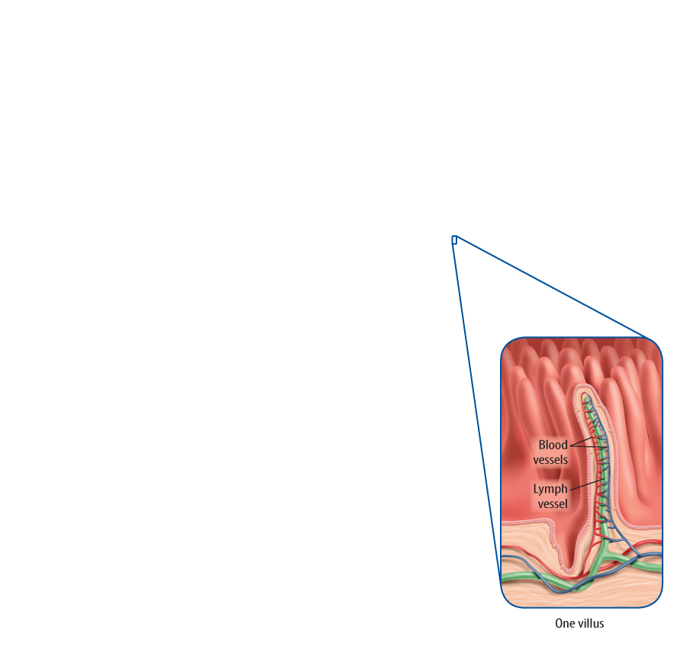
Lesson 2-2

Slide 10
Lesson 2-3
Processing Oxygen and Wastes
Cells use oxygen to perform cellular respiration which releases the energy of food.
Oxygen enters the body through the respiratory system.

Slide 11
Lesson 2-3
Processing Oxygen and Wastes (cont.)
When you inhale, the respiratory system works with the circulatory system and transports oxygen to all cells in the body.
The muscular system also helps the respiratory system by expanding your chest so that air sacs in the lungs fill up with oxygen.

Slide 12
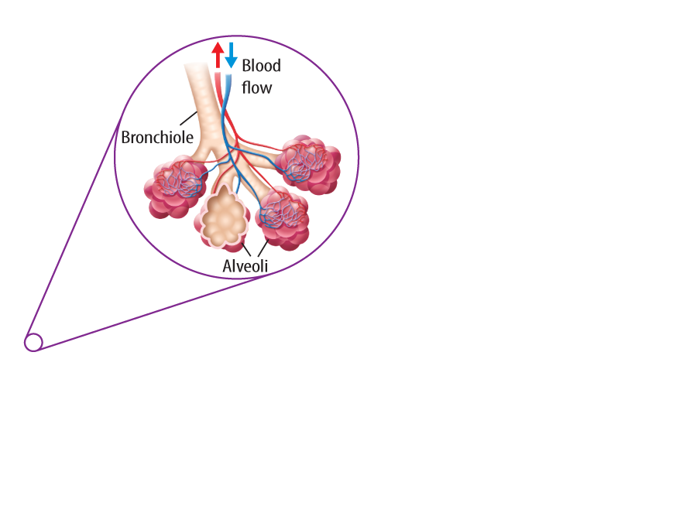
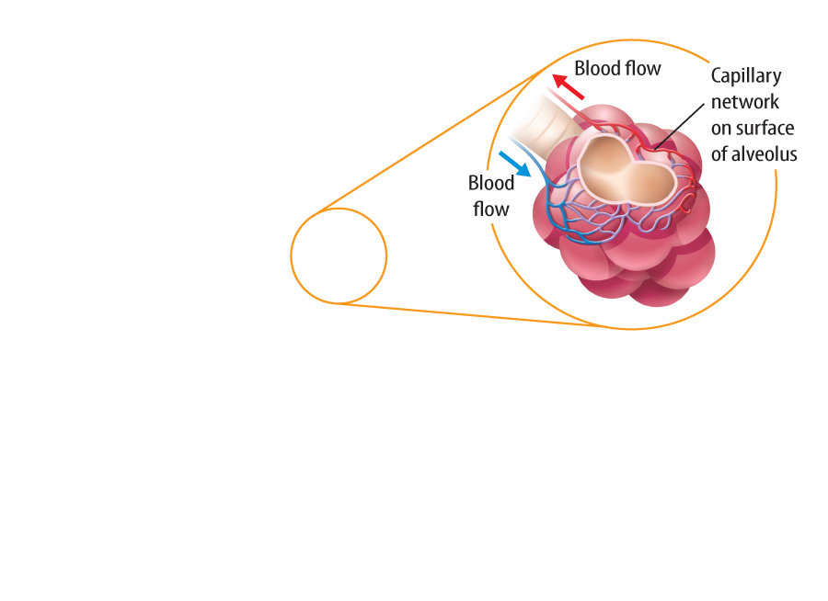
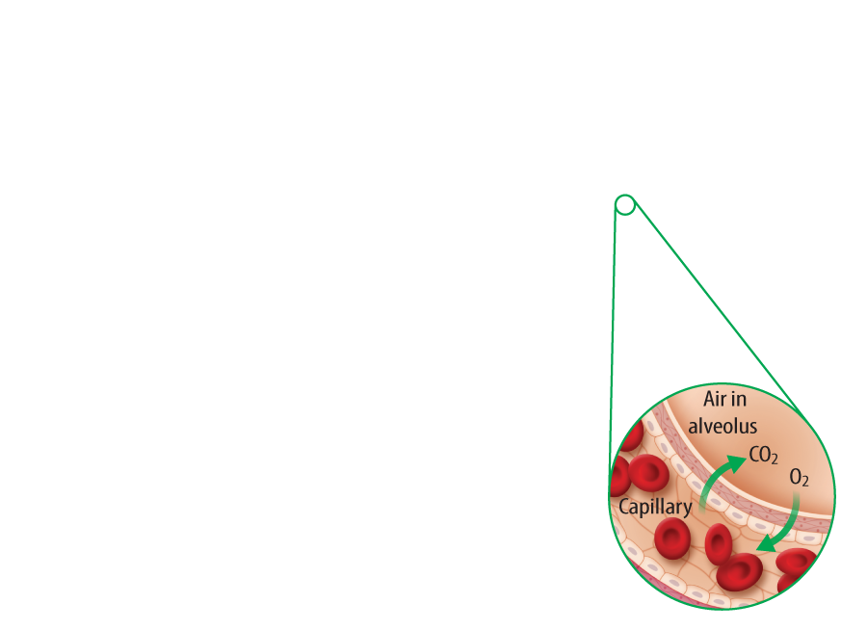
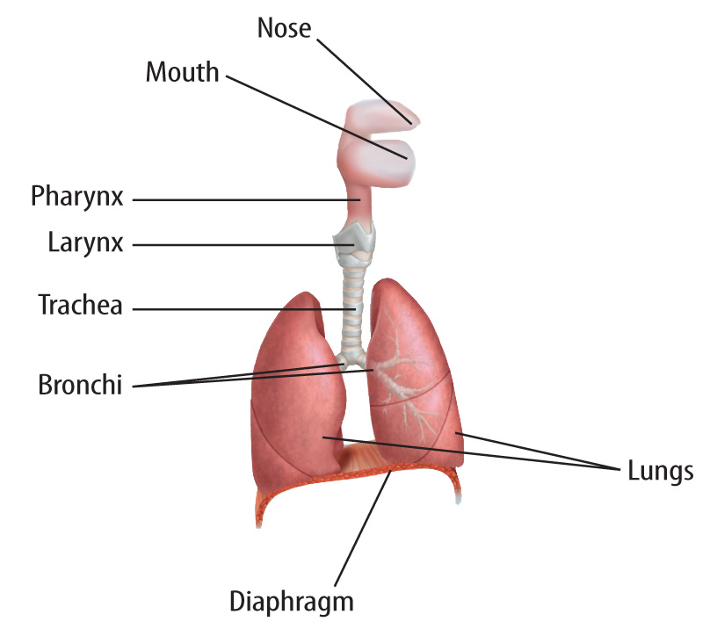
Lesson 2-3
The Respiratory System

Slide 13
Lesson 2-3
Processing Oxygen and Wastes (cont.)
After nutrients are absorbed during digestion, the digestive system removes solid waste products, called feces, through the rectum.
Liquid waste travels through the circulatory system to the kidneys, which make urine to be removed from the body (excretory system).

Slide 14
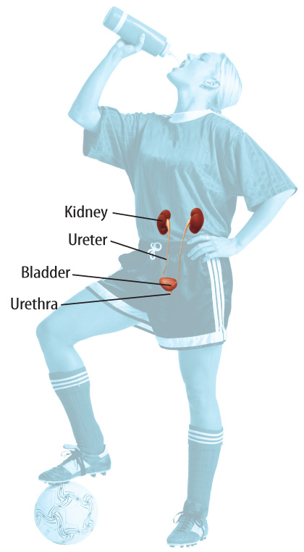
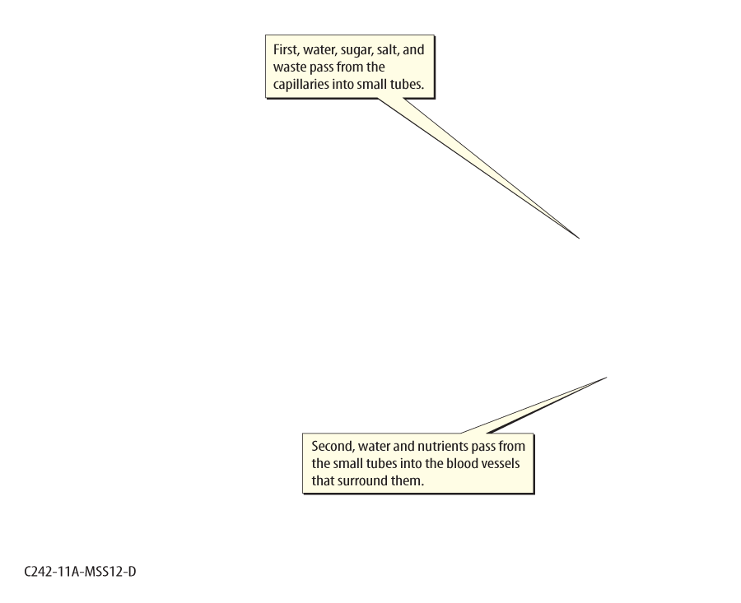
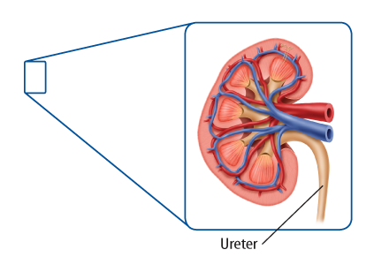
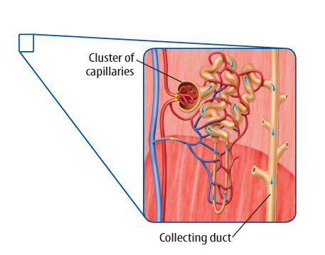
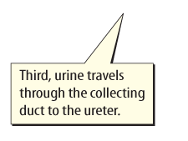
Lesson 2-3
Photodisc/Getty Images

Slide 15
Lesson 2-3
Processing Oxygen and Wastes (cont.)
The respiratory and circulatory systems remove carbon dioxide (CO₂) from the cells of the body.
The CO₂ produced by cells throughout the body enters blood through capillaries and is transported to the lungs, where it is exhaled.

Slide 16
Lesson 2-4
Control and Coordination
The nervous system uses electrical signals to respond to changes in the internal and external environments.
The body also uses the endocrine system to help it respond to changes and maintain homeostasis.
The nervous system coordinates rapid changes, and the endocrine system coordinates ‘slower’ responses.

Slide 17
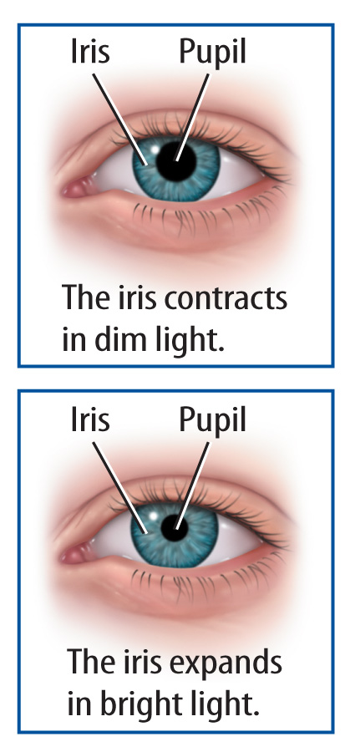
Lesson 2-4
The nervous system coordinates the body’s response to external stimuli.
For example, your pupils increase in size when you enter a darkened room.
The nervous system also coordinates your response to sight, smell, touch, and taste.

Slide 18
Lesson 2-4
Control and Coordination (cont.)
Neurons send electrical signals to the brain or spinal cord for processing so the nervous system can coordinate a response.
The nervous system has a rapid response system, called a reflex, that reacts to stimuli without sending information to the brain for processing.

Slide 19
Lesson 2-4
Control and Coordination (cont.)
The endocrine system coordinates organ systems by using chemical signals called hormones.
Hormones are secreted from endocrine organs such as the thyroid gland, the adrenal gland, and the pancreas.
Insulin, a hormone released from the pancreas, works with the digestive system and maintains energy homeostasis.

Slide 20
Lesson 2-5
Feedback Mechanisms
Organ systems use feedback mechanisms to maintain homeostasis.
Negative feedback is a control system that helps the body maintain homeostasis by sending a signal to stop a response.
Positive feedback is a control system that sends a signal to increase a response.

Slide 21
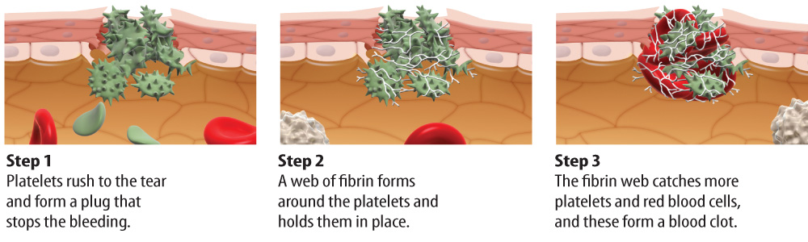
Lesson 2-5
Feedback Mechanisms (cont.)
The body uses positive feedback to clot blood.

Slide 22

Lesson 2 - VS
Muscles that surround the stomach help move food to the small intestine.

Slide 23
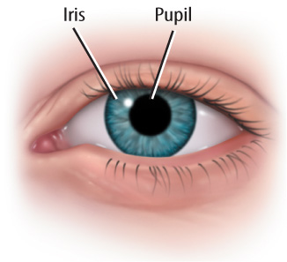
Lesson 2 - VS
The nervous system coordinates the body’s response to external stimuli.

Slide 24
Lesson 2 - VS
When you are bleeding, the circulatory system maintains homeostasis by controlling blood loss.

Slide 25

Lesson 2 – LR1
Oxygen enters the body through which system?
A. circulatory
B. endocrine
C. excretory
D. respiratory

Slide 26
Lesson 2 – LR2
Which sends electrical signals to the brain so the nervous system can coordinate a response?
A. kidneys
B. neurons
C. pancreas
D. villi

Slide 27
Lesson 2 – LR3
Which term describes a control system that sends a signal to increase a response?
A. hormones
B. negative feedback
C. neurons
D. positive feedback

Slide 28

Lesson 2 - Now
Do you agree or disagree?
4. Nutrients are processed by the skeletal system.
5. The nervous system moves oxygen through the body.
6. You do not control reflexes.

