Slide 1



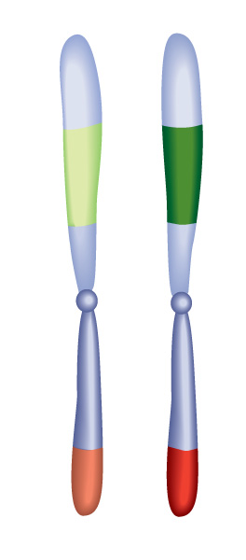




Chapter Menu
Chapter Introduction
Lesson 1 How are traits
inherited?
Lesson 2 Genetics After
Mendel
Lesson 3 Adaptation and
Evolution
Chapter Wrap-Up

Slide 2



Lesson 1 Reading Guide - KC
How are traits inherited?
How are traits inherited?
Why do scientists study genetics?
What did Gregor Mendel investigate and discover about heredity?

Slide 3
Lesson 1-1
From Parent to Offspring
Heredity is the passing of traits from parent to offspring.
Genetics is the study of how traits pass from parents to offspring.
For most organisms, genes are sections of DNA that control how cells work.

Slide 4
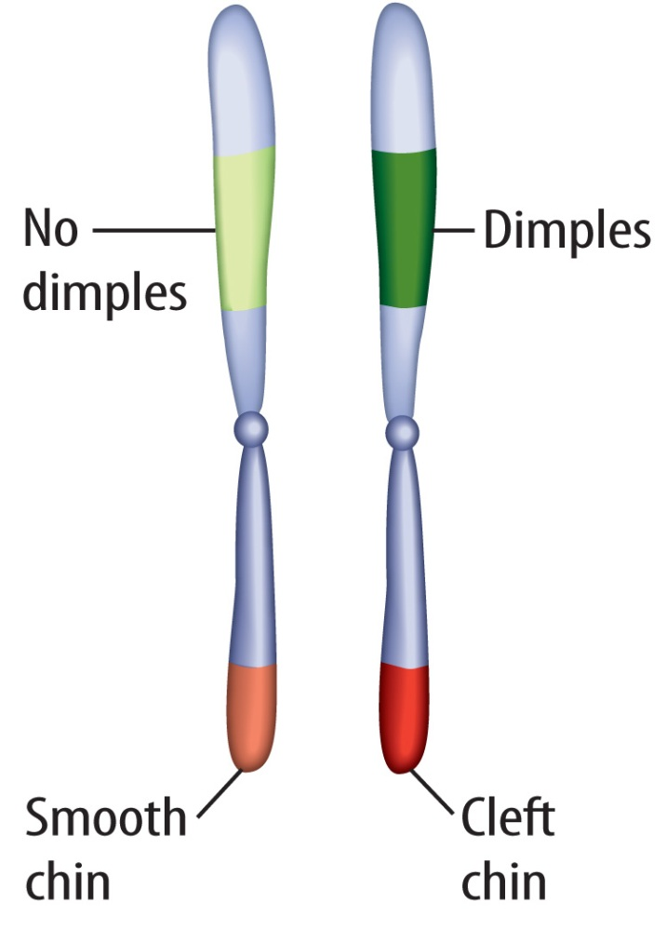
Lesson 1-1
From Parent to Offspring (cont.)
A gene with different information for a trait is called an allele.
Humans have pairs of chromosomes
Each chromosome pair has genes for the same traits in the same location.

Slide 5
Lesson 1-2
How are traits inherited?
An organism passes its traits to its offspring by asexual reproduction or sexual reproduction.
In asexual reproduction, one organism makes a copy of its genes and itself.
In sexual reproduction, offspring receive half of their genes from an egg cell and the other half from a sperm cell.

Slide 6
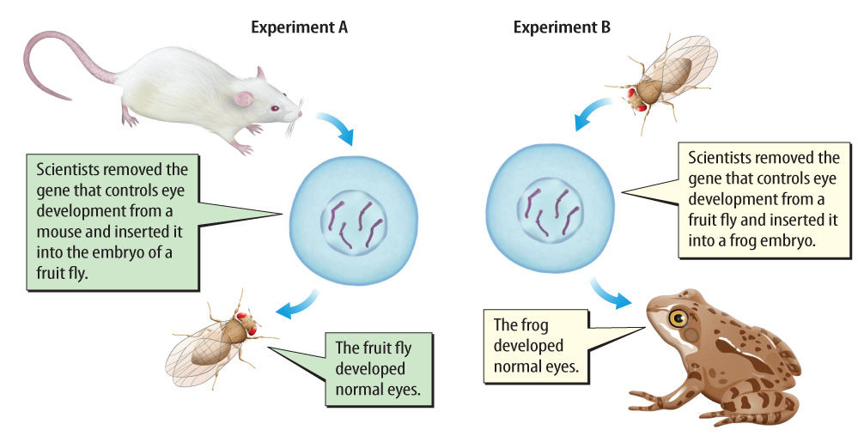
Lesson 1-3
Because the genes from these organisms are similar enough to produce normal eyes when exchanged, scientists suspect that these species share a common, ancient ancestor.

Slide 7
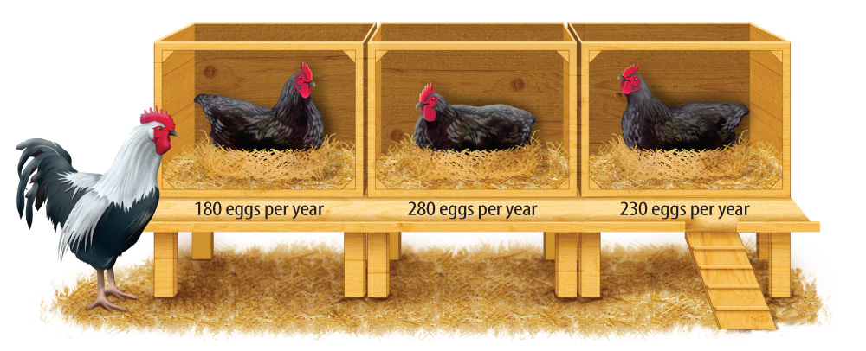
Lesson 1-4
Heredity—the History and the Basics
Selective breeding is the selection and breeding of organisms by people for desired traits.
A farmer might breed the rooster with the hen that produces the most eggs per year.

Slide 8
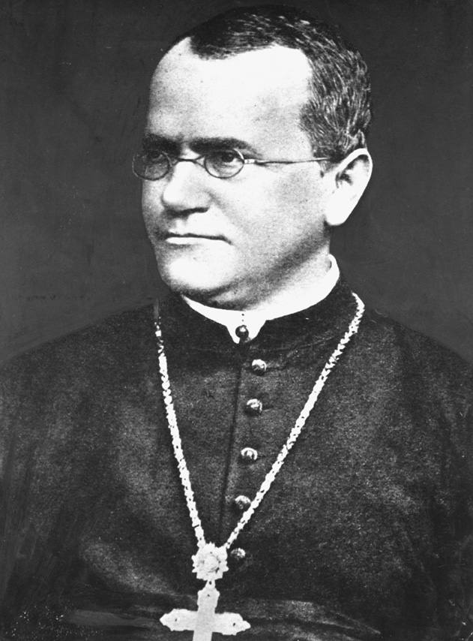
Lesson 1-4
Heredity—the History and the Basics
(cont.)
In 1856, Gregor Mendel began experimenting with pea plants to investigate heredity.
Pixtal/age Fotostock

Slide 9
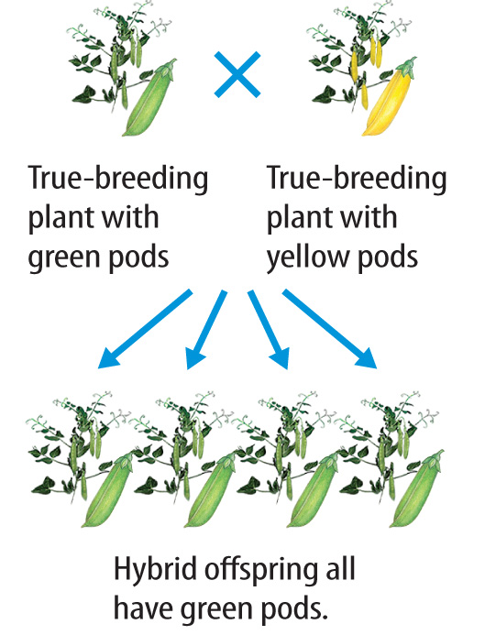
Lesson 1-4
Heredity—the History and the Basics
(cont.)
Mendel chose plants that produced only one characteristic, called true-breeding, and crossed them with true-breeding plants with a different trait.

Slide 10
Lesson 1-4
Heredity—the History and the Basics
(cont.)
All the offspring, called hybrids, produced only green pods.
The yellow-pod trait
seemed to disappear,
not blend with the
green-pod trait.
Mendel proposed that
some traits of organisms
are dominant, while
others are recessive.

Slide 11
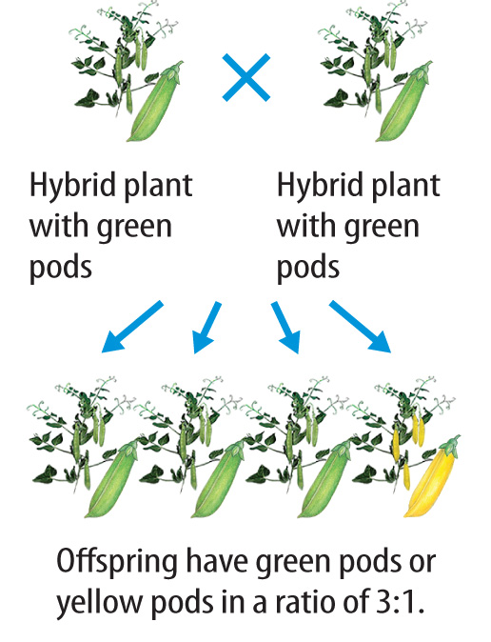
Lesson 1-4
Heredity—the History and the Basics
(cont.)
When Mendel crossed two hybrid plants with green pods, the cross resulted in offspring with green pods and offspring with yellow pods.
These offspring were in a ratio of about 3:1, green to yellow.

Slide 12
Lesson 1-4
Heredity—the History and the Basics
(cont.)
A dominant trait is a genetic
factor that blocks another genetic factor.
A recessive trait is a genetic factor that is blocked by the presence of a dominant factor.
When an individual has one dominant allele and one recessive allele for a trait, the dominant trait is expressed.

Slide 13
Lesson 1-4
Heredity—the History and the Basics
(cont.)
The alleles of all the genes on an organism’s chromosomes make up the organism’s genotype.
How the traits appear, or are expressed, is the organism’s phenotype.

Slide 14
Lesson 1-4
Heredity—the History and the Basics
(cont.)
When an organism’s genotype has
two different alleles for a trait, it is called heterozygous.
When an organism’s genotype has two identical alleles for a trait, it is called homozygous.

Slide 15

Lesson 1 - VS
Traits are passed from parent to offspring during asexual or sexual reproduction.
Through selective breeding, Mendel showed that some traits are dominant and some traits are recessive.

Slide 16
Lesson 1 - VS
An organism’s genotype can be homozygous or heterozygous.
Each gene has two types of alleles, dominant or recessive.
A dominant allele is expressed over a recessive allele.

Slide 17

Lesson 1 – LR1
Which is a gene with different information for a trait?
A. allele
B. chromosome
C. genotype
D. offspring

Slide 18
Lesson 1 – LR2
Which is a genetic factor that blocks another genetic factor?
A. dominant trait
B. genotype
C. phenotype
D. recessive trait

Slide 19
Lesson 1 – LR3
Which is the process by which one organism makes a copy of its genes and itself?
A. asexual reproduction
B. genetics
C. selective breeding
D. sexual reproduction

Slide 20

Lesson 1 - Now
Do you agree or disagree?
1. Genes are on chromosomes.
2. Only dominant genes are passed on to offspring.

